Slide 1


Purchasing Vendor Training
Vendor Setup  RFQ/RFP  Contracts  Purchase Orders  Construction

Slide 2
First Thing to Do: GET REGISTERED!
Supplier Registration – Vendors must be registered with the City of Memphis Purchasing.
Purchasing Registration: Memphistn.gov > Business Tab > Become a Supplier
  Requirements:
    Online Suppliers Registration Form
    IRS Form W-9

Slide 3
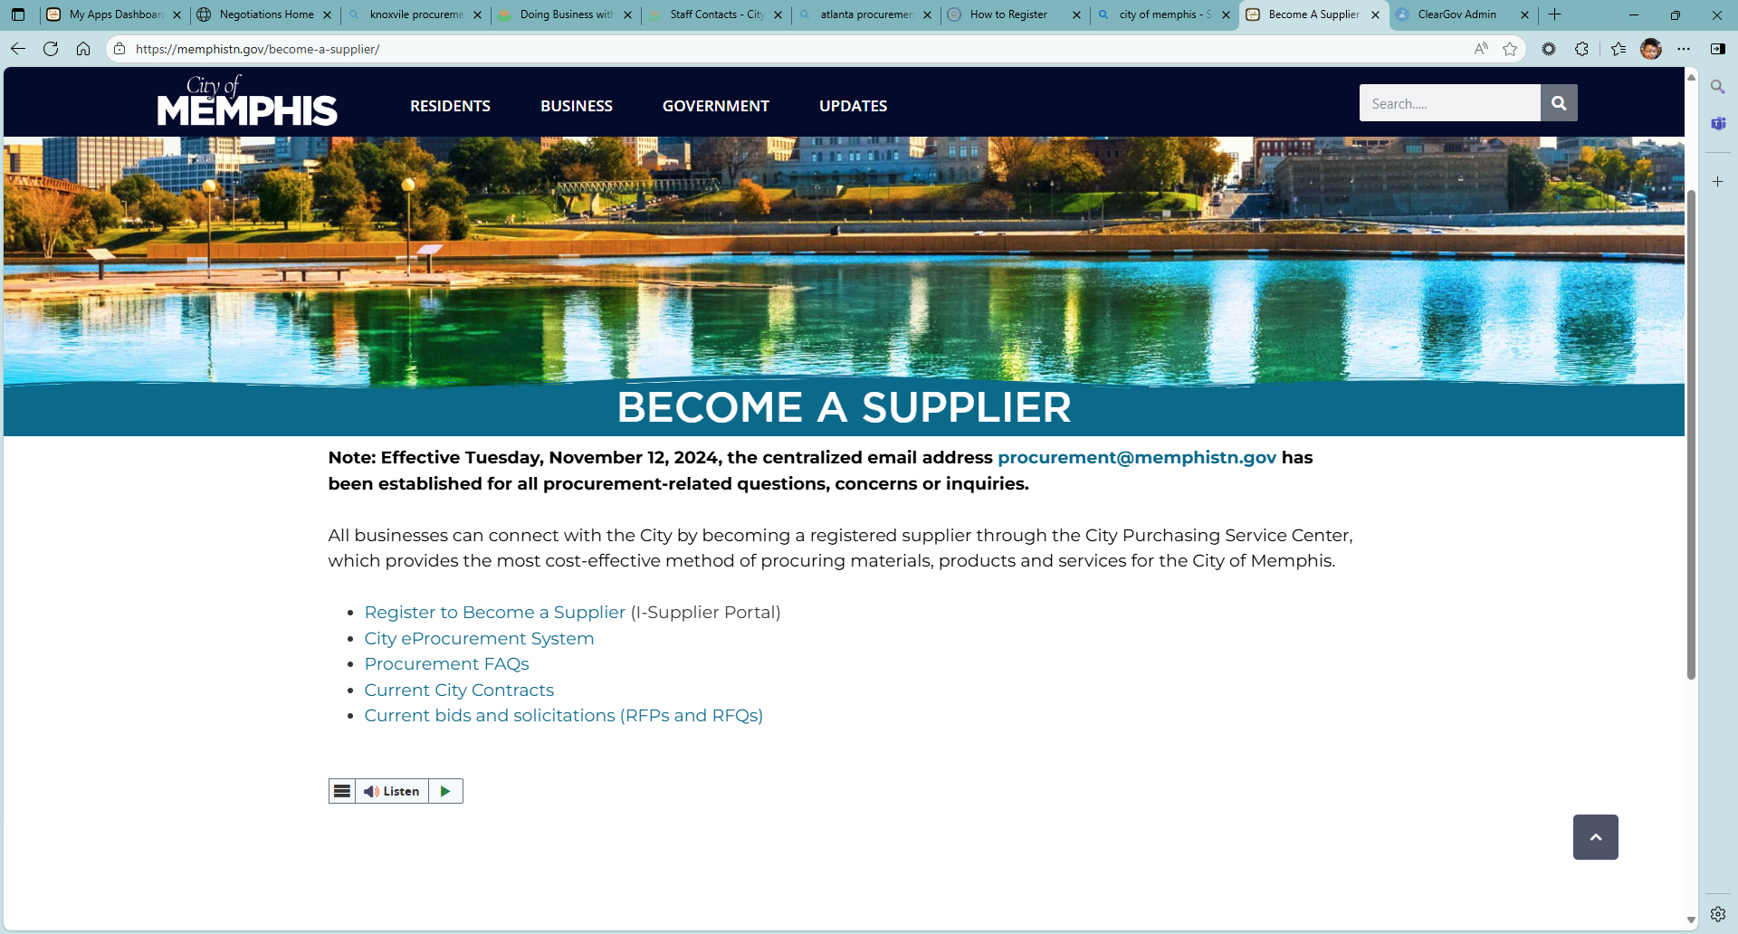
Supplier Registration Cont.

Slide 4
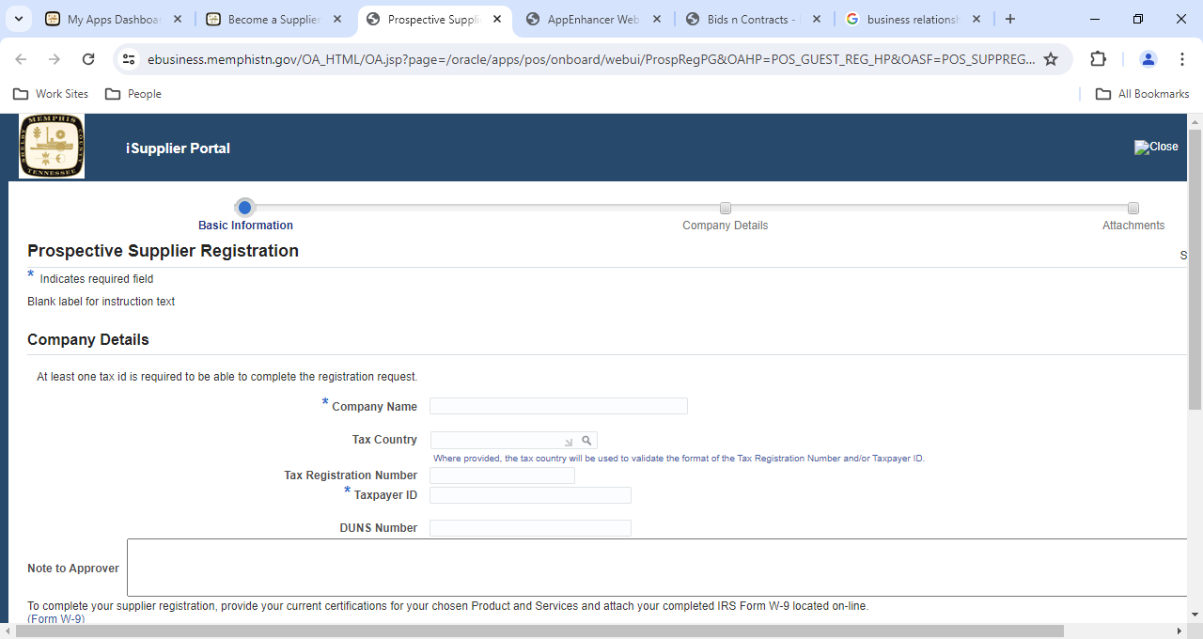
Supplier Registration Cont.

Slide 5
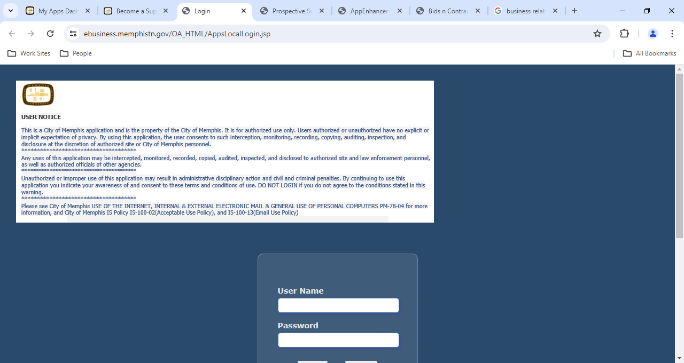
Supplier Portal
The Supplier Portal gives the vendor access to

Slide 6
Where to find Opportunities/Legal Notices
Advertisements:
  The Daily News
  The Daily Memphian
  LaPrensa Latina
Memphistn.gov > Business > RFP/Q
Supplier portal
E-mail notifications
  Invitations to bid are sent out for RFQ (request for Quote)/ITB (Invitation to Bid). If you do not receive an email, you can request an invite. Please make sure you are registered and can comply with the bid requirements.

Slide 7
Basics on Bidding
Please read the entire RFQ//ITB.
Pay attention to the submittal requirements and make sure to adhere to them when submitting your bid.
Make sure you have all attachments and understand which products or services you are bidding on.
Be sure to fill out all information regarding the RFQ/ITB. All items on the bid sheet should be addressed.
Make sure you have the latest information on the RFQ/ITB. Check for addendums regularly to be aware of any changes that could affect your bid.

Slide 8
Bidding on an RFQ (Request for Quote)
RFQ (Request for Quote) solicitations are used for informal bids and sent out to vendors through invites. The invites are based on the classification codes used when setting up the vendor’s profile. If an RFQ matching the classification code listed in a vendor’s profile is used, that vendor will receive an invite sent from the portal to the email listed on the vendor’s profile.
If an invitation is not automatically emailed through the system, it can be requested.
Please make sure you read the specifications and understand the requirements of the RFQ.
If you are using a paper bid, please make sure your bid is signed and that your bid sheet is filled out correctly.
If you have issues submitting your bid, please contact purchasing as soon as possible. Please do not wait until the last minute to submit a bid.

Slide 9
Bidding on an ITB (Invitation to Bid)
ITB (Invitation to Bid) solicitations are used for formal bids and sent out to vendors through invites. The invites are based on the classification codes used when setting up the vendor’s profile. If an ITB matching the classification code listed in a vendor’s profile is used, that vendor will receive an invite sent from the portal to the email listed on the vendor’s profile.
If an invitation is not automatically emailed through the system, it can be requested.
Please make sure you read the specifications and understand the requirements of the ITB.
If you are using a paper bid, please make sure your bid is signed and that your bid sheet is filled out correctly.
If you have issues submitting your bid, please contact purchasing as soon as possible. Please do not wait until the last minute to submit a bid.

Slide 10
Bidding on an RFQ(Request for Qualification)
All information on the RFQ is listed on the City’s website.
  https://www.memphistn.gov/business/rfps-rfqs/
Please make sure you read the specifications and understand the requirements of the RFQ.
Please pay attention to the deadlines for submitting RFQ’s. once the deadline has passed, your proposal is considered non-conforming .
If you have issues or questions submitting your proposal, please contact purchasing as soon as possible. Please do not wait until the last minute to submit your proposal.

Slide 11
Bidding on an RFP(Request for Proposal)
All information on the RFP is listed on the City’s website.
  https://www.memphistn.gov/business/rfps-rfqs/
Please make sure you read the specifications and understand the requirements of the RFP.
Please pay attention to the deadlines for submitting RFP’s. once the deadline has passed, your proposal is considered non-conforming .
If you have issues or questions submitting your proposal, please contact Purchasing via email only when the RFP is actively being solicited.

Slide 12
Submitting Competitive Bids/Proposals
RFQ (Request for Quote)/ITB (Invitation to Bid): Electronic or Hardcopy
Construction RFQ: Hardcopy Only
RFP (Request for Proposals): Hardcopy Only
RFQ (Request for Qualifications): Hardcopy Only

Slide 13
Hardcopy Bid Submittal Requirements
Sealed Envelope
Supplier’s Name
RFQ/RFP/Qualifications Number
Construction: Specific Envelope
Due Date: Listed in RFQ/ITB/RFP/RFQualifications
Location: 125 N. Main Street (Bid box in Lobby) or common courier
Bid Opening: Wednesdays 12:00 pm, City Hall
Bid must be Date and Time stamped

Slide 14
Electronic Bid Submittal Requirements
Make sure that all attachments are uploaded to the system
Ensure that your bid and price sheet is filled out completely
If you are having issues submitting your bid, please contact Purchasing via email before the solicitation is due.

Slide 15
Award Criteria for Bids
RFQs (Request for Quote)/ITB (Invitation to Bid)
  Lowest Cost that Meets Specifications
  Best Bid
  Tie:
    City of Memphis business
    Shelby County business
    TN business
Request for Proposals
  Based on evaluations of Vendor’s Qualifications, Experience, and Competence
Request for Qualifications
  Based on evaluations of vendor’s Qualifications (cost/pricing is not an evaluation component.)

Slide 16
Awarded Contracts
Awarded contracts are contracts won from an RFQ. The compensation is over $50,000.00 or the term is over a year.
Sign contract in oracle
Make sure you have read and understand the insurance requirements
Provide a certificate of insurance (Coi) with the required insurance. The coi date at the top right corner must be within 90days of current date and all policies listed on the coi must be current. The address for the certificate holder should be listed as city of Memphis, attn: risk management, 170 N. main street, 5th floor, Memphis, tn 38103.

Slide 17
Awarded contracts
If your company has 5 or less employees and you do not have workers comp insurance, please send a signed statement on your company’s letterhead.
Please follow the insurance requirements for including the additional insured endorsement or the additional insured language for commercial general liability and auto liability.

Slide 18
Purchase Orders
Awarded Purchase orders are won from a bid. The compensation is under $50,000.00 and the term no more than a year.
Make sure you have read and understand the insurance requirements

Slide 19
Construction contracts
Construction contracts are advertised in the daily news and on the city’s website. The information posted in the paper and online explains where and how to receive the specifications and bid documents.
Please fill out all bid documents completely. Some documents to look for in construction bids are:
  Bid Bond – required if the bid is over $100,000.00
  Certificate of non-discrimination
  Certificate of drug free workplace
  Construction Envelope filled out with the following:
    project title, company name and address, TN license number and expiration date with classifications marked

Slide 20
Construction contracts
All construction bids are received in a sealed envelope. The envelope has to be filled out completely including the vendors license, expiration date and classification codes and solicitation number (RFQ/ITB) on the front of the envelope.
All bids must be time stamped.
No construction bids will be received through the online portal.

Slide 21
Construction Contract
Once a construction contract has been awarded, the vendor is contacted by the division to get the additional documentation signed for the contract packet. That information includes:
  The actual construction contract
  The performance bond
  The escrow agreement
  The insurance documents

Slide 22
Protest Procedures
Protest of Specifications
  Includes solicitation requirements
  Three (3) business days before due date
Protest of Award
  Who: Supplier Who Bid
  What: Written Protest Letter to Purchasing Agent
  When:
    Five (5) CALENDAR days after Intent to Award
    Ten (10) CALENDAR days after Intent to Award (Construction Only)
    Where: 125 N. Main Street, Room 368 or email to Sourcing & Purchasing Agent
    Protest Process: Purchasing Agent Resolves (Appeal to CFO, then Mayor)

Slide 23
Contracts Exempt from Competitive Procurement
Professional Services (Architects, Engineers, etc.)
Single Source (Negotiate with and purchase from one vendor due to required technology or uniqueness.)
Sole Source (Only one supplier meets requirements – technical, legal, patents, copyrights, etc.)
Small Purchases (Purchases under 5,000.00 that divisions may utilize within a fiscal year)

Slide 24
Contact Information
Please contact purchasing if you have any issues or concerns regarding your contracts or bids.
Centralized email address for City of Memphis Sourcing & Procurement Department (all procurement – related questions, concerns or inquiries)
  procurement@memphistn.gov
If your business has a name change or is bought by another company, please remember to notify your division contact as soon as possible, that way the necessary changes can be made in the system to ensure no payments are missed.

