Slide 1
EventSpark Memphis
Developed And Presented By:
Adrian, Chinmay, David, Edgar, Juan, and Siddhi

Slide 2

Key Challenges for Memphis Event Entrepreneurs
Discovering, Creating, and Signing Up for Events
Legal Documentation & Compliance
Accurate Metrics about Events
Temporary Staffing

Slide 3

The Solution: EventSpark Memphis
All-in-One Memphis Event Discovery and Management Platform
Local Focus on Shelby County Compliance
Post and Sign up for Temporary Work Directly
Quantitative Event Metrics

Slide 4
Key Features - Event Management
• Interactive heatmap integration with Felt Maps for optimal Memphis locations
• Event templates for Beer Night, Pop-up Shop, Food Truck Rally, Business Mixer
• QR code ticketing system for seamless attendee registration
• Collaborative event creation with business partnership workflows
• Real-time event discovery with category filtering

Slide 5
Key Features - Legal & Compliance Suite
• "Texas Handshake" contract generator for simplified partnership agreements
• 1099 contractor agreements with pre-filled tax information for gig workers
• Memphis permit automation with streamlined city filing
• Shelby County beer/alcohol license integration
• QR code validation system for permit verification by officials

Slide 6
Key Features - Business Partnership Tools
• Collaboration discovery system - find partners for specific events
• Revenue sharing agreements with built-in contract templates
• Cross-promotion tools leveraging each other's customer bases
• Partnership management dashboard tracking active collaborations
• Memphis business network fostering local economic cooperation

Slide 7
Business Value & ROI
• Eliminates physical legal paperwork and advertising.
• Generates revenue streams via partnerships and cross-promotion which builds sustainable business network • Benefits established and upcoming entrepreneurs

Slide 8
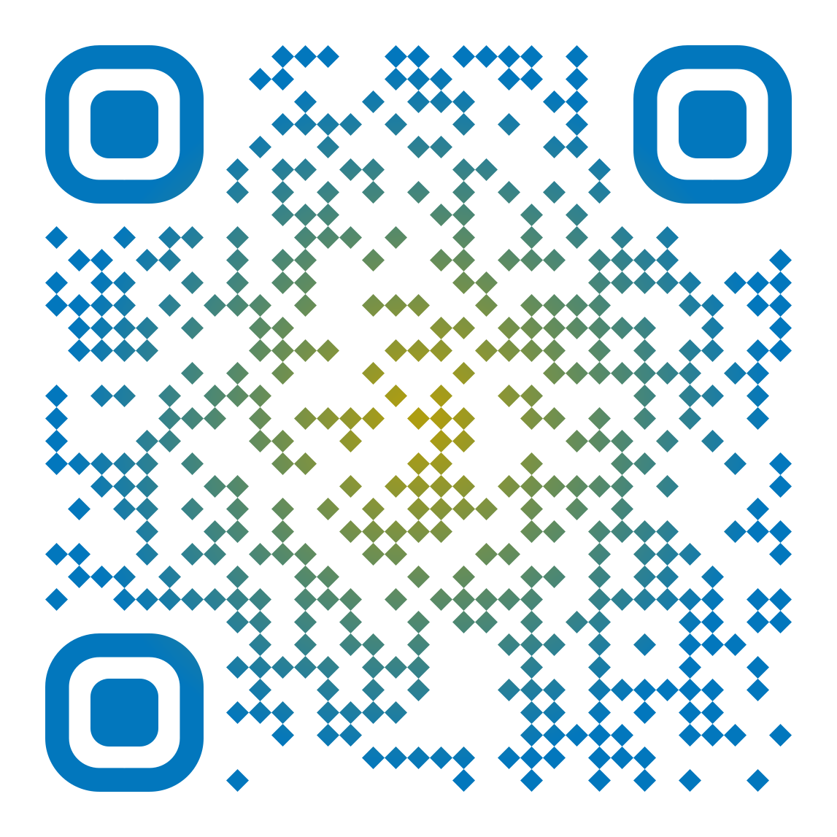

Techstack and Try It Out
Frontend
React
Next.js
Typescript
Backend
Python
Flask
Database
BigQuery
Infrastructure
Cloud Run

