Slide 1



Blight Ops Team
RESTORING HOPE THROUGH
SMARTER DATA & STRONGER NEIGHBORHOODS
Reimagining Property Violation
Intake and Dashboards in Memphis
Team Members: Sky, Devin, Brittany, Shelanda, and Janelle
Notes:
Good morning. Memphis has a large geographic service area and finite resources. With 280,000 service requests, City staff face an impossible question: which problem properties are causing recurring blight issues? Today, BlightOps answers that question. We're a Memphis Property Hub initiative here to transform how Memphis fights blight.

Slide 2


CHALLENGE 1: BLIGHT DATA ANALYTICS
Memphis faces recurring property issues—dilapidated conditions, illegal dumping, and overgrown weeds. We need smarter data to prioritize the right properties, geographic areas, and violations to protect our neighborhoods and citizens.
THE PROBLEM
Bad Data In = Bad Data Out. Memphis 311's intake process needs improvement to capture accurate information from the start.
😵 Information Overload 280,747 total tickets. Staff drowning in data but can't identify the 47 properties that need attention RIGHT NOW. | 🎯 No Prioritization System Which properties, communities, and owners indicate recurring problems? No way to know. All violations treated equally.
🔮 Purely Reactive City only responds AFTER violations occur. No predictive intelligence to prevent problems before they start. | 💸 Wasting Finite Resources Limited Staff. Large geographic area to cover. No insights on where to invest for maximum impact.
🔄 Repeat Violations Everywhere Same properties—illegal dumping piles, high weeds in vacant lots—violate again and again. Stuck in a cycle. | 📊 Dashboard Shows Everything, Solves Nothing Cluttered with vanity metrics. Shows "what happened" but not "what to do next." Zero actionable intelligence.
Notes:
Let me show you the REAL problems Memphis faces. Information overload—280,000 tickets, but staff can't find what matters. No prioritization—which properties are causing recurring problems with illegal dumping and high weeds? The City is purely reactive—always responding after the damage is done. Finite resources are wasted. Repeat violations everywhere—same addresses, same issues, over and over. And the current dashboard? It shows everything but solves nothing. That ends today.

Slide 3
THE SOLUTION
Phase 1: Date Transformation Enhanced 311 intake form with easy to select fields with Memphis citizens in mind Response standardization for problem ranking and smarter routing to decrease response times for all citizens Enforced data accuracy like screen tips, to reduce resource waste AI-powered image analysis to automate resolution recommendations for service providers before they arrive on-site (i.e., needed equipment and staff, consistent approaches across zip codes) | Phase 2: Enhanced Analytics Real-time priority dashboards with GIS mapping that show: Case prioritization and active case metrics Drill-down analysis by location, frequency of complaints, resolution time metrics, and repeat offenders Predictive alerts Investor vs Resident tracking Resource allocation optimization

Slide 4

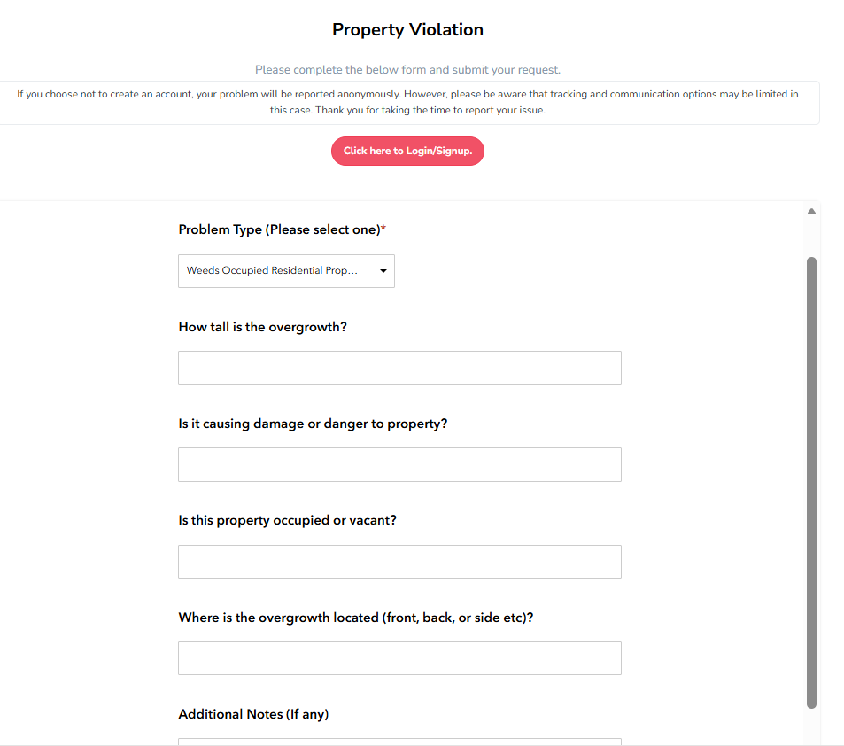
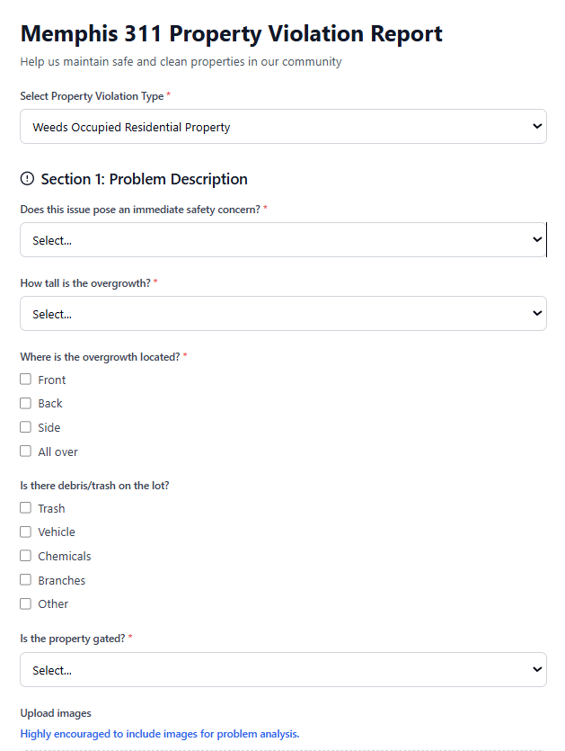

INTAKE: CURRENT VS FUTURE FORM
Use Case: Forms for Property Violations related to Weed Overgrowth

Slide 5
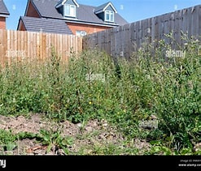
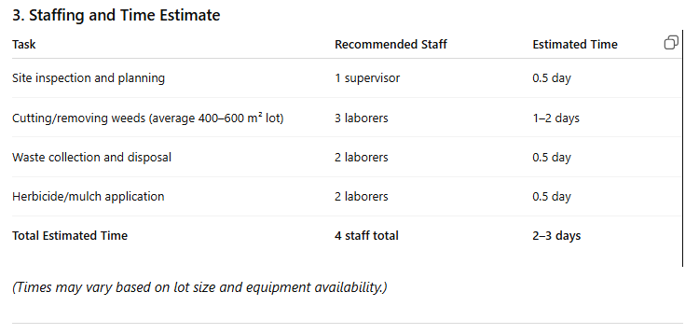
INTAKE: AI-ASSISTED IMAGERY ANALYSIS
Use Case: Property Violations related to Weed Overgrowth
AI Prompt: Recommendations for municipality to remedy existing issue with needed tools, recommended number of staff and time estimate based parcel data associated with address.

Slide 6
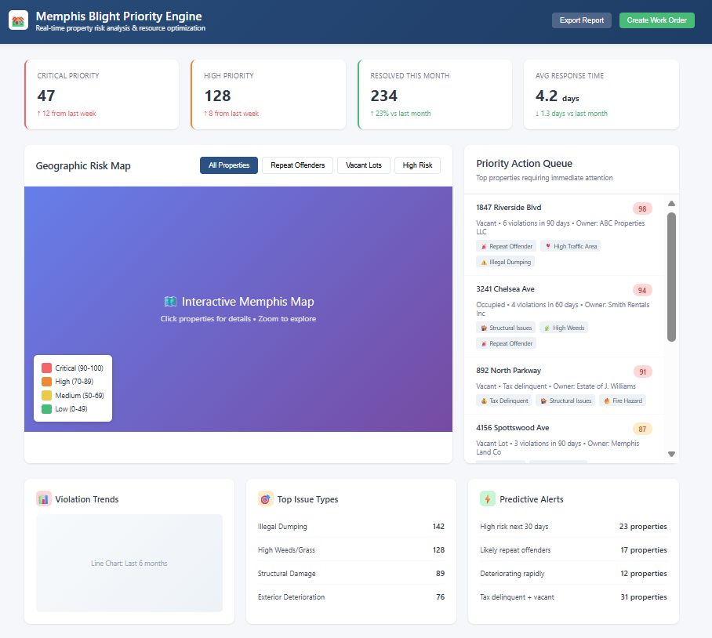

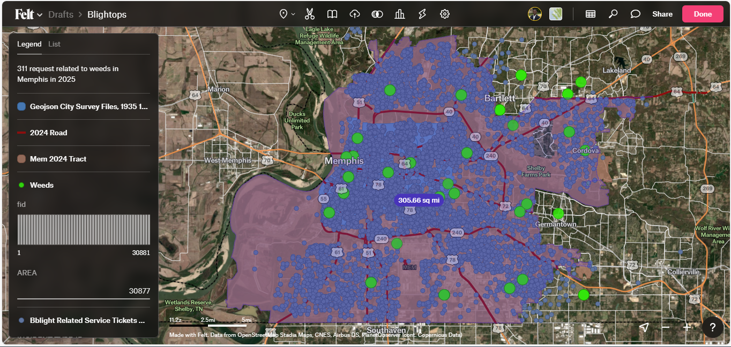
DASHBOARDS: REAL-TIME MONITORING
Live Analytics
Real-time dashboards give full visibility of active cases and predictive analysis using geo-location data.
Notes:
This is Memphis's current dashboard. [Point left] See the problem? 280,000 tickets scattered across 7 charts. Unreadable zBlightOps cuts through the noise. 47 critical properties—that's your action list for TODAY. Not 280,000 abstract numbers. Clean visual hierarchy. Color-coded risk scores—red means deploy the team now. Interactive Memphis map shows exactly WHERE in our large geographic area to focus finite resources. Click any property, get the complete story. Predictive alerts tell you what WILL happen: 'This property has 87% chance of violation in 30 days.' And the resource optimizer? It shows you: address these 20 properties, prevent 100 future violations. That's how you turn finite resources into infinite impact.

Slide 7
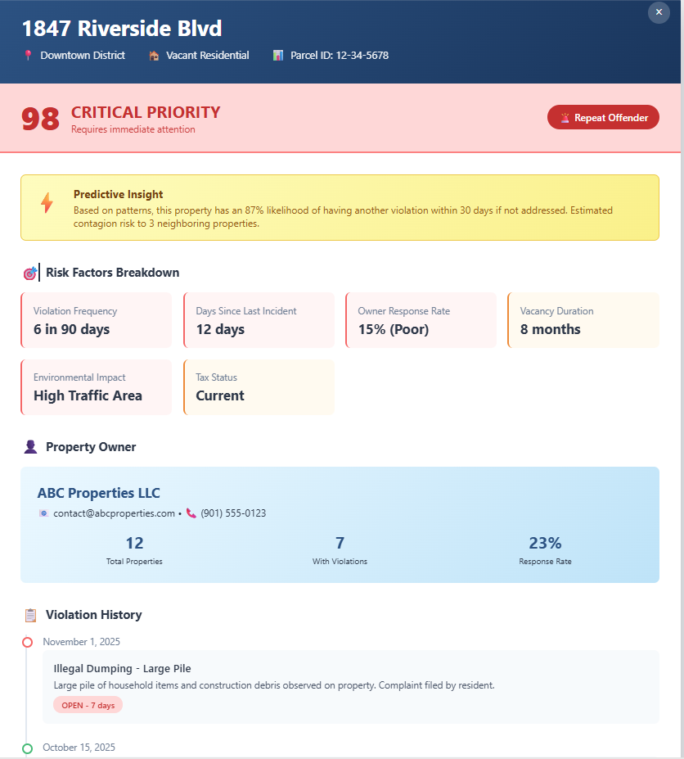

DASHBOARDS: REAL-TIME MONITORING
Smart Alerts
Become more proactive by being the first to know when a property becomes at risk.

Slide 8
Thank You
Let’s build a better Memphis with better data!

