Slide 1

Thrive901: Bridging Small Business & City Contracts
Making vendor registration accessible for every local entrepreneur

Slide 2
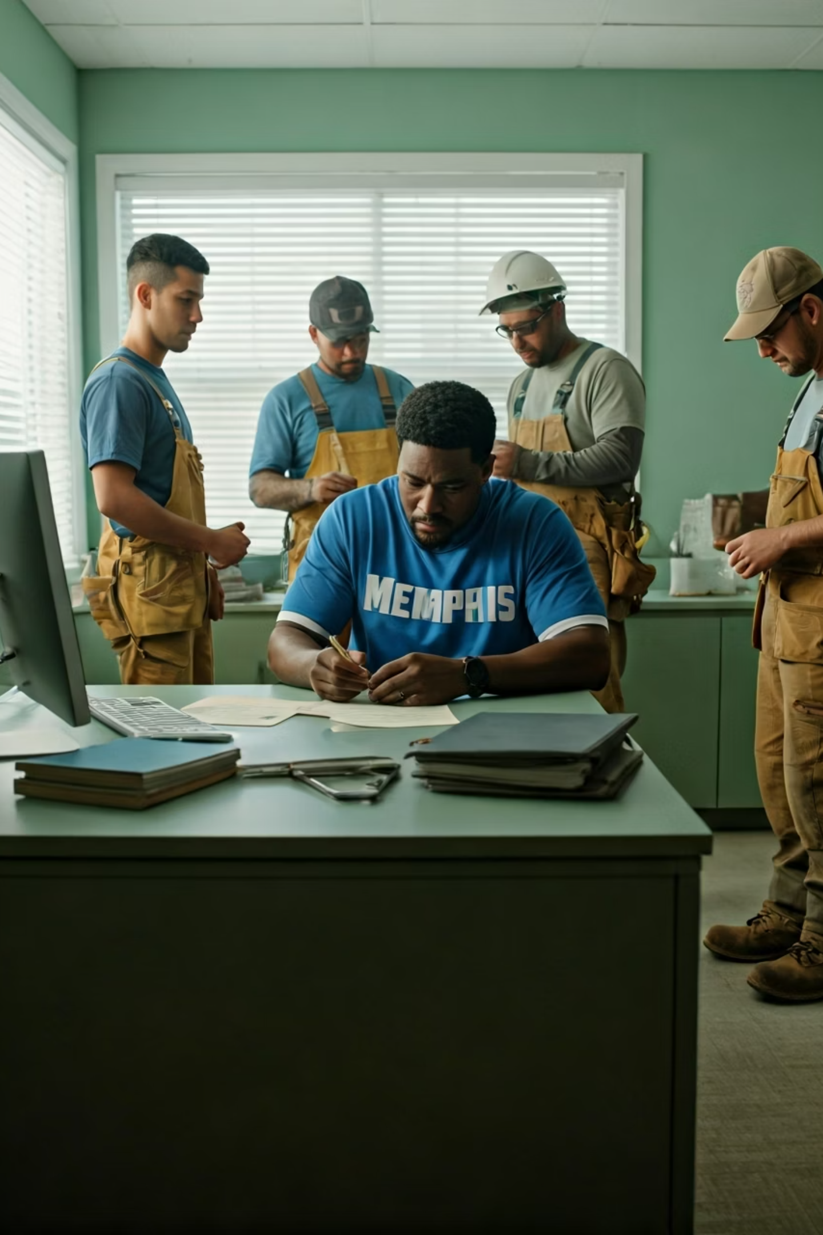
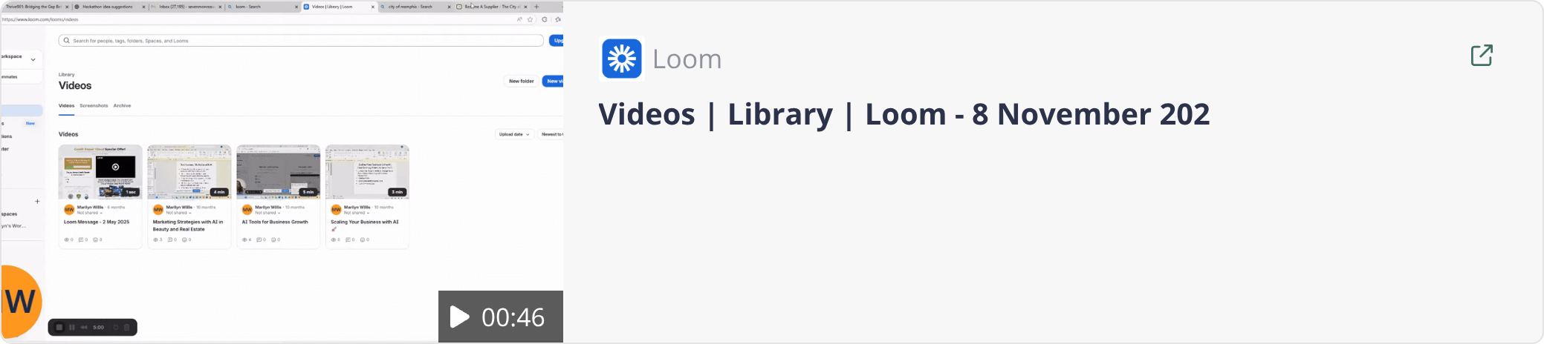
The Current Reality: A Broken Entry
Strategic Obstacles
The Challenge
Who Gets Hurt
Thousands of Memphis small businesses attempt City vendor registration annually
This friction shuts out the entrepreneurs our city needs most
Confusing, assume-you-know-it-all systems
Local small businesses
Minority-owned enterprises
No guidance on missing requirements
Women-owned businesses
Weeks hunting for W-9s, insurance, licenses
First-time vendors
Incomplete applications → rejections
Result: City slows down, locals get locked out

Slide 3
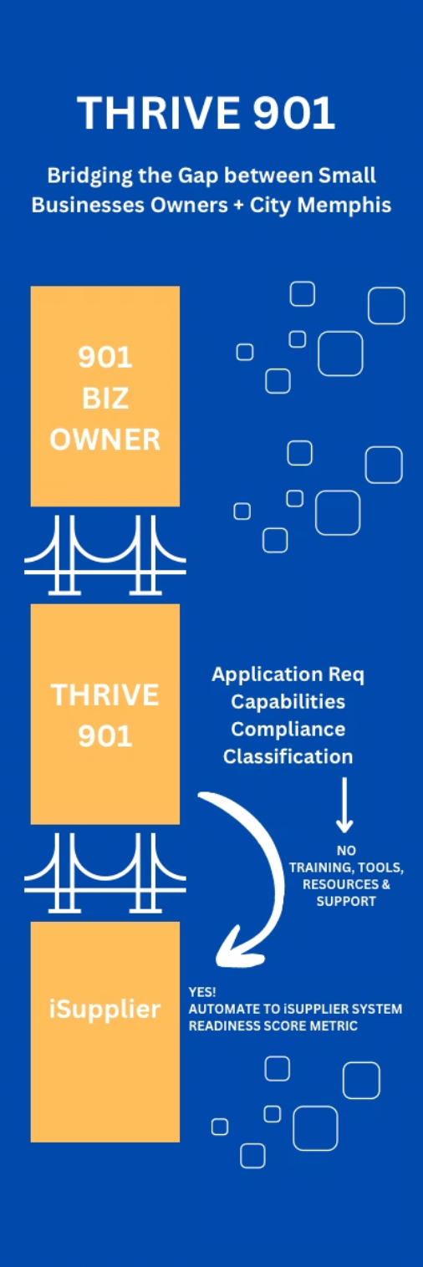




Thrive901: The Bridge and the Solution
Smart Upload
W-9, Business license, Insurance certificate
Auto-Extract
AI reads documents and pre-fills your vendor profile automatically
Readiness Check
Verifies against City requirements:
insurance ✓ license ✓ EIN ✓
Connect & Win
Direct access to RFPs and partnership opportunities

Slide 4
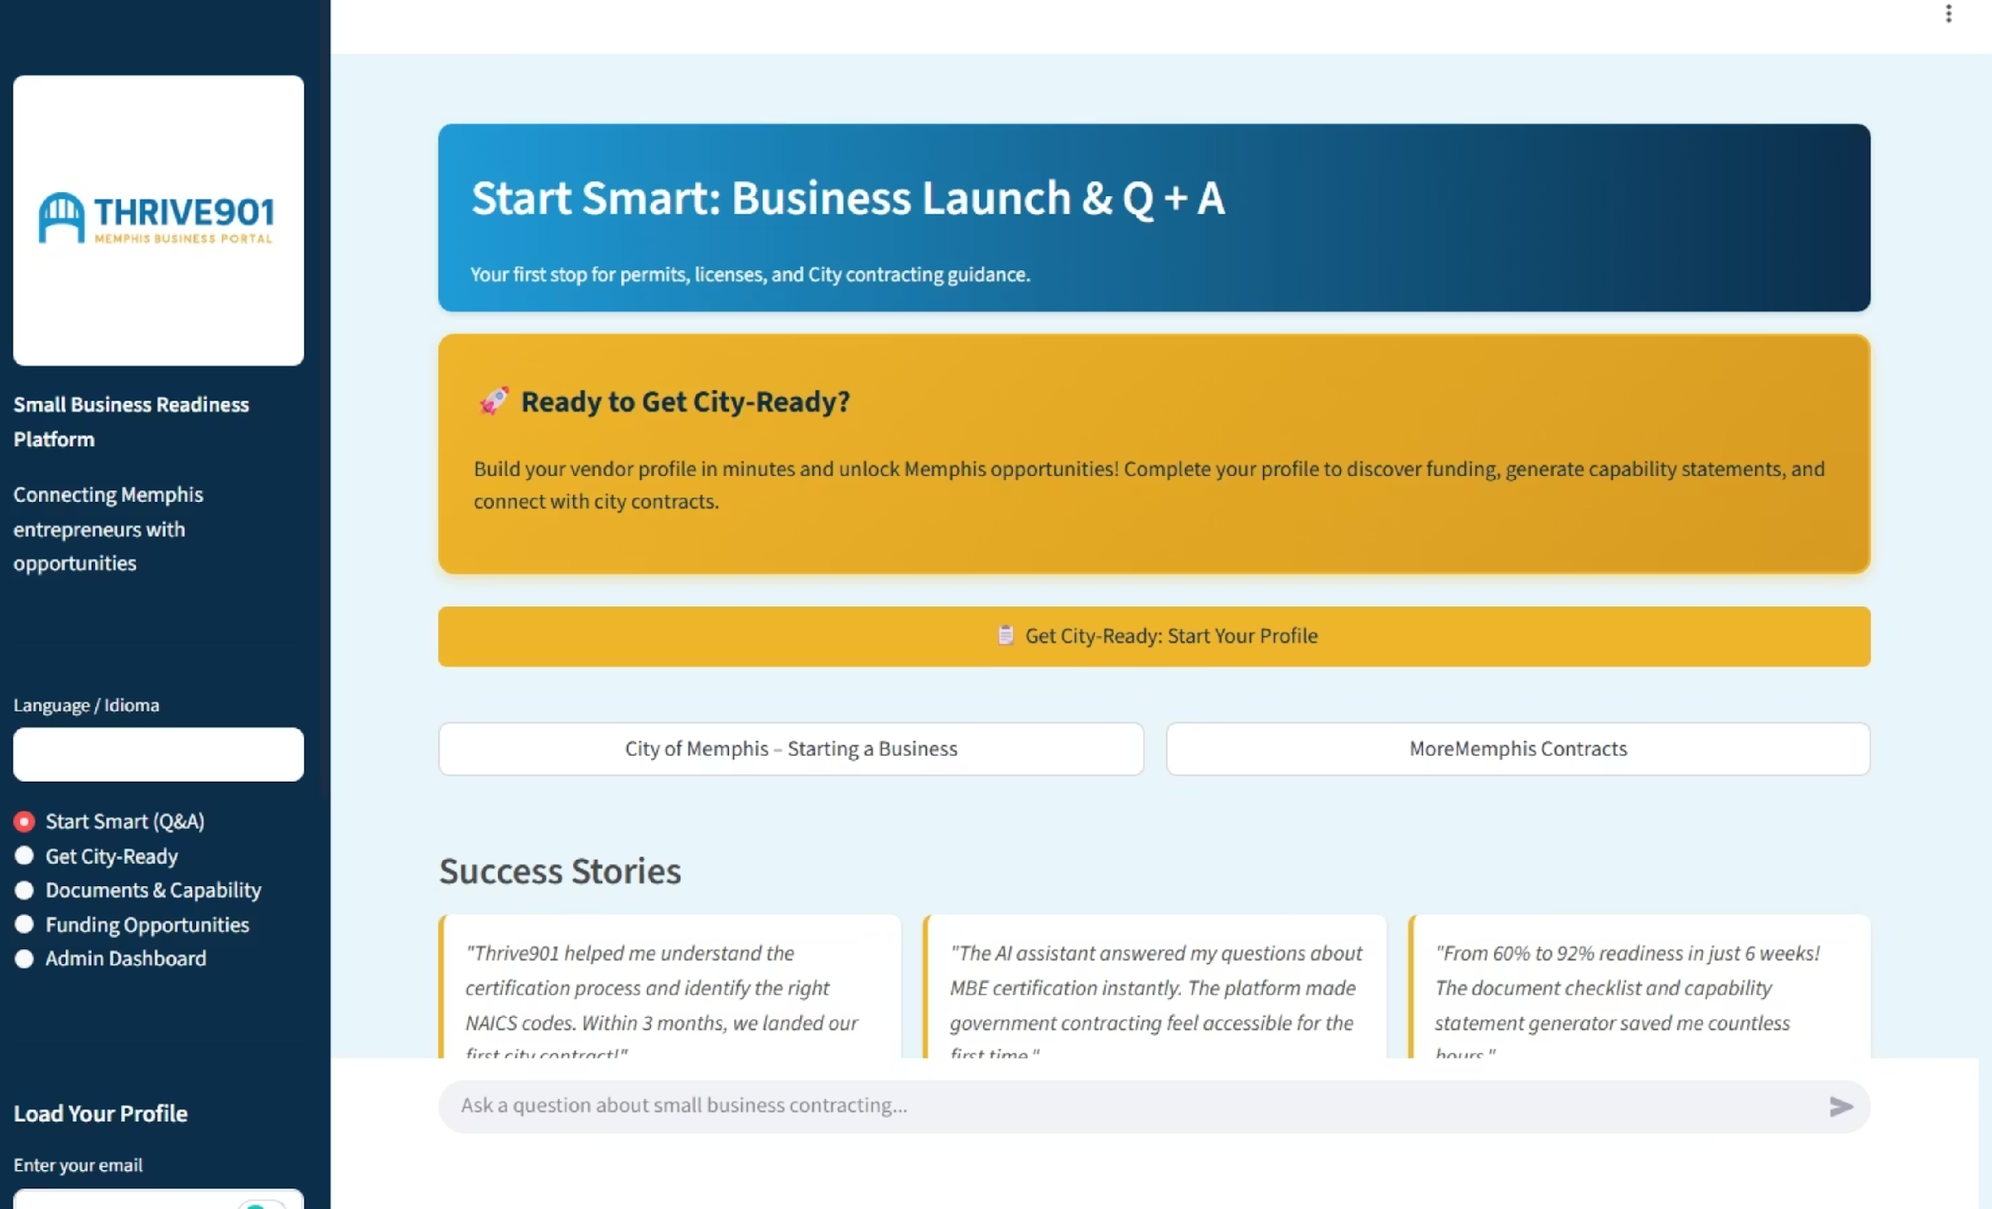

Slide 5
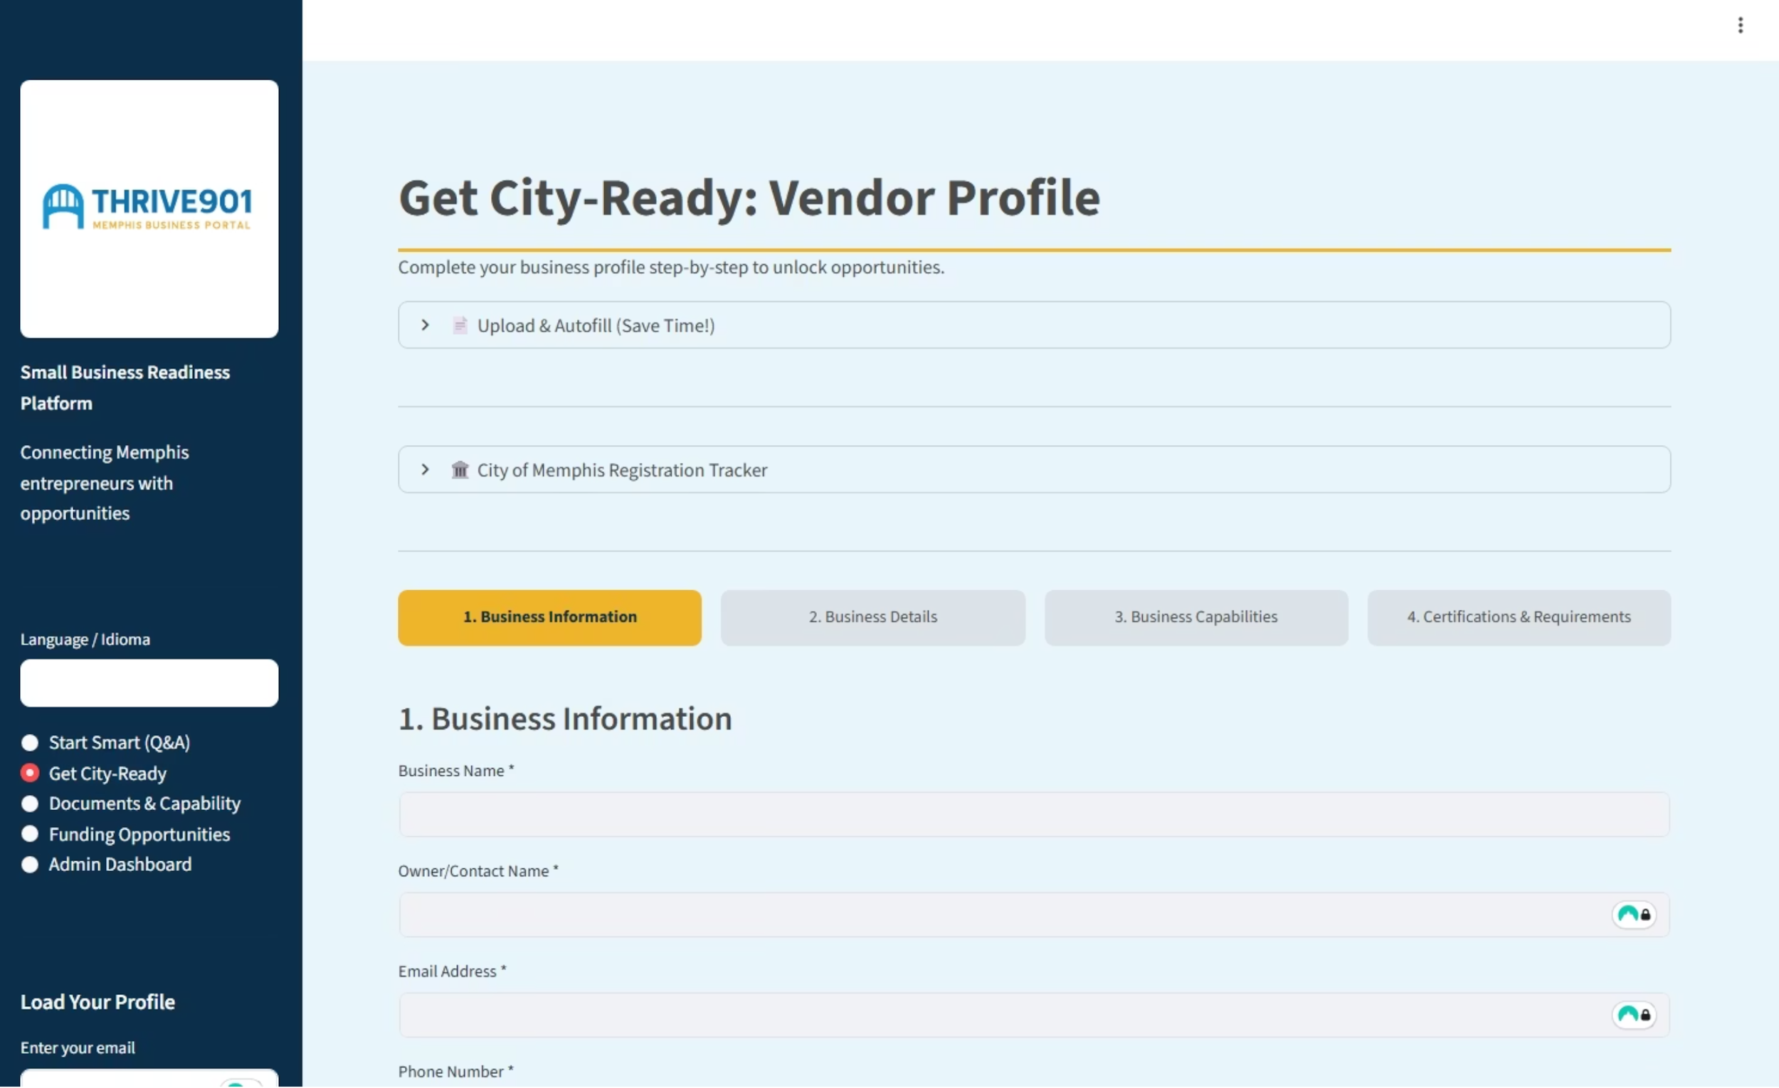




Thrive901: Your Intelligent Readiness Platform
Smart Upload
Upload W-9, business license, or insurance certificate
Auto-Extract
AI reads documents and pre-fills your vendor profile automatically
Readiness Check
Verifies against City requirements: insurance ✓ license ✓ EIN ✓
Connect & Win
Direct access to RFPs and partnership opportunities
Step-by-step guidance from application to award

Slide 6
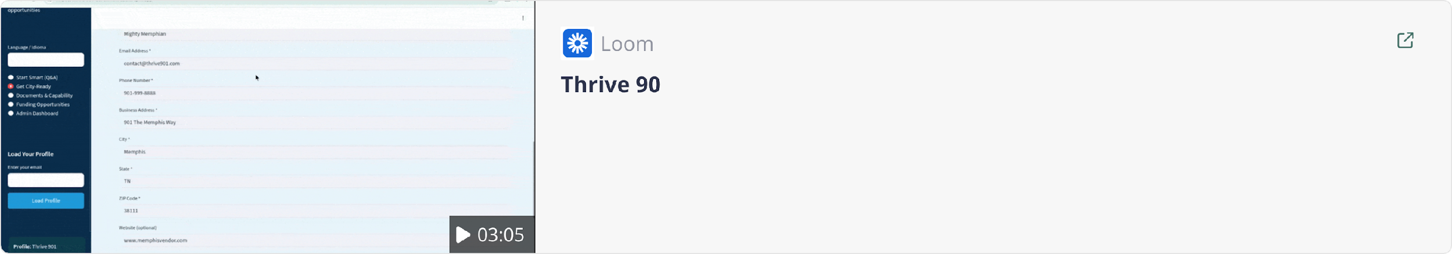

Slide 7
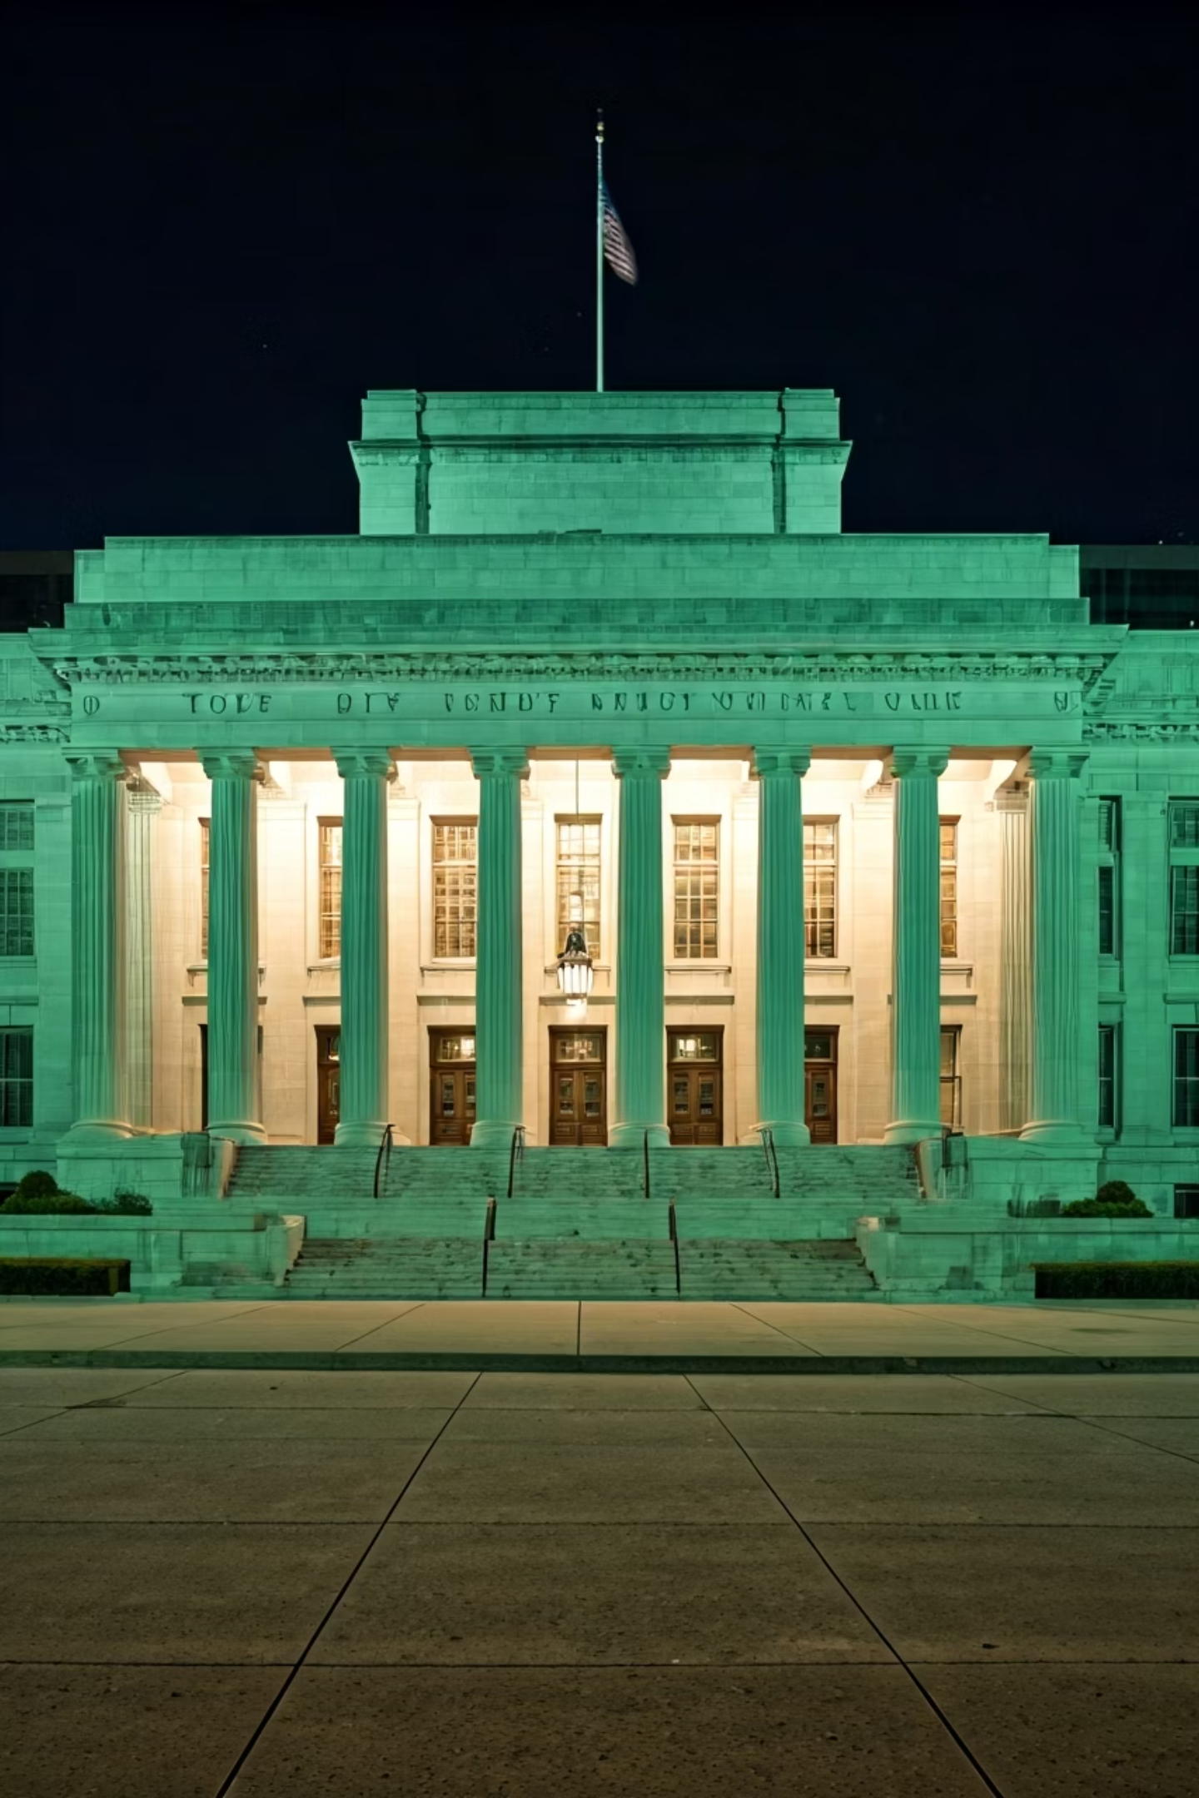
Seamless Integration with City Systems
Complements Existing Tools
Saves Staff Time
Works alongside Oracle iSupplier and Beacon procurement systems
Every business arrives at the City portal ready, complete, and verified
Levels the Playing Field
Equal opportunity access for small, minority, and women-owned businesses
100%
75%
24/7
Document Accuracy
Time Saved
Availability
AI-verified submissions reduce rejection rates
Faster readiness vs. manual methods
Support whenever businesses need it

Slide 8
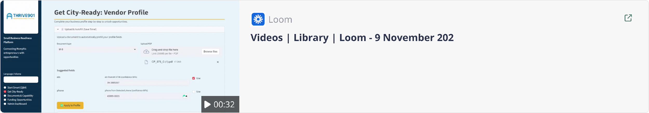

Slide 9




A Movement for Memphis & Beyond
Scale Statewide
Strategic Partnerships
From Memphis across Tennessee
Economic development, chambers, local banks
Ecosystem Growth
Connect verified vendors with funding opportunities
"Get Ready to Do Business with the 901"
We're not just fixing a process — we're building a smarter, fairer ecosystem for business growth in Memphis.

