Slide 1


Team elite
Memphis
Access to
Contracts
Easily
The new way for business owners to easily do business with the City of Memphis

Slide 2

Team elite
Christina
ACE Ai Assistant
Collaborators
Pierre Knox
Web Developer
Dominque Branch
Web & App Designer
Jacquline Exum
Contracting SME

Slide 3
Team elite
The Problem
Complexity for business owners to navigate the necessary steps to do business with the City of Memphis.
Failure or under-utilization of available technology to improve the contract administration process and provide valuable cost-saving information that can prove to be financially beneficial to the City of Memphis.

Slide 4
Team elite
Solicitation
Bid Submission, Review & Analysis
Contract Award, Progression Monitoring, Contract Award & Close-Out
The Solution
A web-based platform, also available on mobile app to the make the process of registration and obtaining a Supplier Number extremely fast and easy for Business Owners
An application designed with efficiency in mind, allowing for full contract administration from issuing the solicitation, to analyzing the bid using automated analysis, contract award, and monitoring of contract progression through contract close-out

Slide 5

Team elite
Key Features
Useful statistical information for Bidders to assist with preparing and submitting a competitive bid.
A completely integrated application, also providing valuable analytical information for Contract Administration staff members
Notes:
Business owners to easily register with the City of Memphis, access statistical information and submit bids

Slide 6
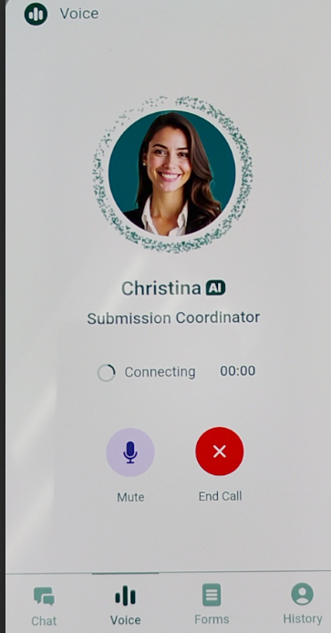
Team elite
Memphis ACE AI Capabilities
End-User:
Supplier Communicates with AI Assistant to verify last year’s winning bid in preparation to bid for current solicitation.
Contract Administrator:
In preparing for issuance of an upcoming Solicitation for RFP, Christina is asked for the range for last year’s bid, as well as, the winning bid amount.
Notes:
Example of Business Owners interaction with our ACE AI Assistant, Christina.

Slide 7
Team elite
Examples of AI Statistical and Analytical Production
Bidder Statistical Information Request
Contract Admin Analytical Request

Slide 8
Thank you
Memphis Access Contracts Easily (ACE) App
An Innovative Enhanced AI Platform Making Contracting Easy and Simple!
Team elite (Pierre knox, Dominique branch, & jacquline exum)
901-356-5395
teamelite@ace.com
WWW.memphisace.COM
Notes:
Introduction of Team

