Slide 1
M3: Making Memphis Marvelous
Make reporting blight as easy as posting a photo.

Slide 2
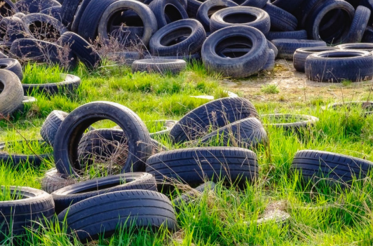
The Current Problem: Blight Data Analytics
Underreported and inconsistently tracked
‘Blank trips’
High-risk areas: apartments, rental housing, small businesses
Memphis needs accurate, real-time data to allocate resources effectively
Goal: Engage residents, improve data quality, support predictive analytics for the City of Memphis

Slide 3
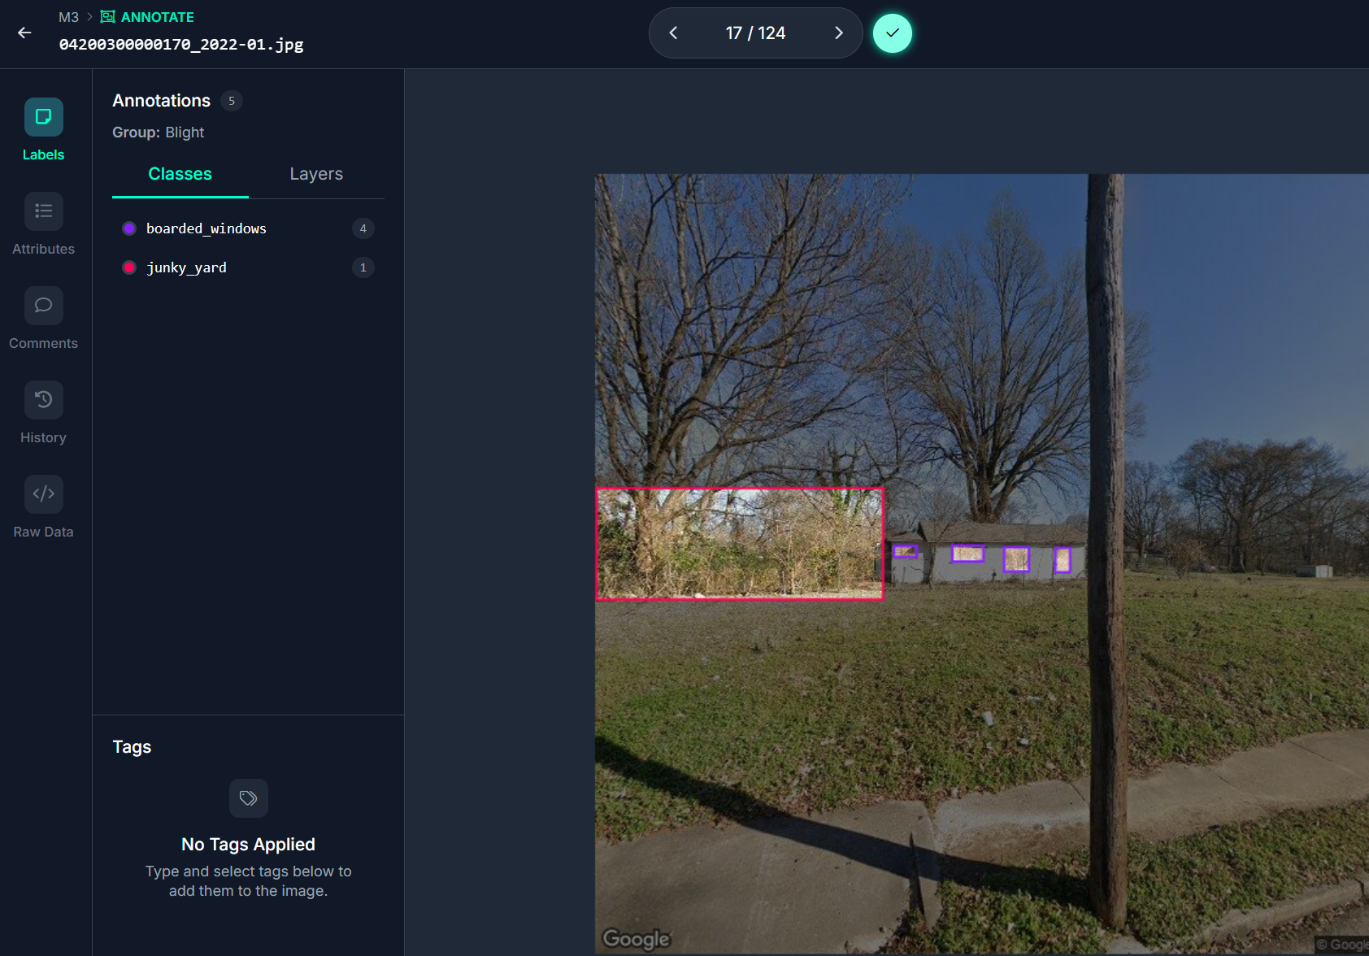
Our Proposed Solution
AI data processing for automated categorization & reporting of blight through an image capture mobile application.
Roboflow: object detection ML model
User Submissions & Bulk Submissions
Notes:
React Native (Expo), FastAPI, Firebase Firestore, Firebase Storage, Firebase Analytics, Roboflow (object detection ML model)
Roboflow: 891 Images from dataset for confidence
(No) Boarded windows, (No) Junky yard

Slide 4
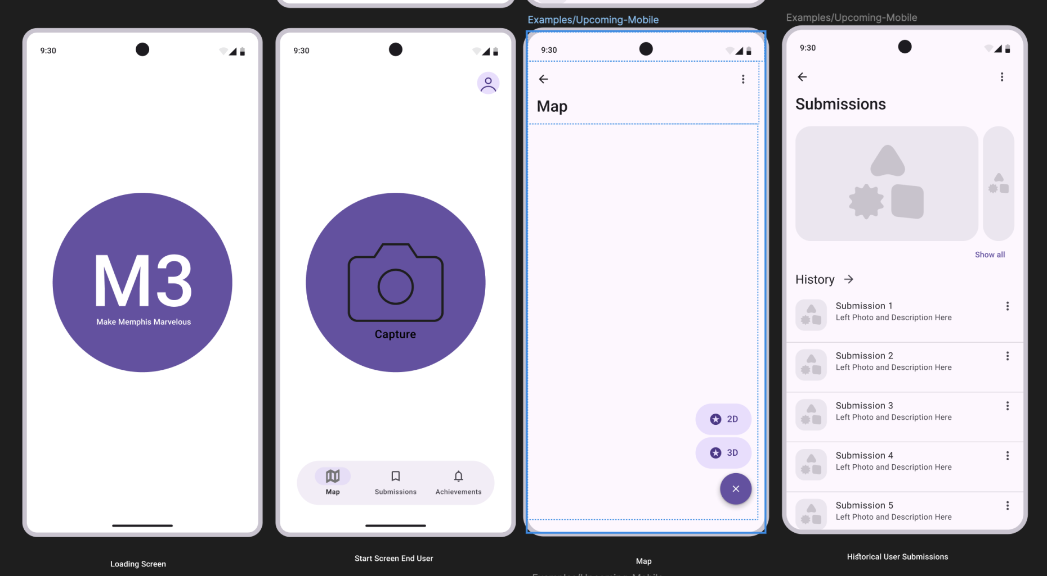
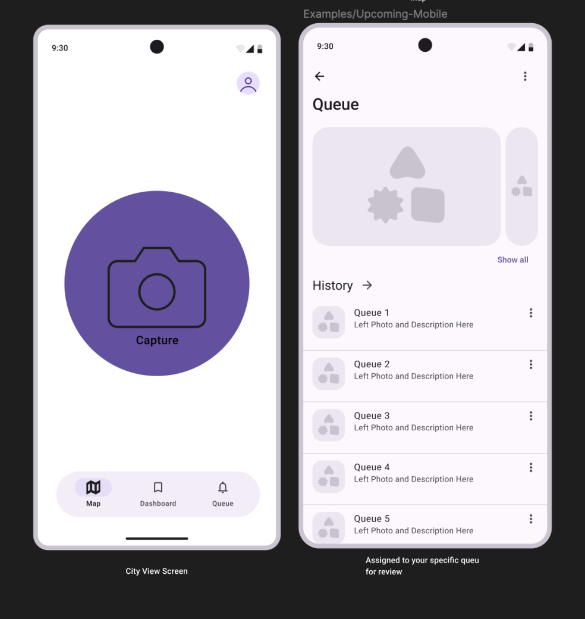
Two Profile Types: User View vs City View
Notes:
Simple 3-step reporting flow: open → snap photo → submit
Clean, intuitive interface with visual clarity
Geo-tagged GPS coordinates
City View has analytics across city: map, dashboard, queue to give to workers to assign projects (tickets routed to queue defined by city as region, zip code, etc)

Slide 5
Our Value
Residents: easy, rewarding, transparent reporting process
City Staff: clean, structured data improves dashboard insights
Leadership: smarter resource use, fewer wasted inspections
Community: empowers residents to care for their neighborhoods
Long-Term: enables predictive modeling in future phases

Slide 6
Future Directions
Severity & Priority: Heat Mapping & Pinning
Wrapper for gamification
Points reward system connected to local businesses
Integration of ‘Know the Code’ tips to educate residents

