Slide 1

Team
Turning Civic Data Into Action

Slide 2
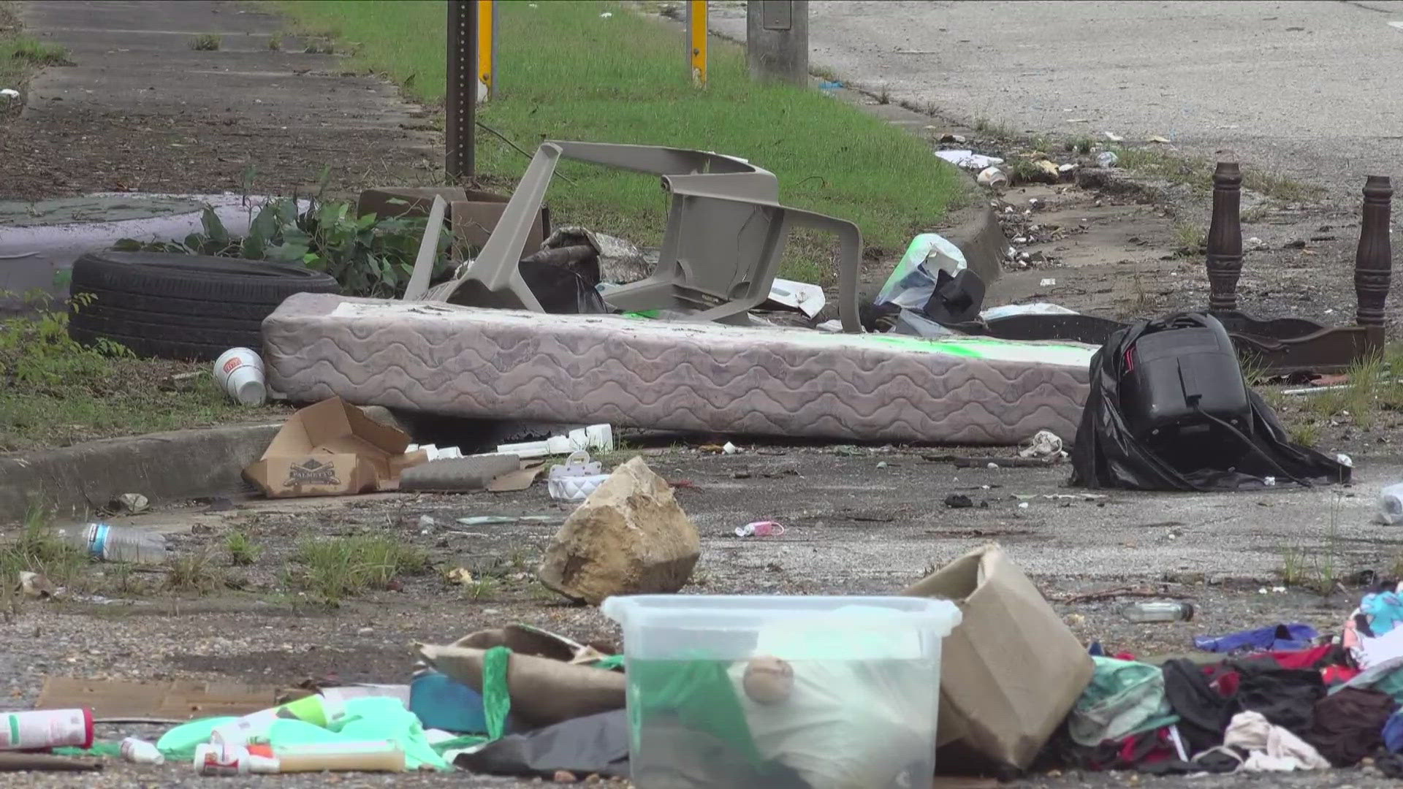
Photo soure: ABC24

Slide 3
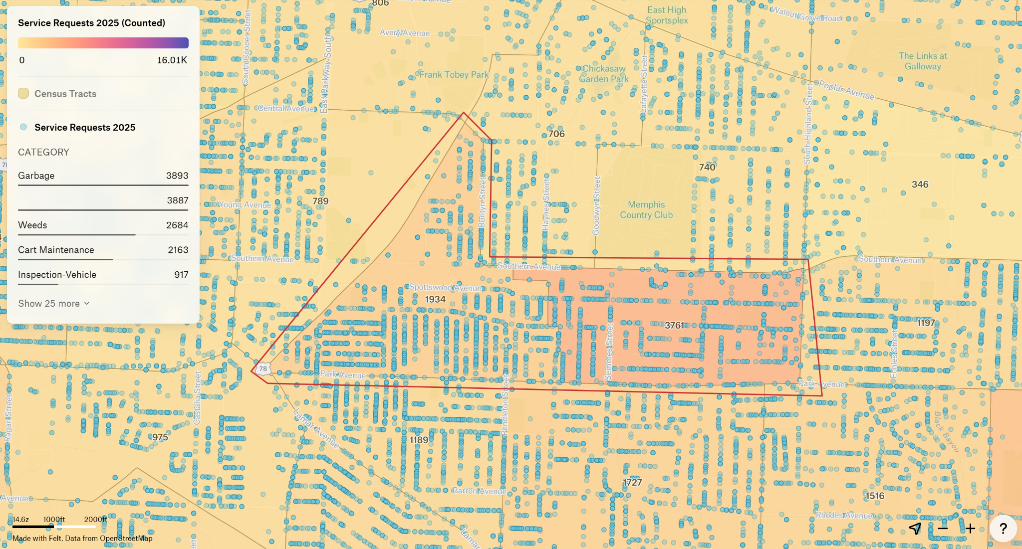
Not enough resources for the city to handle or resolve all the requests.

Slide 4
Cycle of Neighborhood Blight Apathy
Blight
Disconnection
Neighborhood Blight Apathy
Neglect

Slide 5
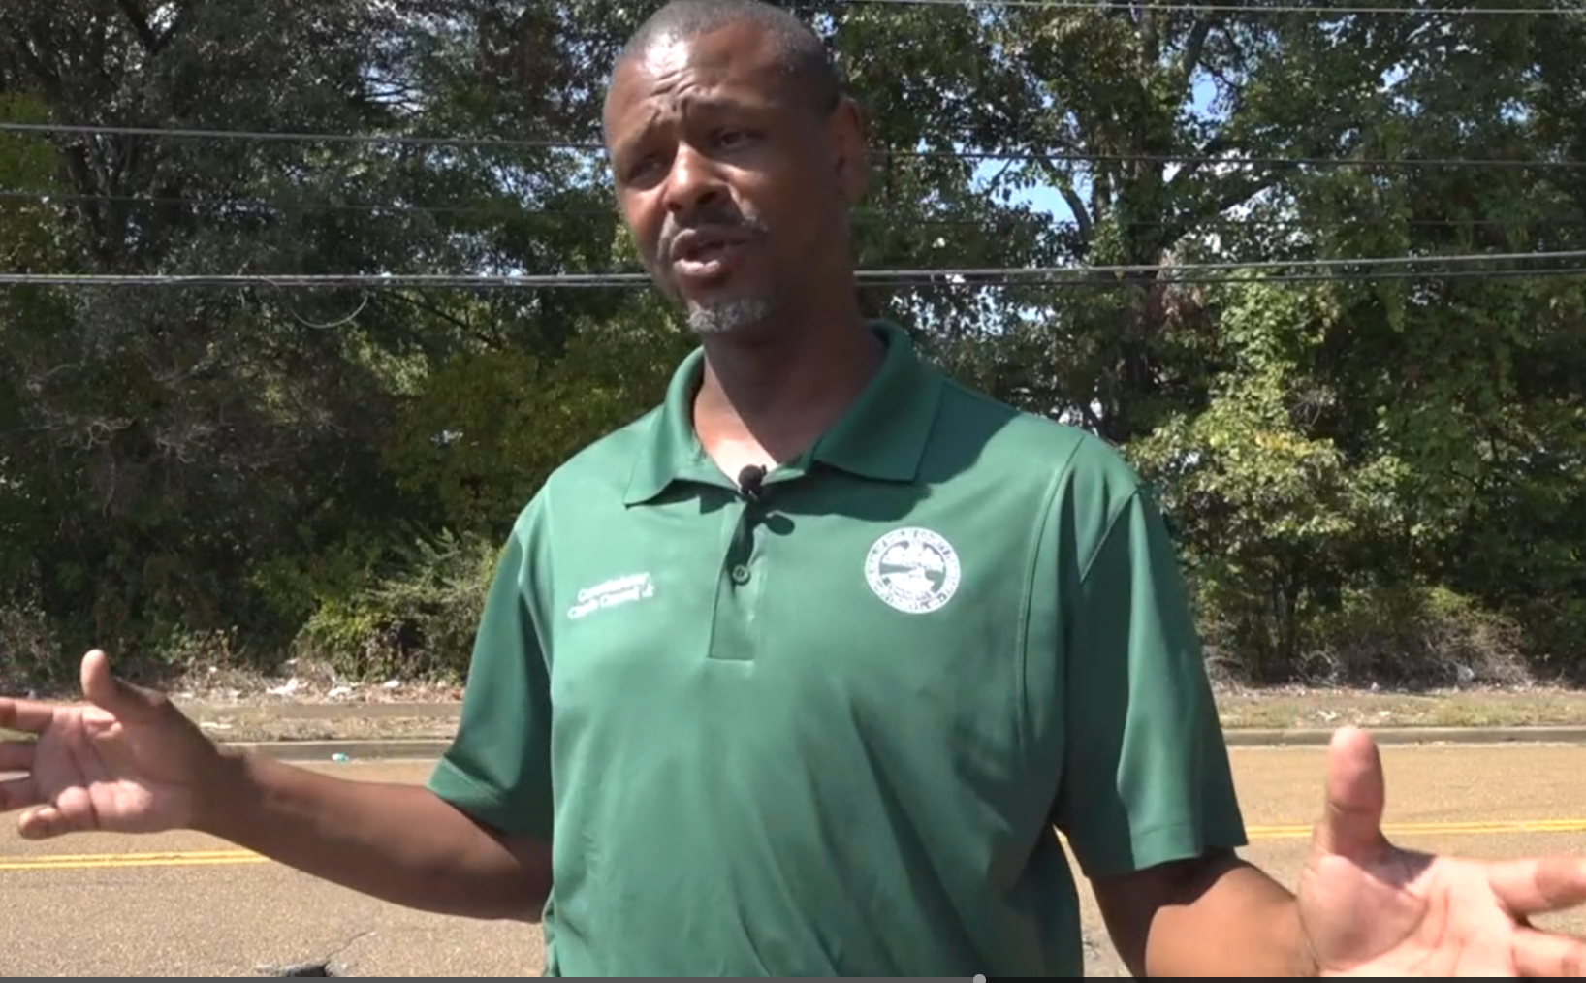
“People often wait to see if others will take action”- District 6 Resident

Slide 6
Problem
Solution
There isn’t any functionality to report the severity level when reporting an issue
Apps like Nextdoor promise to unite us but turn to gossip
Connect community
Empower action
Prevent blight
Notes:
Promised to bring us together and make neighborhoods better
But it's turned into complaints and gossiping
Not community action

Slide 7
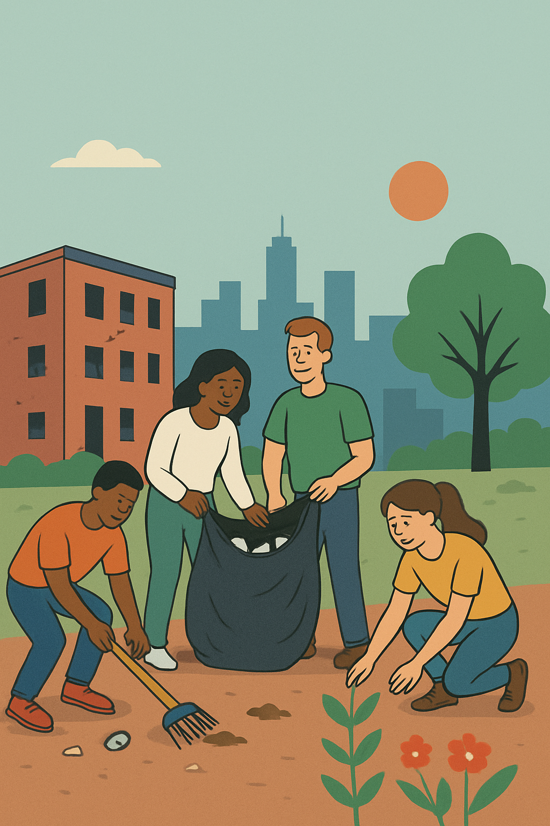

Slide 8

Be The Change Against Blight
Notes:
This is where blightwatch kicks in

Slide 9
Breaking the Cycle with BlightWatch
Bloom
Connection
Breaking the Cycle with BlightWatch
Revitalization

Slide 10
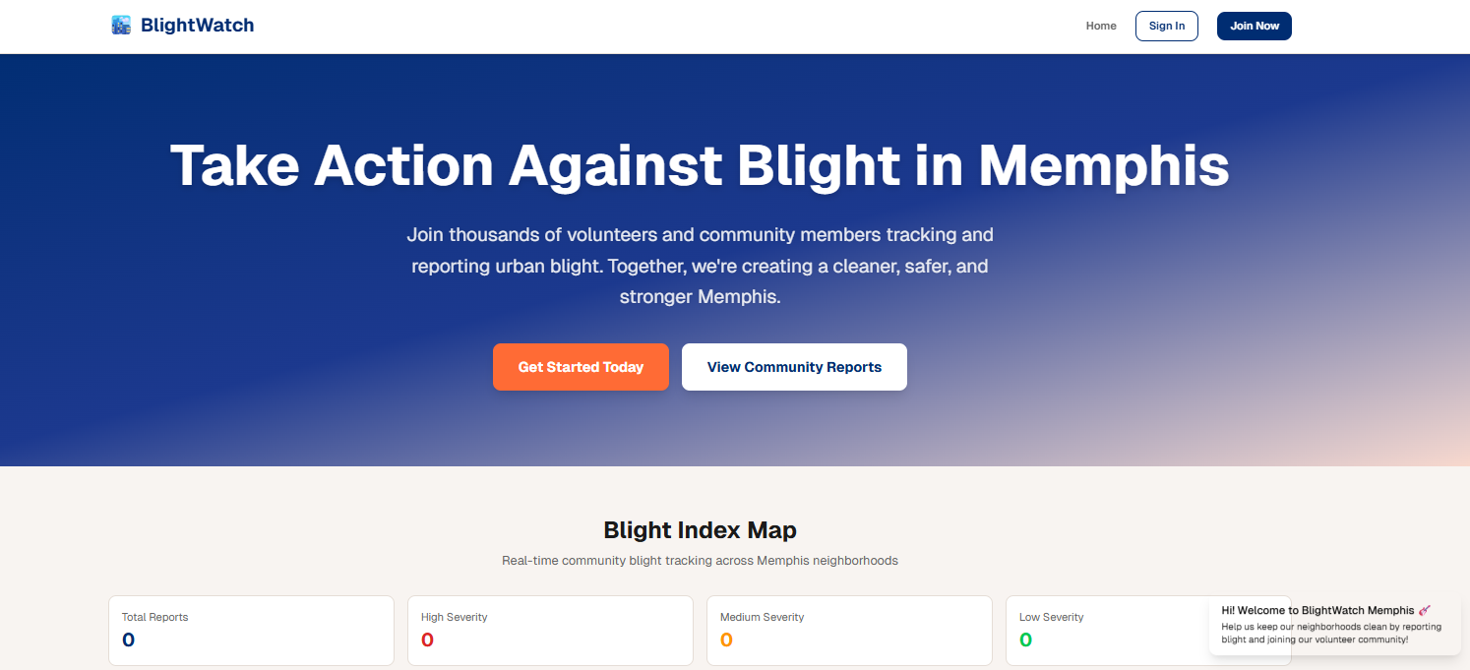
Demo website
BlightWatch Memphis - Community Blight Reporting

