Slide 1
Inspectors’ AI Gadget
Hi-Lo
Notes:
Blight Busters or Sesame Sweep - HiLo – City Hackathon slides
Self-Intro: One-line intros only – name and role in project
Title: AI Assistant for Code Enforcement — Rapid Prioritization for Memphis

Slide 2
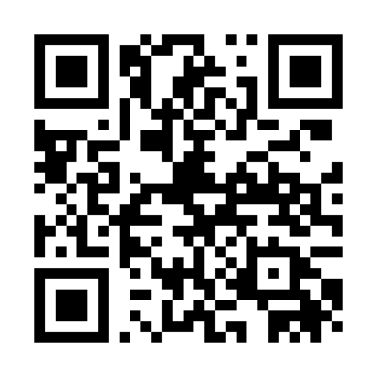
Scan me
Text entry during talks
Notes:
Speaker note: Emphasize fast iteration and why Python is used for spatial work and scoring logic.

Slide 3
Hackers
Yuki Sui – AI, API, and web
Ray Lumumba – Back-end & infrastructure
Meghan Carr – Data
Charles Plowman – Back-end & infrastructure
Ayana Smith – Front-end & design
Notes:
SHORT

Slide 4
Problem Statements - Blight
Case enforcement has no method to prioritize cases or plan efficient routes, wasted time, redundant travel, and uneven resource allocation
Residents should be able to report blight quickly and easily – simplify the reporting experience to empower citizens to better their community
Notes:
Speaker note: State scale (200k) and the single measurable aim: faster, targeted inspections.
Problem: ~200,000 blight‑related requests with no prioritization
Goal: Give Code Enforcement Inspectors an AI assistant that delivers fast, data‑driven, context‑aware recommendations to reduce triage time and improve field visits
Case enforcement has no method to prioritize cases or plan efficient routes. So wasted time, redundant travel, and uneven resource allocation – a need for a data-driven approach to prioritize cases and optimize field operations.
Residents should be able to report blight quickly and easily – simplify the reporting experience to empower citizens to engage with their community
Problem Statement for a Proposal or Grant Blight case enforcers face a critical challenge: there is no existing system to help them prioritize cases or plan efficient routes. This lack of structure leads to wasted time, redundant travel, and uneven resource allocation—ultimately slowing down response times and reducing the city’s ability to address blight effectively.
Pitch / Presentation Style Today, blight enforcement officers are working without a system that helps them decide which cases to tackle first or how to reach them efficiently. This means more time spent on the road, fewer cases resolved, and higher operational costs. There’s a clear need for a data-driven approach to prioritize cases and optimize field operations.
Plow — 8:44 AM
Residents want to report blight quickly and easily—but the current system makes that cumbersome. Too many steps, unclear questions, and limited feedback discourage participation. By simplifying the reporting experience, we can empower citizens to engage with their community and help service providers act faster with better data.

Slide 5
Goal
Give Code Enforcement Inspectors an AI assistant that delivers fast, data‑driven, context‑aware recommendations to reduce triage time and improve field visits
Notes:
Speaker note: State scale (200k) and the single measurable aim: faster, targeted inspections.

Slide 6
What we built
Tech stack: React + Vite, Python, API integration
Core outputs: AI guidance (MCP), Severity table, for Code Enforcement Inspectors:
  Assignments
  Routing hints
Used AI as a pair programmer (time efficient)
Modularity: Other services can plug-in
Notes:
What we built (UI + Stack + Key outputs)
Speaker note: Emphasize fast iteration and why Python is used for spatial work and scoring logic.
React + Vite (frontend), Python (joins, scoring), API integration
User experience
Citizen report flow
Code Enforcement Inspectors dashboard

Slide 7
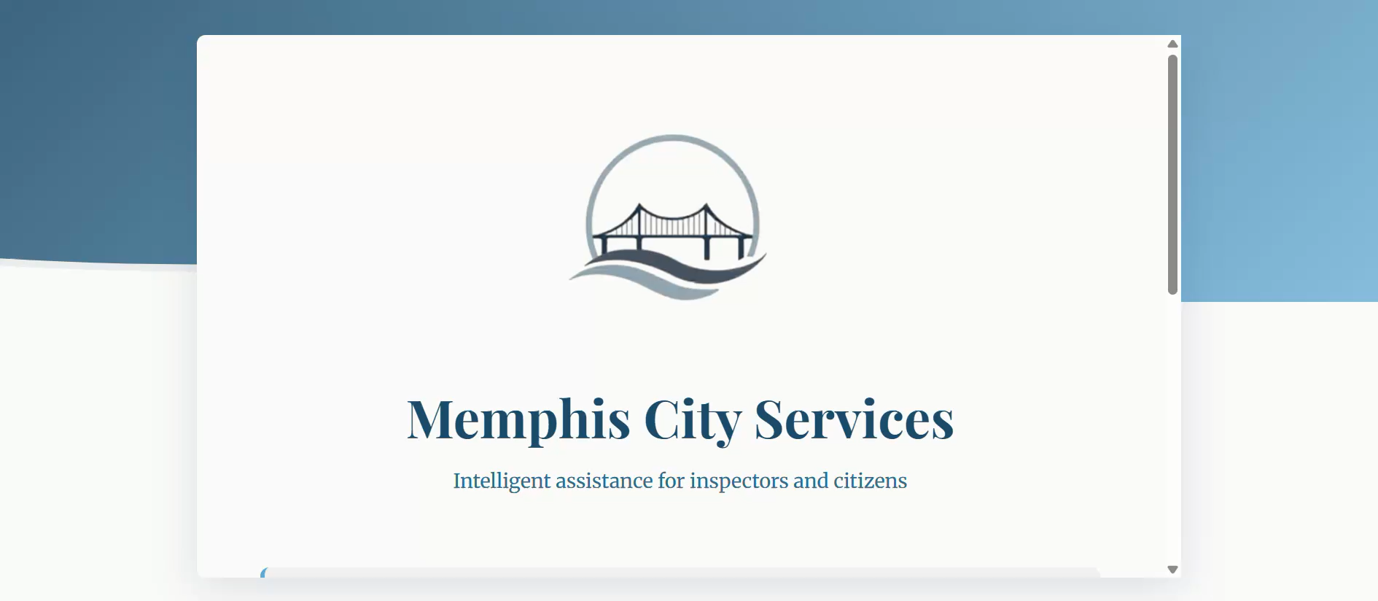

Slide 8
Data sources
Memphis Data Hub (city) (data.memphistn.gov)
Public Safety (city) (publicsafety.memphistn.gov)
Memphis Property Hub (NGO) (datamidsouth.org)
Derived prioritization - Code Enforcement Inspectors’ Severity ratings → Assignments
Notes:
Data sources: Blight, Crime/public Safety, Properties, Zones (census/tract geometry), Google Maps (routing/street view)
Memphis Data Hub / Socrata (BLIGHT: hmd4‑ddta) /SERVICE REQUESTS: https://data.memphistn.gov/dataset/Service-Requests-since-2016/hmd4-ddta/about_data
Public Safety feeds (CRIME: publicsafety.memphistn.gov)
Memphis Property Hub (SITES / parcel exports via datamidsouth.org)
Civic Assets (points and lines) / Census tract geometry (polygons)
Google Maps APIs (routing, Street View)
Derived: Severity table (rubric, etc.); CODE_ENFORCER assignments

Slide 9
Thank you

