Slide 1

City Connect
AI-POWERED 24/7 RESOURCE NAVIGATION FOR MEMPHIS RESIDENTS
City of Memphis 2025 Hackathon - Challenge 2: User-Friendly Resource Navigation

Slide 2
The Problem
MEMPHIS RESIDENTS EXPERIENCE DIFFICULTY WITH FINDING THE RIGHT RESOURCES:
• Limited Availability: Live staff support isn't available 24/7 or in every neighborhood
• Communication Gaps: Many residents speak limited English and struggle to understand available resources or eligibility requirements
• Navigation Complexity: Hard to navigate across 20+ City divisions, County, nonprofits, and community services
• Outdated Information: Resource directories become outdated, leading to dead ends and frustration

Slide 3
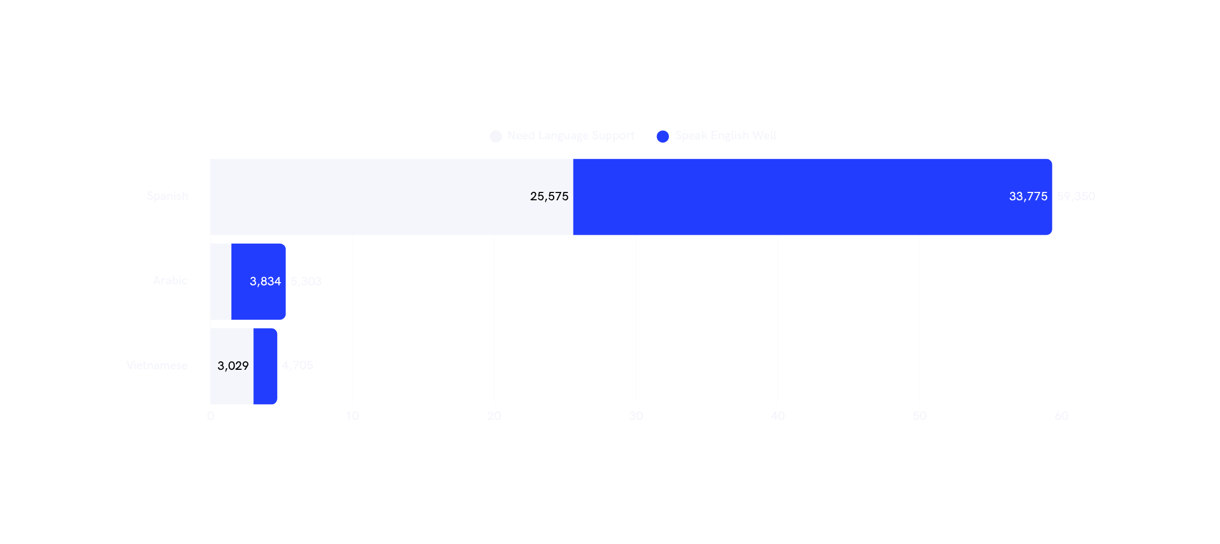
Language Barriers in Memphis
Over 30,000 Memphians may encounter barriers while trying to locate or understand resources that are there to help them.

Slide 4
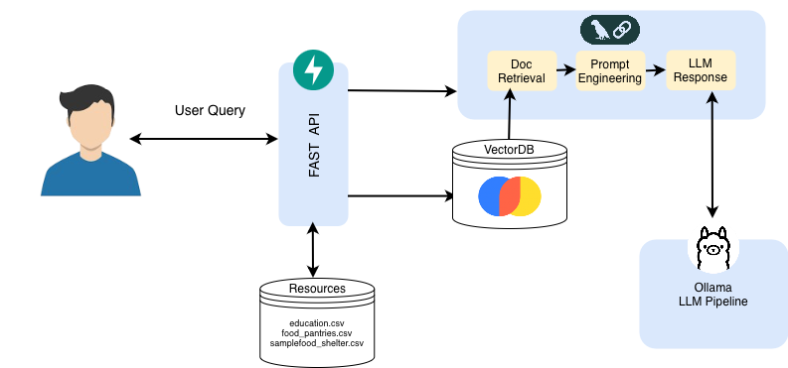
MVP:

Slide 5

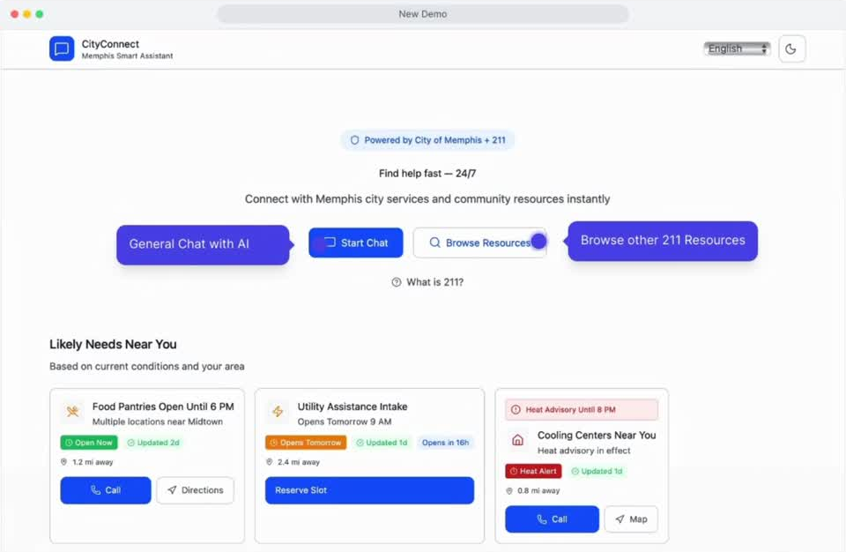

Slide 6
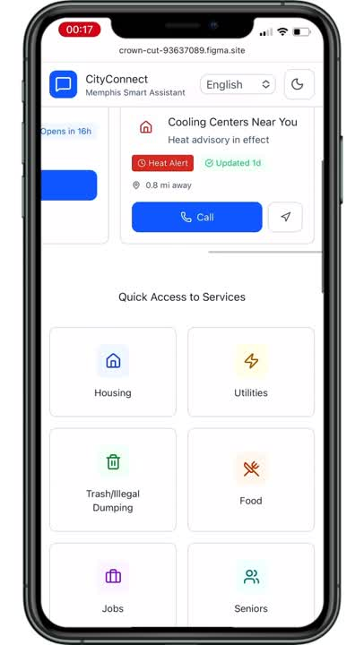

Slide 7
Why It Matters
EMPOWERING MEMPHIS RESIDENTS WITH INSTANT ACCESS TO HELP
• Accessibility: 24/7 access means help is always available, even outside business hours
• Efficiency: Residents find the right resource in seconds instead of hours of searching
• Equity: Simple conversational interface works for all digital literacy levels
• Scalability: One chatbot can serve unlimited residents simultaneously
• Cost-Effective: Reduces load on 211 operators for basic information requests
• Better Outcomes: Faster connections to resources lead to better resident outcomes

Slide 8

Connecting all of Memphis to the Support They Need
The right resources, at the right time, every time.
Reference:
  Most common languages spoken at home in Greater Memphis and surrounding regions. Stacker. (2022, October 19). https://stacker.com/stories/tennessee/memphis/most-common-languages-spoken-home-greater-memphis-and-surrounding-regions
AI Use:
  Figma and ChatGPT used to create wireframe
MemphAI Five:
  Thika You
  Khoa Tran
  Truc Nguyen
  Calvin Payton
  Wesley Marizane
QUESTIONS?

Slide 9
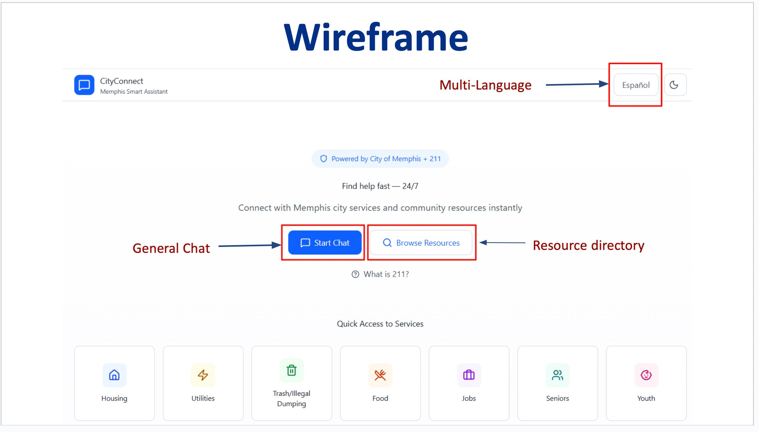

Slide 10
