Slide 1
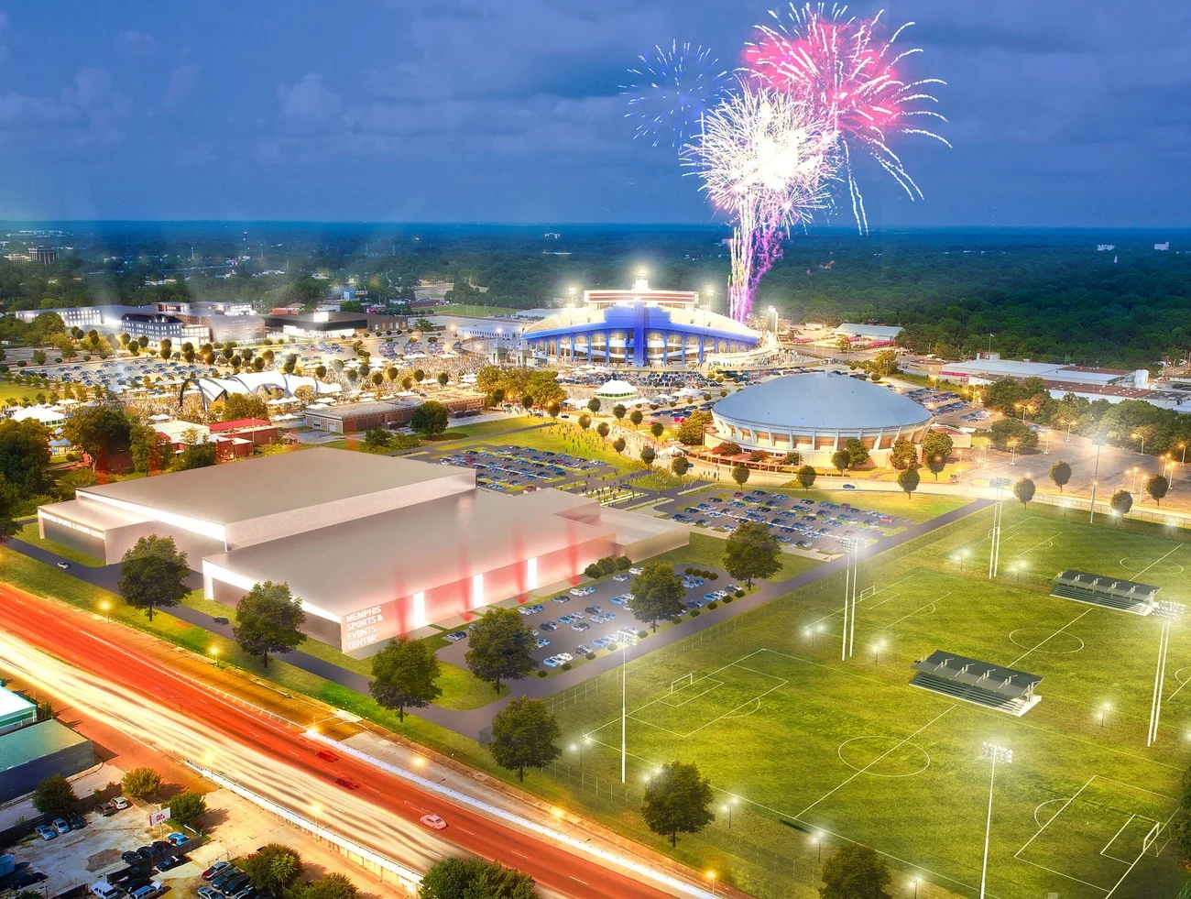
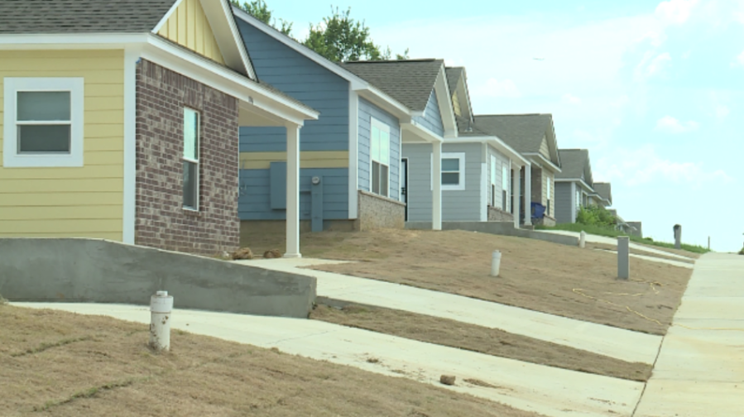
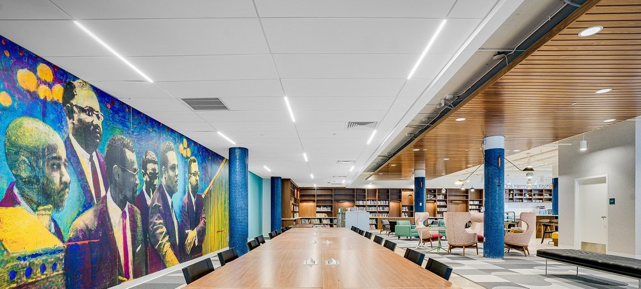

ANNUAL ACTION PLAN (AAP) PY2025/FY2026
+
FEDERAL ENTITLEMENTS
CITY COUNCIL PRESENTATION
August 19, 2025
APPROVING CONSOLIDATED PLAN
(ANNUAL ACTION PLAN PY2025/FY2026) &
APPROPRIATING FEDERAL ENTITLEMENTS

Slide 2
Annual Action Plan (AAP) PY2025/FY2025
(July 1, 2025 - June 30, 2026)
FY 2026 funds to be received from HUD:
Program Name | Allocated Funds | Percent of Total
CDBG Program | $6,037,192.00 | 41%
Bass Pro - PI | $750,000.00 | 5%
HOME Program | $3,282,236.57 | 23%
HOME Program Income | $361,041.46 | 2%
Emergency Solutions Grant Program (ESG) | $538,182.00 | 4%
HOPWA | $3,602,250.00 | 25%
TOTAL | $14,570,902.03 | 100%

Slide 3
Annual Action Plan (AAP) PY2025/FY2026
(July 1, 2025 - June 30, 2026)
FY 2026 Priority Areas:
Priority Need Category | Proposed Expenditures | Percent of Total
Housing | $4,403,564.03 | 30%
Homeless | $802,818.00 | 6%
Special Needs | $3,894,761.00 | 27%
Neighborhood, Economic, & Community Development | $3,585,450.00 | 25%
General Administration & Planning | $1,884,309.00 | 13%
TOTAL | $14,570,902.03 | 100%

Slide 4
Awardees FY26
Type of Funding | Agency Name | Awarded Amount | Type of Project or Activity
HOPWA | Case Management, Inc. | $ 502,900.00 | Operating Costs for Housing/Supp. Srvs./Admin
HOPWA | Friends for Life Corp. | $ 492,200.00 | Master Leasing/Supp. Srvs./Admin
HOPWA | Friends for Life Corp. | $ 695,500.00 | STRMU/Supp. Srvs./Admin.
HOPWA | Friends for Life Corp. | $ 749,000.00 | TBRA/Supp. Srvs./Admin
HOPWA | Hope House Day Care | $ 1,754,800.00 | TBRA/Supp. Srvs./Admin
HOME | Agape | $ 310,000.00 | Home TBRA
CDBG | Community Alliance for the Homeless | $ 150,000.00 | Admin.
City | Community Alliance for the Homeless | $ 282,500.00 | Homeless Action Plan
CDBG | MIFA | $ 155,000.00 | Public Services / Homeless Referral
CDBG | MIFA | $ 150,000.00 | Public Services / Homeless Hotline
CSG | Memphis Child Advocacy Center | $ 36,000.00 | Public Services / Abused Children
CSG | A Way Out Ministries | $ 31,000.00 | Public Services / Trafficking
CSG | Generous Life | $ 31,000.00 | Public Services / Homeless
CSG | Hope House Day Care | $ 32,000.00 | Public Services / HIV/AIDS
CSG | Downtown Memphis Ministries, Inc. | $ 32,000.00 | Public Services / Substance Abuse
CSG | Kindred Place | $ 33,000.00 | Public Services / Mental Health
CSG | Young Actors Guild | $ 31,000.00 | Public Services / Low Income Individuals
CSG | Friends for All | $ 32,000.00 | Public Services / HIV/AIDS
CSG | Memphis Medical District Collaboration | $ 31,000.00 | Public Services / Low Income Individuals
CSG | Innovate Memphis | $ 32,000.00 | Public Services / Low Income Individuals
CSG | YWCA of Greater Memphis | $ 33,000.00 | Public Services / Domestic Violence
CSG | Synergy Treatment Center | $ 35,000.00 | Public Services / Substance Abuse
CSG | Salvation Army | $ 35,000.00 | Public Services / Homeless Families
CSG | Creative Aging Memphis | $ 36,000.00 | Public Services / Seniors
ESG | Room In The Inn | $ 83,000.00 | Emergency Shelter / HMIS
ESG | MIFA | $ 182,000.00 | Rapid Re-Housing/Homeless Prevention/Emergency Shelter/HMIS
ESG | Catholic Charities of West TN, Inc. | $ 107,000.00 | Street Outreach / Rapid Re-Housing
ESG | The Salvation Army | $ 78,000.00 | Emergency Shelter
ESG | Hope House Day Care | $ 18,000.00 | Emergency Shelter
ESG | YWCA of Greater Memphis (AWS) | $ 50,000.00 | Emergency Shelter

Slide 5
Neighborhood Partnership Awardees FY26
NPG | Alpha Memphis Education Foundation | $ 15,000.00 | Alpha Memphis Education Fund
NPG | Binghampton Development Corporation | $ 15,000.00 | BDC Entrepreneurship Training Program
NPG | Christopher A Pugh II Center | $ 15,000.00 | Christopher A. Pugh II Center Needs Assessment and Workforce Program
NPG | City Leadership | $ 15,000.00 | Choose901 Alumni Program
NPG | Giving Youth A Chance | $ 15,000.00 | Pathways to Peace: Reducing Juvenile Crime Throught Mentorship & Conflict Resolutions
NPG | Junior League of Memphis | $ 15,000.00 | GROW Thursday Night and GROW Brewster
NPG | Klondike Smokey City CDC, Inc. | $ 15,000.00 | Family Engagement and Preservation
NPG | Mustard Seed Inc. | $ 15,000.00 | Project READY: Reinvigorations and Empowering African American Disadvantaged Youth
NPG | RISE Memphis, Inc. | $ 15,000.00 | Save Up
NPG | SchoolSeed/Project STAND | $ 15,000.00 | School Seed - Project STAND
NPG | Service Over Self | $ 15,000.00 | SOS Builds
NPG | United Housing, Inc. | $ 15,000.00 | Homebuyer Education and Credit Coaching Support
NPG | Young Actors Guild | $ 15,000.00 | Young Actors Guild Performing Arts Academy

