Slide 1
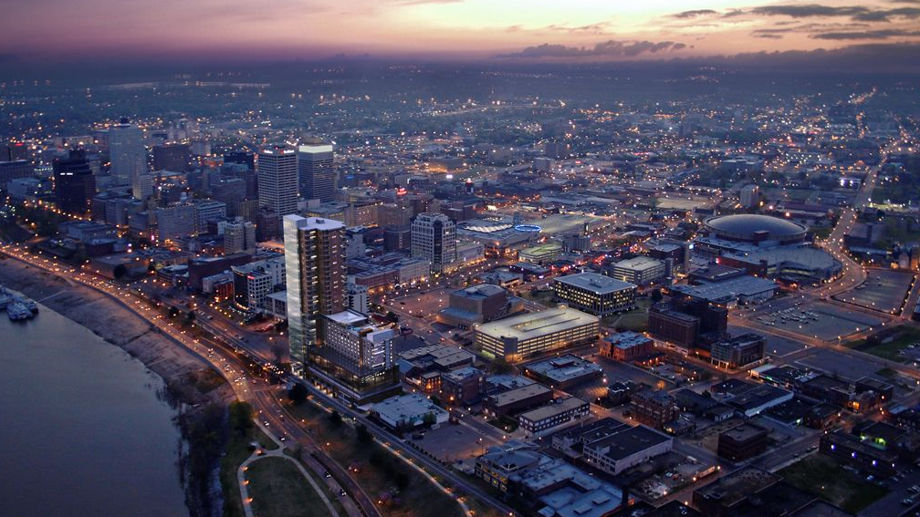

Police Services
Fiscal Year 2025 Operating Budget Request
CHIEF: C.J. Davis
FUND: GENERAL
DATE: 5/13/2024

Slide 2
THE GUIDING IDEAOLOGY FOR THE MEMPHIS POLICE DEPARTMENT
MISSION
The mission of the Memphis Police Department is to reduce crime by providing quality public safety in partnership with our community.
VISION
We strive to be a best-in-class leader in policing by continually improving our people, processes, technology, and service to our community.
VALUES
Professionalism- A commitment to consistently achieve high job performance standards while in public and privately.
Integrity– Demonstrating high moral and ethical principles at all times.
Collaboration- Striving for excellence by working collectively with our internal and external stakeholders/partners to solve problems.
Accountability- Fulfilling our responsibilities by doing what is expected in all situations.

Slide 3
MPD FY 23/24 Accomplishments
PUBLIC SAFETY ENCHANTMENTS:
Created a citywide Crime Reduction Strategic Plan – FY23/24 Overall 20% Reduction Citywide
Re-established the Special Traffic Enforcement Unit (STEU) to focus on speeding & reckless driving
Utilization of Auxiliary Units to support increased patrol demands (Mounted Patrol, Motors, etc.)
Expanded the Violent Crimes Unit - investigation non-fatal aggravated assaults (shootings)
Expanded the Homicide Unit to include 10 additional Investigators to the Charlie Shift
Created the public facing Repeat Offender Dashboard & Homicide Dashboard
Created the Memphis Most Wanted Webpage – located on the MPD Website
Deployment of TASERs to all Uniform Patrol Personnel for De-Escalation & less lethal options
Expanded the Crisis Intervention (CIT) Program to the recruit training curriculum for all new Officers.
Expanded the MPD Connect2Memphis Camera Network to business and other city facilities.

Slide 4
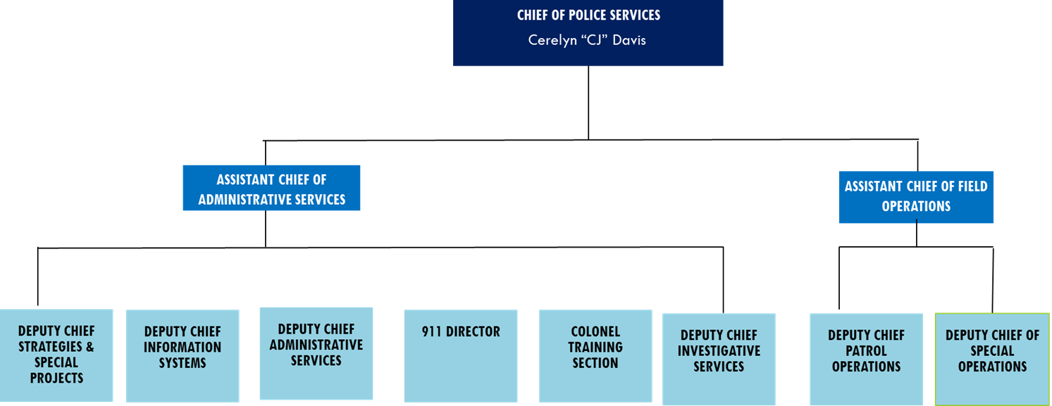

ORG CHART

Slide 5
MPD Public Safety Strategic Measures
Strategic Initiatives to Create a Safer Memphis:
Reduce Violent Crime by 10%
Reduce Property Crime by 10%
Reduce Traffic Fatalities by 20%
Conduct 2 “Code Zero” Collaborative Operations Monthly
Reduce Priority 1 Call Response times to 13 minutes
Increase Murder/Homicide Clearance Rate to 60%
Increase Crimes Against Persons Clearance Rate to 60%
Hire 200 Police Recruits (FY24/25)
Reduce Citizen Complaints 10%
Reduce Administrative Complaints by 20%

Slide 6

Police Services
FY25 - FY29 Police Services Projects
$15M
$14M
$13M
$12M
$12M
$11M
$10M
Axon Enterprise Solution Take-Home Car Program New Mount Moriah Station Helicopter Maintenance Police Academy Renovations Violent Crime Building
$54,000,000
$3,000,000
$2,000,000
$1,400,000
$1,215,000
$200,000
87.36%
4.85%
3.24%
2.26%
1.97%
0.32%
$5M
0
2025
2026
2027
2028
2029
Summary of Requests
Project No. / Category | FY2025 | FY2026 | FY2027 | FY2028 | FY2029 | Total
PD02013 | $1,215,000 | $0 | $0 | $0 | $0 | $1,215,000
Police Academy
Renovations
PD02016 | $1,000,000 | $1,000,000 | $0 | $0 | $0 | $2,000,000
New Mount Moriah
Station
PD03010 | $0 | $1,000,000 | $1,000,000 | $1,000,000 | $0 | $3,000,000
Take-Home Car
Program
PD04031 | $10,000,000 | $11,000,000 | $11,000,000 | $11,000,000 | $11,000,000 | $54,000,000
Axon Enterprise
Solution
PD04026 | $1,400,000 | $0 | $0 | $0 | $0 | $1,400,000
Helicopter Maintenance
PD2018 | $200,000 | $0 | $0 | $0 | $0 | $200,000
Violent Crime Building
Total Summary of Requests | $13,815,000 | $13,000,000 | $12,000,000 | $12,000,000 | $11,000,000 | $61,815,000

Slide 7
FY25 Operating Budget Request
Strategic priorities addressed by this budget:
Public Safety
Perform Operation Code Zero details twice a month to reduce crime by focusing on Strategic Enforcement & Intervention, Community Engagement, and Prevention strategies throughout the city.
Focus on violent repeat offenders to support crime reduction efforts( e.g., GVIP, prosecution, referrals, etc.)
Enhance traffic enforcement on various shifts citywide to reduce reckless driving and traffic related fatalities
Continue to focus on increasing hiring and retention of commissioned officers
Police Services - FY25 Operating Budget Request

Slide 8
FY25 Operating Budget Request
Strategic priorities addressed by this budget:
Technology
Enhance the current public-facing data reporting system on our website to inform the community regarding crime and policing activities.
Increase the number of cameras in the FUSUS (Connect2Memphis) solution through our public and private partnership
Upgrade the infrastructure of the RTCC to support the growth of the camera network system
Police Services - FY25 Operating Budget Request

Slide 9
FY25 Operating Budget Request
Strategic priorities addressed by this budget:
Leadership
Expand Memphis Police Leadership Academy in Partnership with the University of Tennessee (Major Cities Chiefs-MCAA).
Establish a formal International Association of Chiefs of Police (IACP) mentoring program for executive ranks.
Ensure Mid-Management personnel receive leadership training, i.e., FBI, PERF, SPI, and Northwestern.
Establish peer exchange shadowing opportunities within the City government and external partners.
Police Services - FY25 Operating Budget Request

Slide 10
FY25 Operating Budget Request
Strategic priorities addressed by this budget:
Community Outreach
Ensure commissioned officers complete 4 mandatory community service hours annually.
Enhance the community outreach program activities with youth-specific focus through public and private partnerships.
Strengthen partnerships with the community through outreach efforts to improve communication and collective crime-fighting strategies.
Ensure MPD is represented at various non-police-related community events, i.e., Churches, Town Hall Meetings, and Community Walks.
Enhance police-community relations.
Police Services - FY25 Operating Budget Request

Slide 11
EXPENDITURES
Police Services- FY25 Operating Budget Request

Slide 12
FY24 Expenditures Bridge
to FY25 Request

Slide 13
Program Comparative Spending

Slide 14
FY25 Year Over Year
Changes in Expenditures

Slide 15
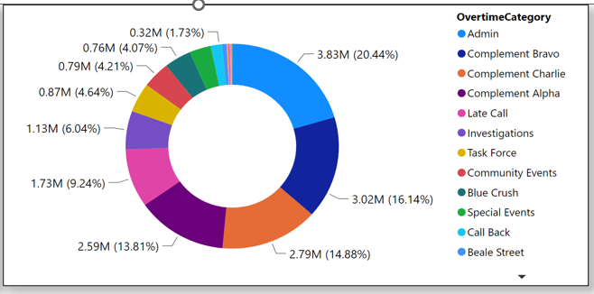
Overtime
Overtime Management
Notes:
Overtime Costs
No alt text provided
tableEx
No alt text provided
tableEx
No alt text provided
donutChart
No alt text provided
Current Pay Period
No alt text provided
textbox
No alt text provided
pageNavigator
No alt text provided
slicer
No alt text provided
textbox
No alt text provided
shape
No alt text provided

Slide 16
REVENUE

Slide 17
FY24 Adopted Revenues
Bridge to FY25 Request

Slide 18
FY25 Year Over Year
Changes in Revenues

Slide 19
DIVISION DETAIL INFORMATION

Slide 20
PERSONNEL INFORMATION

Slide 21
Division Authorized
Complement (AC)

Slide 22
ARPA FUNDING HAS ENABLED THE MPD TO RECRUIT AGGRESSIVELY OVER THE PAST TWO YEARS

Slide 23
MATERIAL & SUPPLY EXPENDITURES (M&S)

Slide 24
Major M&S Expenditures

Slide 25
Major M&S Expenditures

Slide 26
Account Details
Professional Services

Slide 27
Account Details
Leases

Slide 28
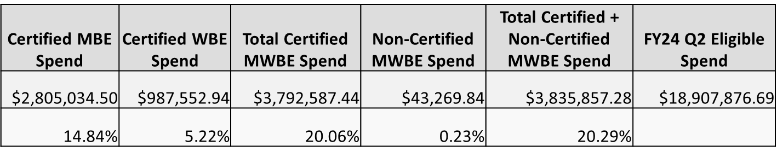
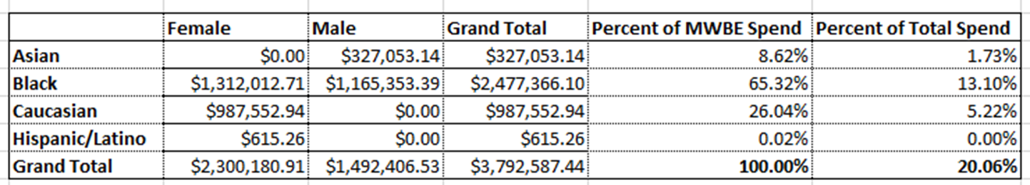
Minority/Women Business Enterprises (MWBE) Utilization
MWBE Spend for the Police Services Division as of December 31, 2023 (FY24)

