Slide 1
sMATA Industries
Memphis Moves sMATA Presents:
Ride-Sharing Service App
Notes:
Link: https://embed.domo.com/cards/oVPy j || https://github.com/theimpending/MemphisMovessMATA/blob/main/new/carpooling.html

Slide 2
Why Carpool in
sMATA Industries
Memphis?

Slide 3
Why Carpool in
sMATA Industries
Memphis?
More reliable than public service
MATA buses on time performance is around 63 Percent
Reference 1:https://data.memphistn.gov/dataset/Improve-MATA-On-Time-Performance/cq98-42uy

Slide 4
Why Carpool in
sMATA Industries
Memphis?
More reliable than public service
MATA buses on time performance is around 63 Percent
Affordability
most carpoolers make a median earnings of 35,442
Reference 1:https://data.memphistn.gov/dataset/Improve-MATA-On-Time-Performance/cq98-42uy
Reference 2: Means of Transportation to Work by Selected Characteristics by the US Census Bureau

Slide 5
Why Carpool in
sMATA Industries
Memphis?
More reliable than public service
MATA buses on time performance is around 63 Percent
Affordability
most carpoolers make a median earnings of 35,442
Uber is too expensive
Reference 1:https://data.memphistn.gov/dataset/Improve-MATA-On-Time-Performance/cq98-42uy
Reference 2: Means of Transportation to Work by Selected Characteristics by the US Census Bureau

Slide 6
Why Carpool in
sMATA Industries
Memphis?
More reliable than public service
MATA buses on time performance is around 63 Percent
Affordability
most carpoolers make a median earnings of 35,442
Uber is too expensive
Cost to go to airport from UofM: $19.50 (standard) for 11 miles = $1.77 per mile
Reference 1:https://data.memphistn.gov/dataset/Improve-MATA-On-Time-Performance/cq98-42uy
Reference 2: Means of Transportation to Work by Selected Characteristics by the US Census Bureau

Slide 7
Why Carpool in
sMATA Industries
Memphis?
More reliable than public service
MATA buses on time performance is around 63 Percent
Affordability
most carpoolers make a median earnings of 35,442
Uber is too expensive
Cost to go to airport from UofM: $19.50 (standard) for 11 miles = $1.77 per mile
Personal Car: 250 miles, 24.5 MPG = $0.12 per mile
Reference 1:https://data.memphistn.gov/dataset/Improve-MATA-On-Time-Performance/cq98-42uy
Reference 2: Means of Transportation to Work by Selected Characteristics by the US Census Bureau

Slide 8
sMATA Industries
Family and Friends
Forever!
According to Memphis Explore Report:
“Almost every person engaged in research made comments about how they rely upon extended family members”

Slide 9
Problems

Slide 10
Problems
Communication and Scheduling

Slide 11
Problems
Communication and Scheduling
Customizable Fares

Slide 12
Workforce
sMATA Industries
Mobility?

Slide 13
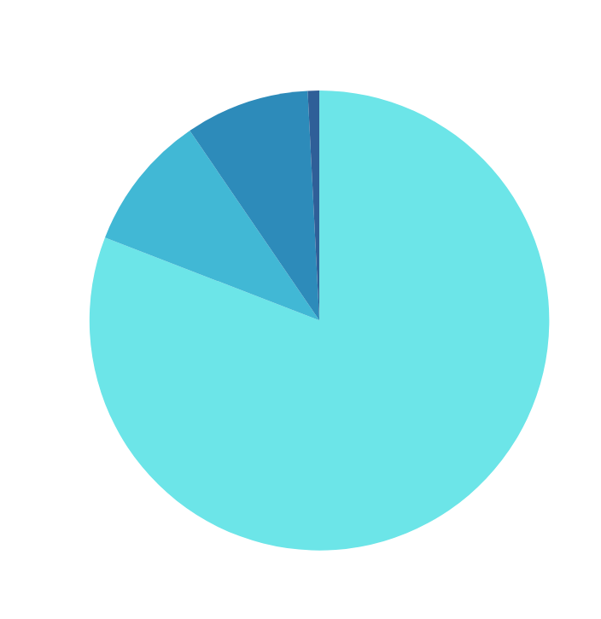
Workforce
sMATA Industries
Mobility?
Workers over 16 and over = 25,672 carpoolers (Public Tran. 2,172)
Workers Mean of Transportation age 16+
Reference 1: Means of Transportation to Work by Selected Characteristics by the US Census Bureau

Slide 14
Workforce
sMATA Industries
Mobility?
Workers over 16 and over = 25,672 carpoolers (Public Tran. 2,172)
Most workers work in entry level jobs located in logistic center located away from transit area
Fedex, DHL, etc.
Workers Mean of Transportation age 16+
Reference 1: Means of Transportation to Work by Selected Characteristics by the US Census Bureau
Reference 2: Memphis Explore Report

Slide 15
Fedex
30,000 employees (Memphis Hub - 13,000)
940 Acres of land
9 percent of total entry jobs at Memphis Hub would be roughly 400 people that carpools
Reference 1: https://newsroom.fedex.com/newsroom/global-english/fedex-unveils-new-automated-sorting-facility-at-memphis-world-hub#:~:text=The%20FedEx%20World%20Hub%20is,process%20484%2C000%20packages%20per%20hour.

Slide 16
Blue Oval City
Largest automobile factory in the United States
33,000 employees
4,100 Acres of land
TDECD reports 176,000 new resident
9 percent of total entry jobs at Blue Oval City would be roughly 1,485 people that would require carpools
Reference 1: https://haywoodtn.gov/blue-oval-city/
Reference 2: https://tennesseelookout.com/2024/09/13/what-to-know-the-new-ford-blueoval-city-plant-poised-to-reshape-west-tennessee/

Slide 17
Area Deprivation Index:

Slide 18
Area Deprivation Index:
Memphis to Stanton:
46.5 Miles (43 Min)
Uber:
$1.77 per mile = $82 one way

Slide 19
Ideas
Company Specific Section
Tax benefits
Rather than strangers pick you up, it will be your fellow co-workers going to work
Tennessee gives tax breaks to those who enroll for a carpool system

Slide 20
sMATA Industries
Thankyou
For Your Attention

