Slide 1
Employee
Transit
Network
Improving Transportation Access for Memphis’ Workforce

Slide 2
Supporting the Backbone of Memphis’ Economy
Impact on the Economy:
Factories and Hospitals rely on a steady, punctual workforce.
Low-income employees support essential services but face systemic barriers
Transportation barriers perpetuate cycles of poverty.
Last-Mile Solutions: Partnering with ride-share or shuttle like services for connections beyond bus stops.

Slide 3
Data at a Glance
93% of our current MATA riders are transit-dependent
25% reduction in daily service
47% of current bus routes have to wait an hour because they miss their bus
50% use MATA primarily for work
63% ride the bus 5+ times per week
Almost half of customers have been riding MATA for 10+ years
52% of customers transferred to another bus to complete their trip
34% of customers take 3 or more buses to complete their trip
as quoted by TransPro Consulting Report "The Modernization of MATA...."

Slide 5
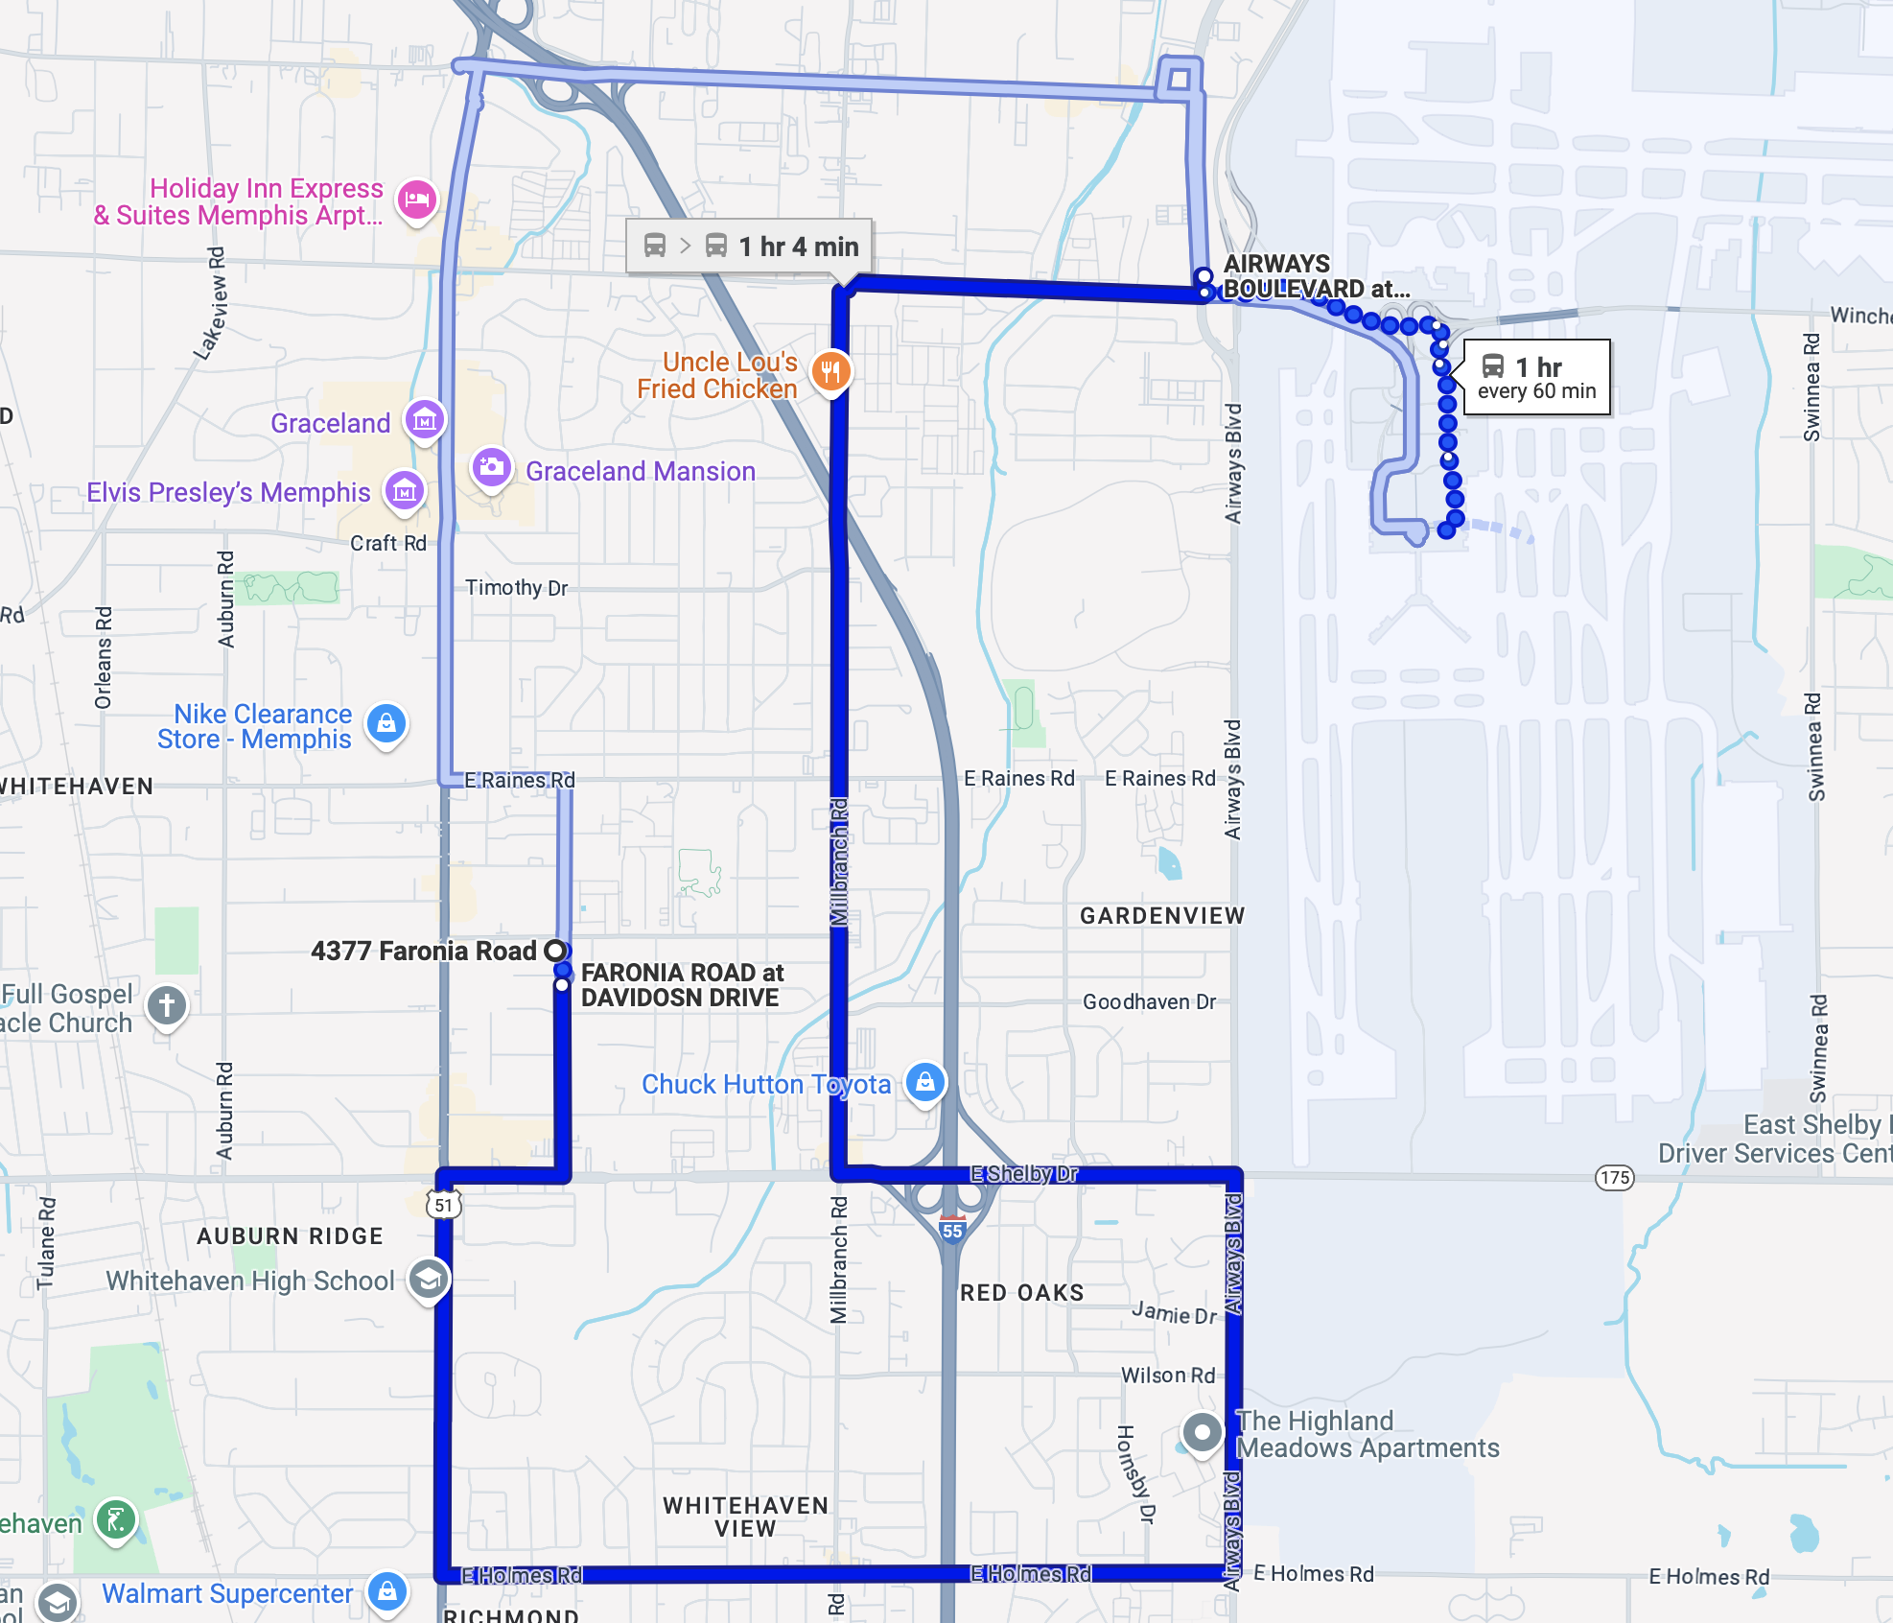

Slide 6
Transportation: Bridge to Opportunity
Current Benefits:
MATA serves Memphis neighborhoods and key employment hubs.
MATAPlus ensures ADA-compliant options for those with disabilities.
Groove OnDemand currently serves Downtown Memphis and Medical Districts
Challenges:
MATA has limited resources
MATAPlus doesn’t cover workforce
Groove OnDemand has limited coverage throughout Memphis

Slide 7
E.T.N. Recommendation
E.T.N. Recommendation is to Partner with Groove On Demand
The ability to pre-schedule rides to ensure employees’ transportation
Expand accessibility to those with no or infrequent bus access.
Implement technology-driven last-mile solutions.
As quoted by Gary Rosenfeld, Chief Executive Officer at MATA. “The launch of Groove On-Demand is another opportunity for MATA to improve how people connect to their destinations using an on demand-response service that transports riders directly from their doorstep to their destination.

Slide 8
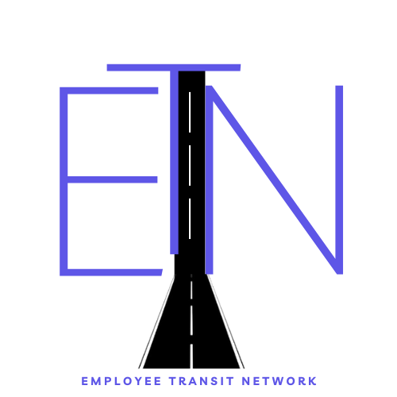
Technical Presentation
https://employeetransnetwork.z13.web.core.windows.net/

Slide 9
Frequently Asked Questions
How will it be paid for?
Nike and Kellogs invested in ride-sharing programs
What are some expected benefits?
Investment in labor force and ride share drivers
What are some risks?
People may feel more comfortable with a bigger bus versus ride share

Slide 10
Call us Today
Contact us to get more info
firstplace@etn.com
123 Anywhere St., Any City
+123-456-7890
www.etn.com
Presented by Nathan Stokes, Darius Calliet, Von George, and Judy Lane

