Slide 1
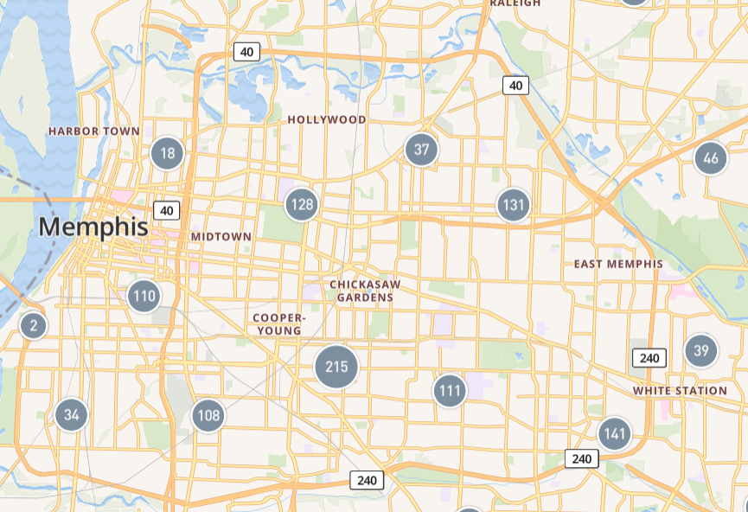
MyPart901
#DoMyPart901
City & Case Cleanup Application
11/15 - 11/17
Team Blight Busters Present:
Notes:
https://blight-busters.vercel.app/
Slide 1 - Title Slide
Ok, let’s get right to it. Thank you for your time, I’d like to introduce you to Memphis’s next chapter in blight reduction initiatives and more, MyPart901!

Slide 2
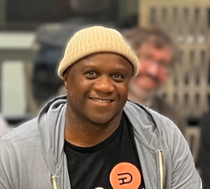
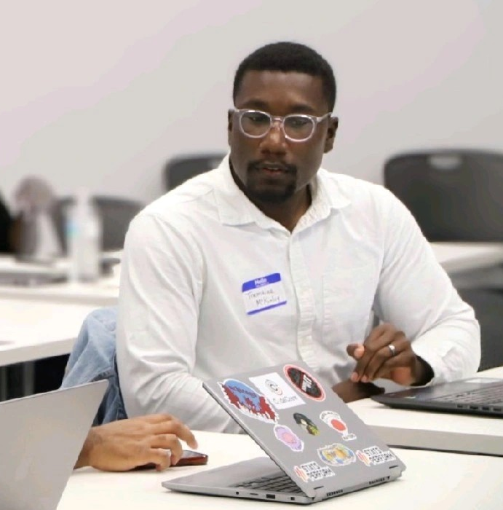
Meet the Team
Thank you to the coaches & hosts that supported us!
Coriano H.
UX/UI
Jesus M.
Full-Stack
Tremaine M.
Project Mgmt
JC Smiley
Front-end Lead
Notes:
Slide 2 - Team Members
I’ll be very brief with the introductions so that you can know how this innovation came to be.
Coriano Harris primarily served as our UI/UX lead, he created our Figma file and drafted the workflow you’ll see.
Jesus Marron was our backend designer and engineer, he took the time to analyze the 311 data we’re pulling from and guided us on how to use it in our app.
My name is Tremaine McKinley, I served as the junior front-end dev on this project, with my primary role being project manager and presentation designer.
JC Smiley - JC was the driver on our front-end development, along with support from the rest of us.
Thank you to the coaches and hosts who helped us make this possible in a weekend!

Slide 3
Problem Statements
The city has multiple methods for citizens to report 311 cases, these cases span multiple departments and levels of complexity.
Code Enforcement has limited person-power and challenges with data integrity
Challenge:
Finding an innovative solution to help address the 311 case queue.
Notes:
Slide 3 - The Problem
Our goal for the weekend was to address the first problem presented to us, neighborhood improvement through blight reduction. Assuming we here understand what that is, let’s talk about the slice of the problem we focused on.
The city has made it easy to report 311 cases whether it’s through an app, a phonecall, AI, or CE officers themselves.
Along with that, the intake channels are many, but the person-power is limited, right? There is only so much that the City’s Code Enforcement team can deal with effectively.
These statements together spell for a steady backlog of cases with various levels of data integrity. The challenge we want to address is doing something tangible about that backlog for our citizens and CE employees

Slide 4
This is Memphis.
High Case Intake
Engaged volunteers
Rich supply of nonprofits
<ᐧ?ᐧ>
Civic Tech Innovators
Limited CE Capacity
Blight Reduction Initiatives
Neighborhood pride
Notes:
Slide 3 - This is Memphis
Now, we’ve identified a problem, we aren’t the first to do so, and this isn’t something unique to our city, but this IS Memphis afterall and we can’t ignore the assets and advantages that gives us to innovate with so let's talk about the rest of our situation.
First and foremost, Memphis is home to plenty of civic innovators and tech disruptors. I don’t need to say more here.
We’re one of the most philanthropic cities in the US
We’ve got a nonprofit on every corner, engaged volunteer bases, and multiple blight reduction efforts around the city.
Memphian pride in their neighborhood is special
But, willing hands and hearts aren’t always the some ones who are fully read up on what they can do in the neighborhoods around them.
How can we be sure that whenever there’s a mobilized group of volunteers ready to improve their community, they’ve got an actionable and effective answer to “do what” and “where?” and that that energy doesn’t go underutilized?

Slide 5
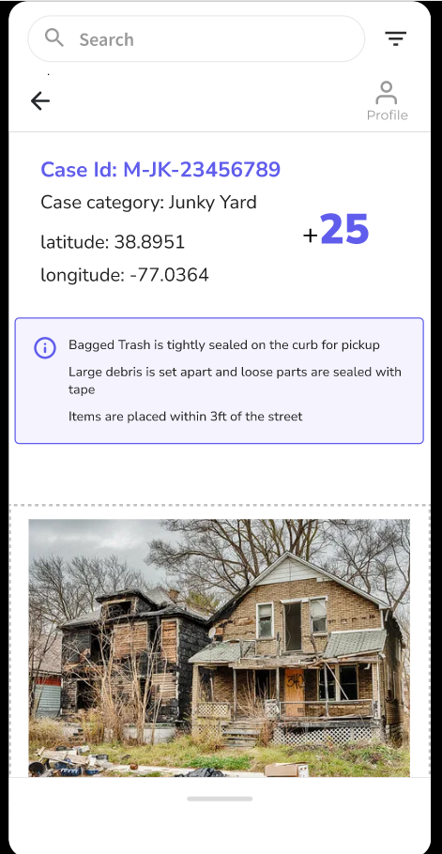
MyPart901
Team Blight Busters Present:
Notes:
Slide 4 - MyPart901
Our answer to that question is the MyPart901 app!

Slide 6
MyPart901
Empowering Memphians to address:
Unsightly vacant lots
Weeds & Tall Grass
Detail validation of misc. cases
All in a Gamified way
Team Blight Busters Present:

Slide 7
Key Features
Public Users (Citizens)
Administrators (City of Memphis)
User profiles for tracking
Gamified leveling
Dashboard compiling nearby service opportunities
Linked to 311 and other relevant databases
Simplified blight reduction instructions
Streamlined submission data to review & validate
High-powered application to educate the public.
Single application for organizational collaboration.
Memphis City Beautiful
Blight Authority of Memphis
Notes:
Key Features
Public Users (Citizens)
User profiles for tracking
Gamified leveling
Dashboard compiling nearby service opportunities
Linked to 311 and other relevant databases
Simplified blight reduction instructions
Administrators (City of Memphis)
Streamlined submission data to review & validate
High-powered application to educate the public.
Single application for organizational collaboration.
Memphis City Beautiful
Blight Authority of Memphis

Slide 8
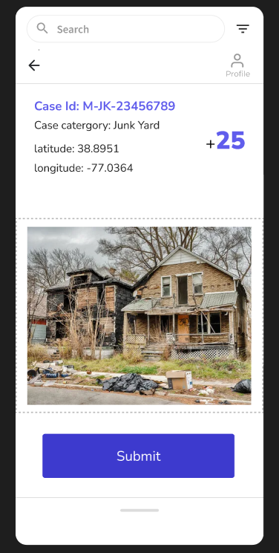
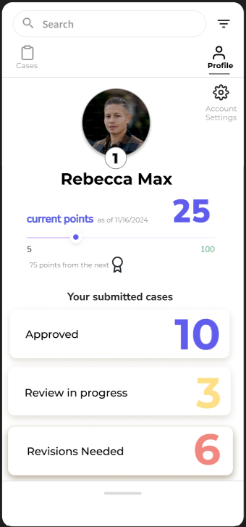
MyPart901
Team Blight Busters Present:
Demo
Notes:
https://blight-busters.vercel.app/

Slide 9
Future Updates
Organizational Groups
Hosting Challenges
Licensed Professional Tasks
Renovations, etc.
Education on city initiatives
Local and City investment for monetary prizes

Slide 10
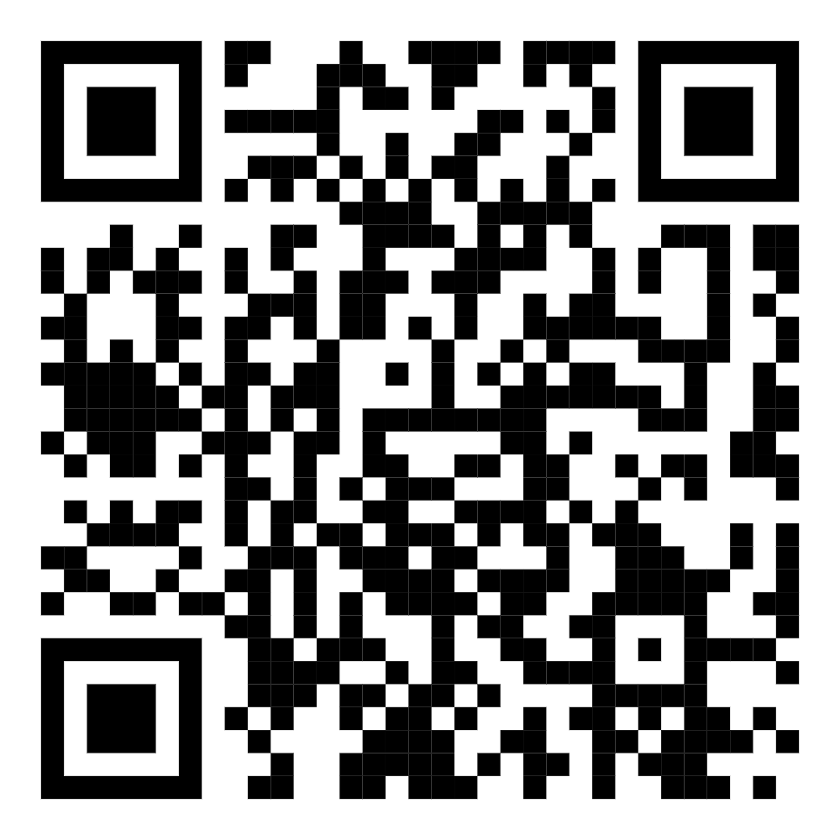
Check out our prototype!
Thank You!
Notes:
Slide 4 - MyPart901
Our answer to that question is the MyPart901 app!

