Slide 1
Middle-Income Housing Pilot Program (MI-Pilot)
Launch Workshop
Orange Mound Library
October 1, 2024

Slide 2
Greetings Program Overview & Goals Definitions Program Details Eligibility Application Components How to Apply Q&A
AGENDA

Slide 3
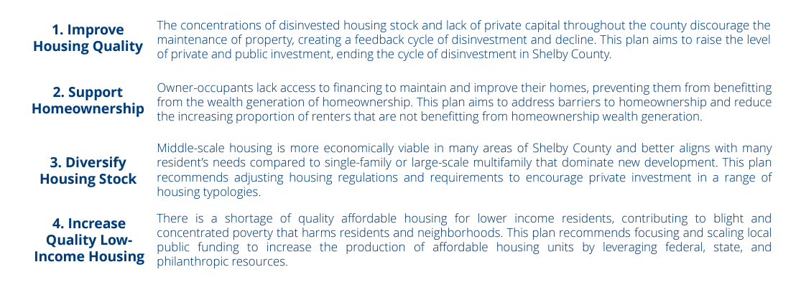
Background
This program aligns with and expands upon the following City of Memphis initiatives:
Memphis 3.0 Comprehensive Plan
Accelerate Memphis Plan
Memphis and Shelby County Joint Housing Policy Plan

Slide 4
Program Overview & Goals
The Memphis Middle-Income Housing Pilot Program (MI-Pilot) promotes infill development of "missing middle" housing affordable to middle-income Memphians through financial support to local non-profit and for-profit developers in the construction or rehabilitation of infill housing units.
Goals:
create a more diverse housing stock,
develop attainable owner-occupied and rental units,
increase local developer capacity,
reduce blight – spurring additional development

Slide 5
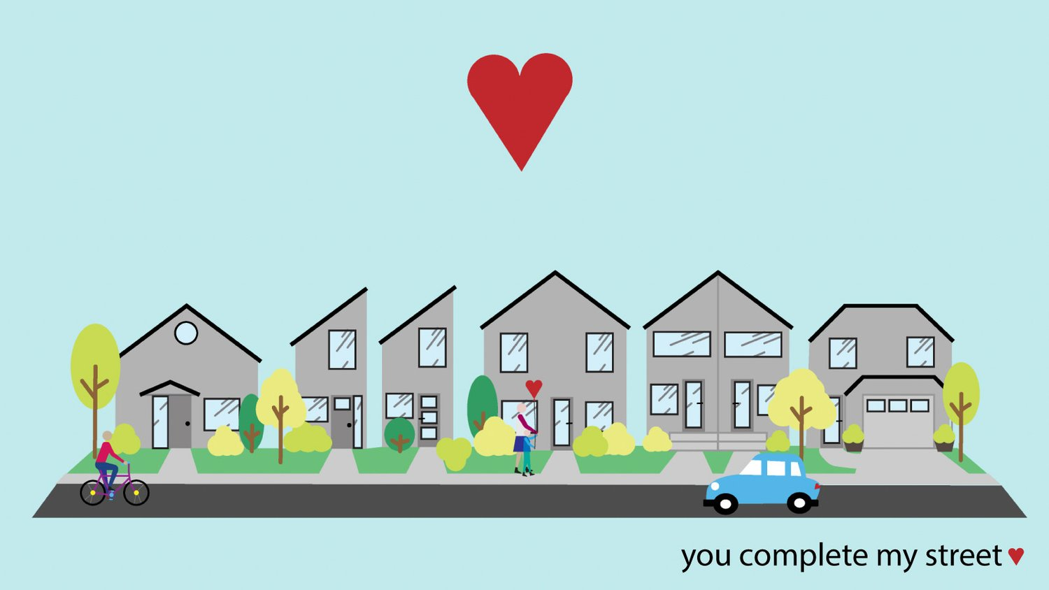
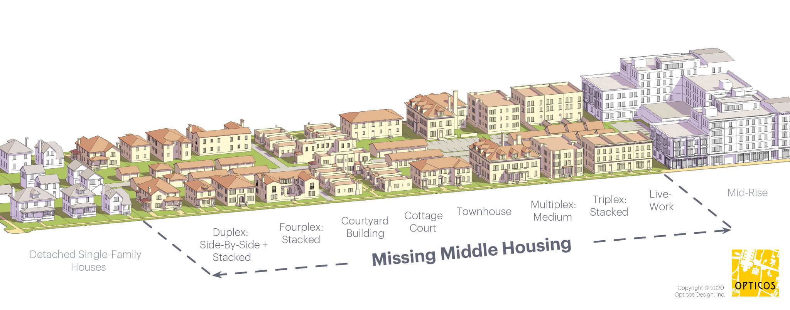
Definitions
“Missing Middle” housing: 2–6-unit structures (duplexes, townhomes, and small multifamily “large homes”), as well as infill single-family homes.
Eligible single-family:
small single-family or “cottage” home on an infill lot with <45 ft width;
multiple small single-family homes on a larger lot with shared open space – known as a “cottage court” or “pocket neighborhood”
YIMBY Winnipeg and Jason Syvixay/Jennifer Becker

Slide 6
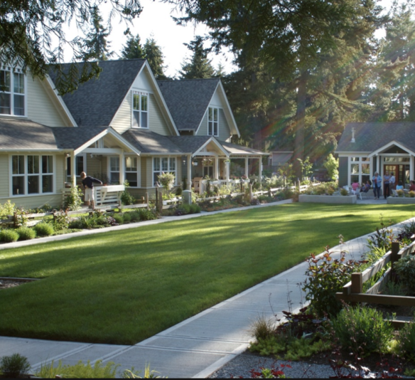
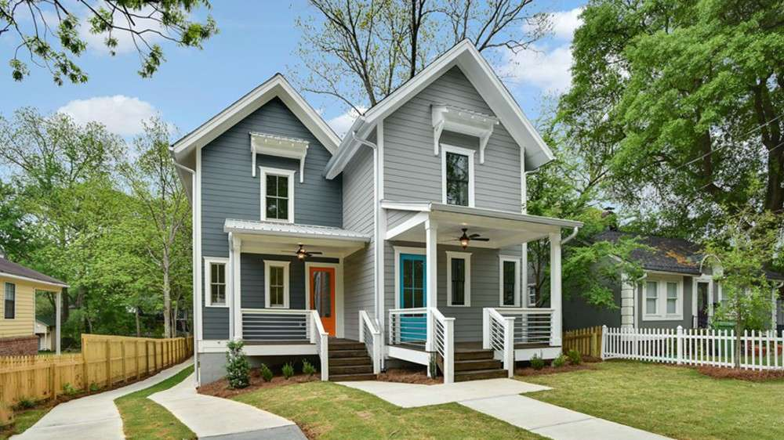
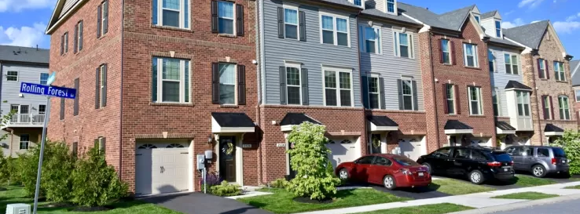

Slide 7
Definitions
Attainable/Middle-Income: affordable for households at 80-120% of HUD Area Median Income
For a family of four, this is an annual income between $68,150 – $102,240
Housing is affordable if it costs up to 30% of monthly income
Affordable Sales Price
 | 80% AMI | 100% AMI | 120% AMI
Recommended | $127,835 | $195,080 | $261,782
Maximum | $175,038 | $254,095 | $332,599
Affordable Rent Ranges
Studio | $1,030 | $1,230
1 BR | $1,145 | $1,405
2 BR | $1,270 | $1,580
3 BR | $1,430 | $1,755
4 BR | $1,590 | $1,995

Slide 8
Program Details
$1M available – applications accepted until funds are exhausted
Minimum award: $50,000
Maximum award: $500,000 ($50,000/unit)
Funding will be 50% grant & 50% loan (low-interest)
Affordable rent prices will be monitored by submitting rent roles annually (rent cannot increase >3% annually)
Affordable for-sale units will have restrictive covenants to maintain long-term affordability
Affordability periods:
5-15 years for rehab/conversion of existing housing (based on funding amount)
20 years for new construction

Slide 9
Eligibility
Applicants: Non-profit and for-profit developers are eligible to apply
Eligible activities:
New construction of vacant infill single-family housing
New construction of vacant 2–6-unit multifamily housing units
Rehabilitation or conversion of vacant multifamily units
Project must have a minimum of four (4) units (can include multiple sites/lots)
All sites must be within 3 miles of each other to support increased density near neighborhood anchors (bonus points if within ½ mile of Memphis 3.0 Nurture/Accelerate Anchors) *link to map in application
Applicant must have site control and move into construction within 240 days of funding award
Developers must utilize MWBEs for a minimum of 25% of project costs

Slide 10
Application Components
Organization/Agency Information
Development Experience
Agency Budget
Project Information
Budget Narrative
Budget Worksheet
Pro Forma
Funding Commitment Letters
Neighborhood/Market Description
Project Narrative
Introductory Site Plan

Slide 12
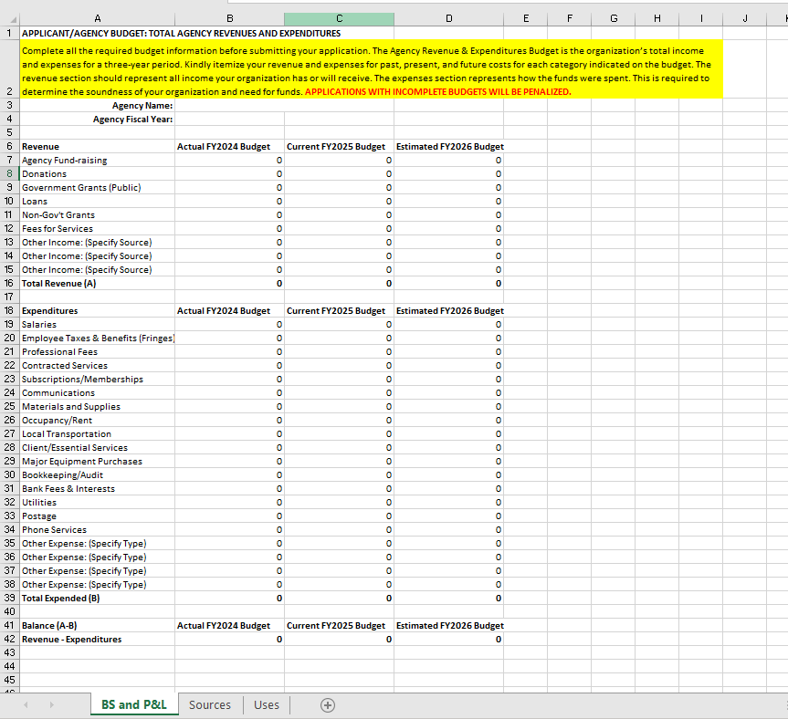
Financial Reporting

Slide 14
Scoring
Applications will be reviewed/scored by the Review Committee
Minimum score for funding: 100/135
Threshold Criteria (85 Points)
Site Control
Project Readiness
Development Team Capacity
Feasibility & Funding
Affordability Terms
Applications with an incomplete Agency/Project Budget and/or Pro Forma will be denied

Slide 15
Bonuses (50 Points)
MWBE Participation
Alignment with Anchor Strategy
Energy-efficiency
Universal Design & Visitability
Community Connectivity

Slide 16
MI-Pilot Application Review
Application Reviewed & Scored
By Review Committee of Industry Experts
Notifications
Award Approvals or Denial Letters
By Program Staff
Completeness and Eligibility Reviews

Slide 17
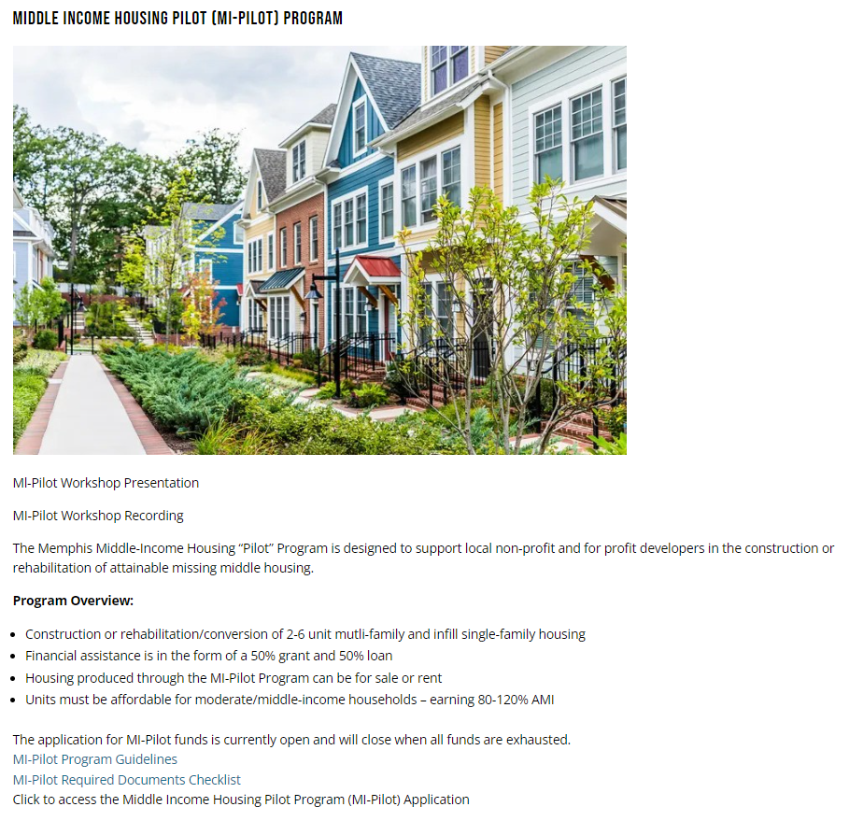
How to Apply
Application will become live on HCD’s website on Tuesday, October 1st, 2024 at 2:00pm CST
1
Visit memphistn.gov/developers
2
Open Middle Income Housing Pilot (MI-Pilot) Program Tab
3
Click the link to fill out the Application

Slide 18
Submission Process & Tips
Download and Review the Program Guide and Required Documents Checklist located on the City of Memphis HCD website prior to starting your application
Application is through Docusign
You will be prompted to enter your name and email
An Access Code will be sent to your email to enter before you can proceed
Click “finish later” to save the application as a draft until you are ready to submit as final
If additional people need to work on the application click “ Assign to Someone Else” to give them access
You will need to provide them with the Access Code
Review your application for completion and ensure all documents have been uploaded on the “Required Documents Checklist” page prior to submitting your final application
Print a copy of the application for your records

Slide 19
Questions?

Slide 20
Thank you for Attending!
For More Information Contact
Amanda O’Meara, Planning Coordinator
Amanda.OMeara@memphistn.gov
(901) 636-7364
Felicia Harris, Deputy Director
Felicia.Harris@memphistn.gov
(901) 636-7403

