Slide 1


MPACT: Revolutionizing Memphis Commutes
Helping Memphians get to work affordably, safely, and reliably
by Tech Titans
VM
Notes:
https://www.youtube.com/watch?v=lRL3O2yrm1U

Slide 2

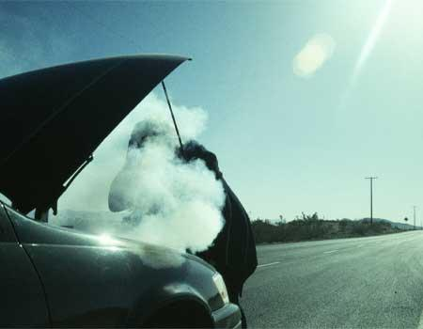

The Challenge: Memphis Commute to Work
Notes:
“We can’t continue to afford groceries for the week or rent for the month,” an FedEx employee said. “It becomes widely expensive trying to get Uber to the Hub on a regular basis.”
“It’s very upsetting for a lot of reasons,” the employee said. “We have co-workers all the way from Mississippi who are still getting transportation, but Memphians are being stranded. We’ve tried to use the bus system and it could take up to three hours to get to Point A to Point B.”
https://wreg.com/news/fedex-faces-backlash-after-ending-get-a-free-ride-to-work-program/

Slide 3
The Challenge: Memphis Commute Crisis
Employers Face:
Employees Struggle With:
• Absenteeism due to transportation issues
• Limited/unreliable public transportation
• Difficulty attracting workforce
• Safety concerns during commute

Slide 4



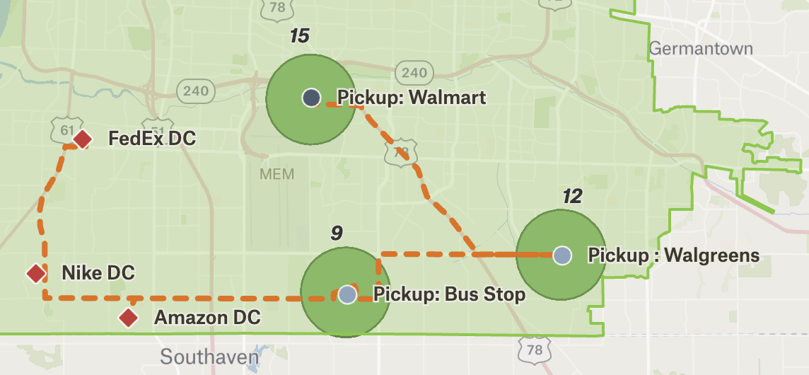
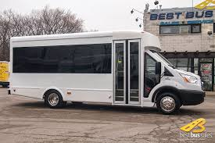
Solution: Aggregated Employee data for commute

Slide 5
Solution
https://www.youtube.com/watch?v=lRL3O2yrm1U
Notes:
https://www.youtube.com/watch?v=lRL3O2yrm1U

Slide 6




Why MPACT Stands Out
Safety First
Vetted drivers and vehicles for peace of mind
Reliability
Punctual pickups and dropoffs, reducing tardiness
Employer-Employee Win
Attractive benefit improving job satisfaction and retention

Slide 7
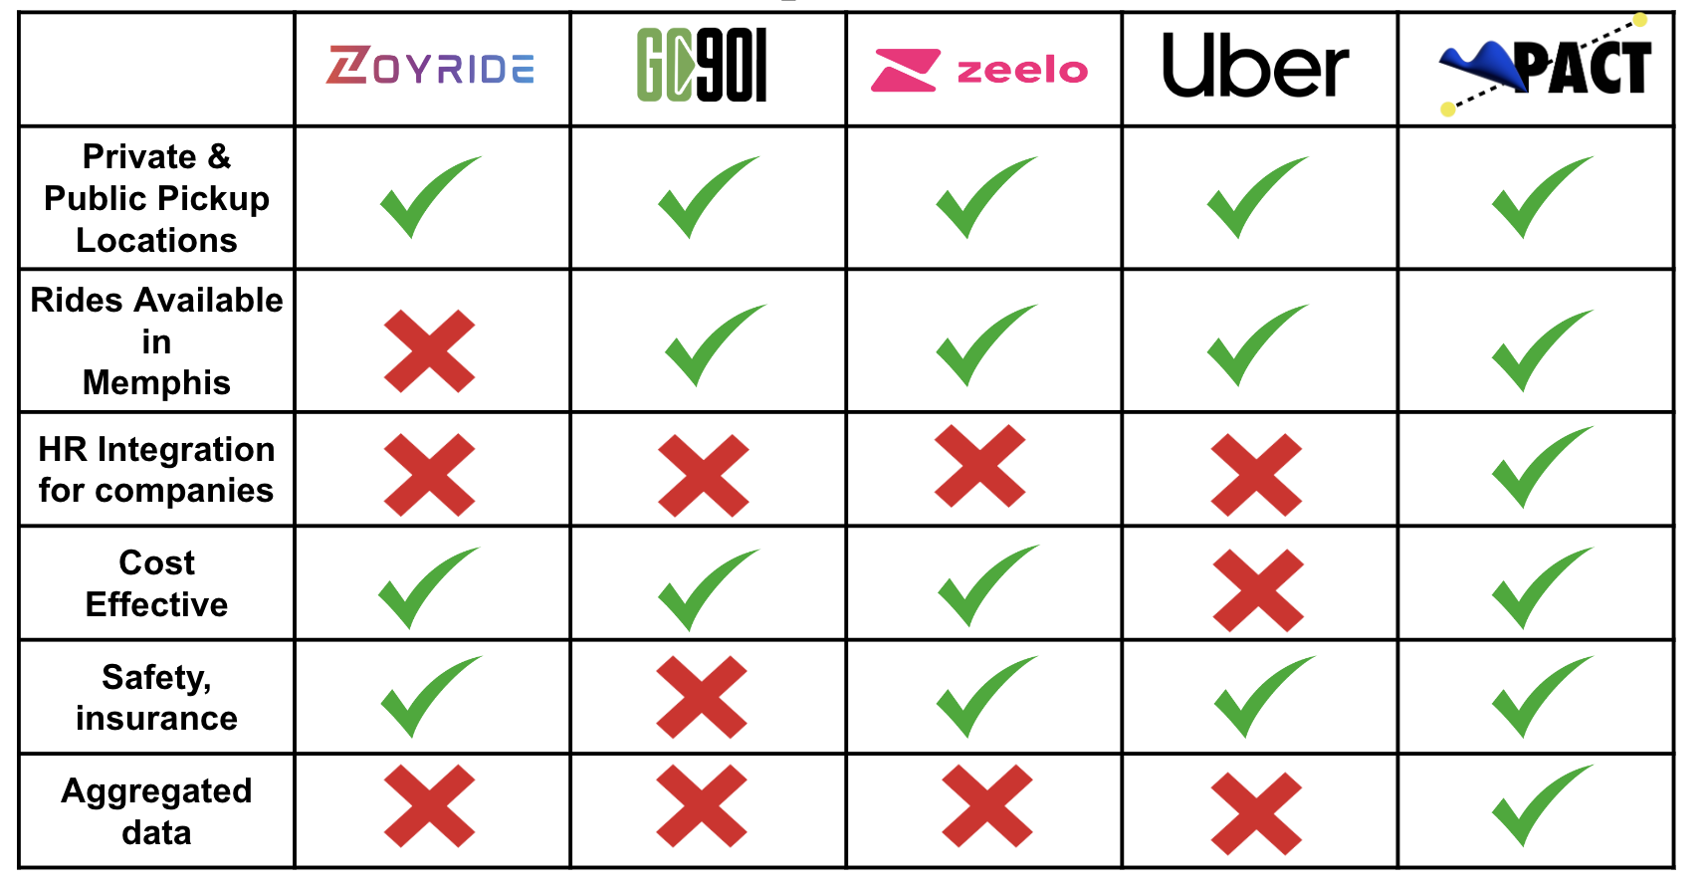
Competition

Slide 8

Let's Transform Memphis Commute to Work Together
24/7
30%
50+
Always Available
Potential Absenteeism Reduction
Memphis Businesses
Round-the-clock support for employers and commuters
MPACT services

Slide 9




—Team—
Venki Mandapati
Venky Rajendran
Carl Bledsoe Jr
Balaji Venkatasubramaniyar
Data Science
Project Management
Design & Marketing
Software Engineering

