Slide 1
Challenge 1: Neighborhood Improvement

Slide 2
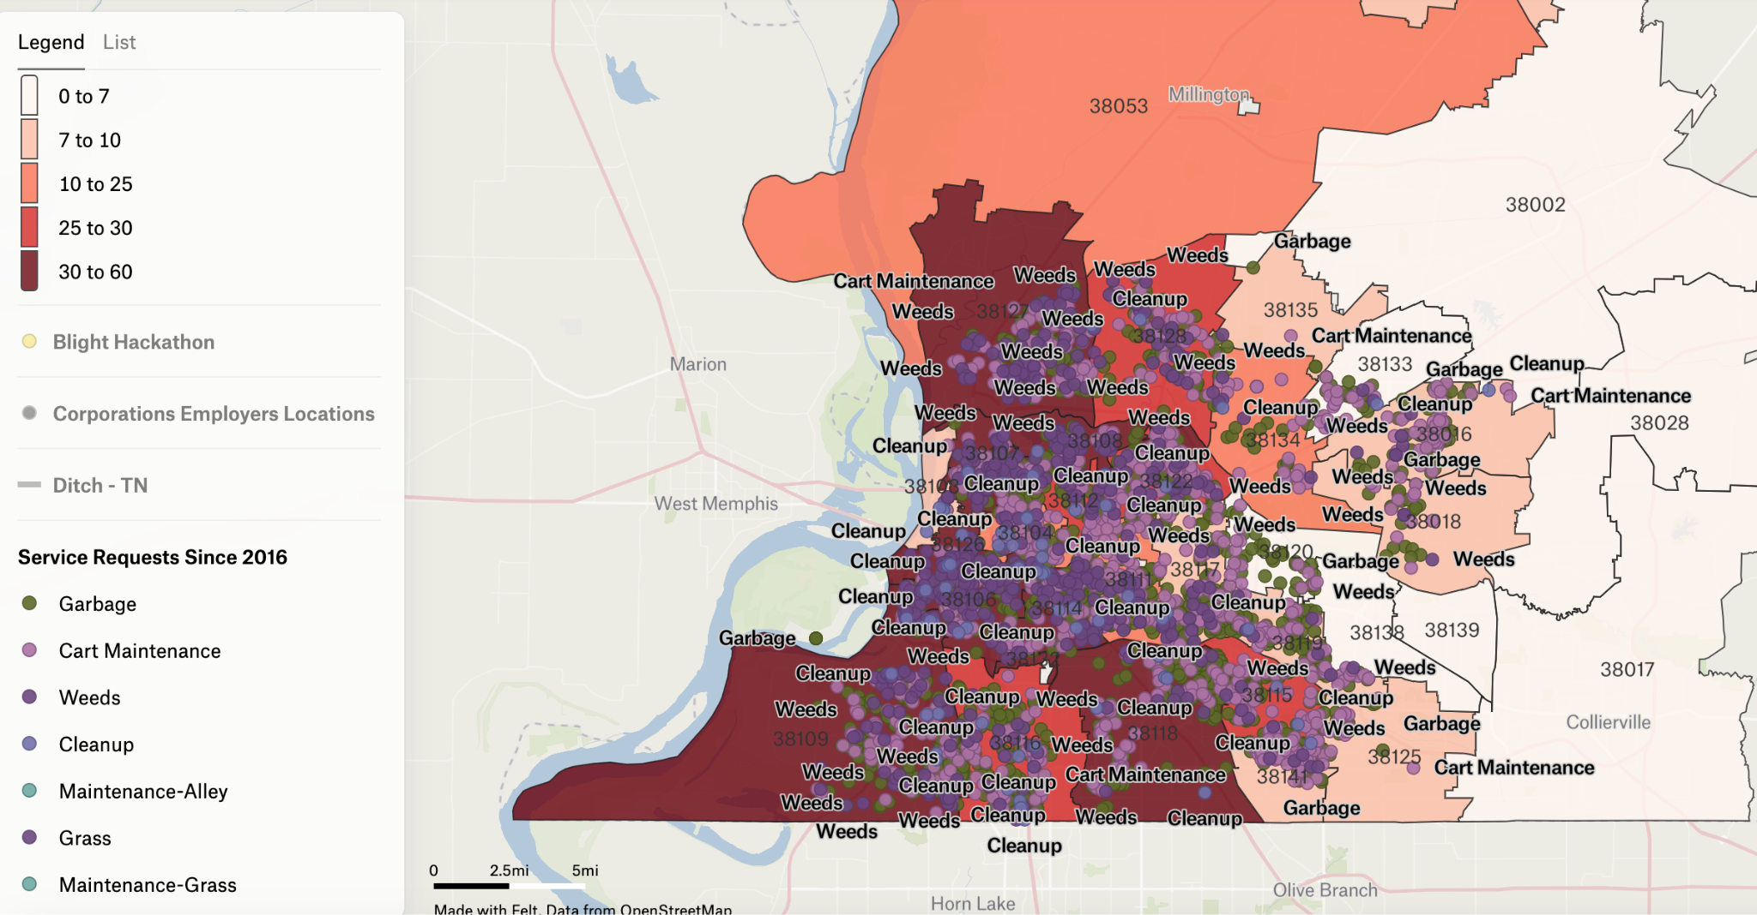
Notes:
10% decrease of blight in each zip code

Slide 3
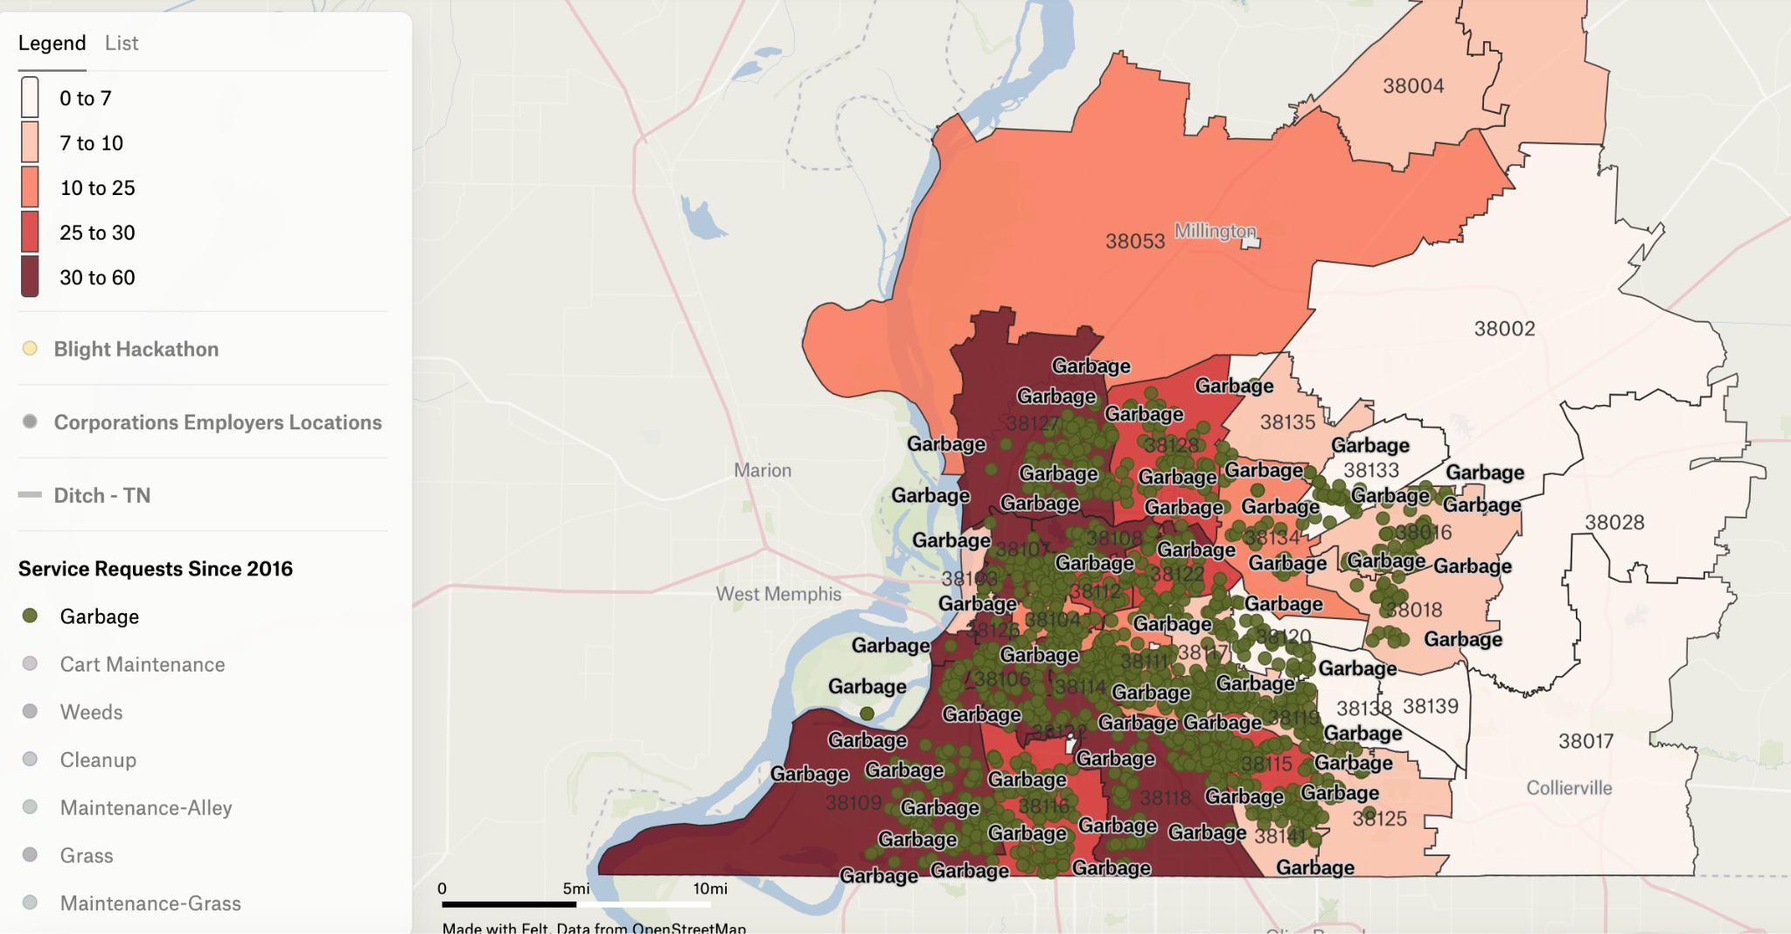

Slide 4
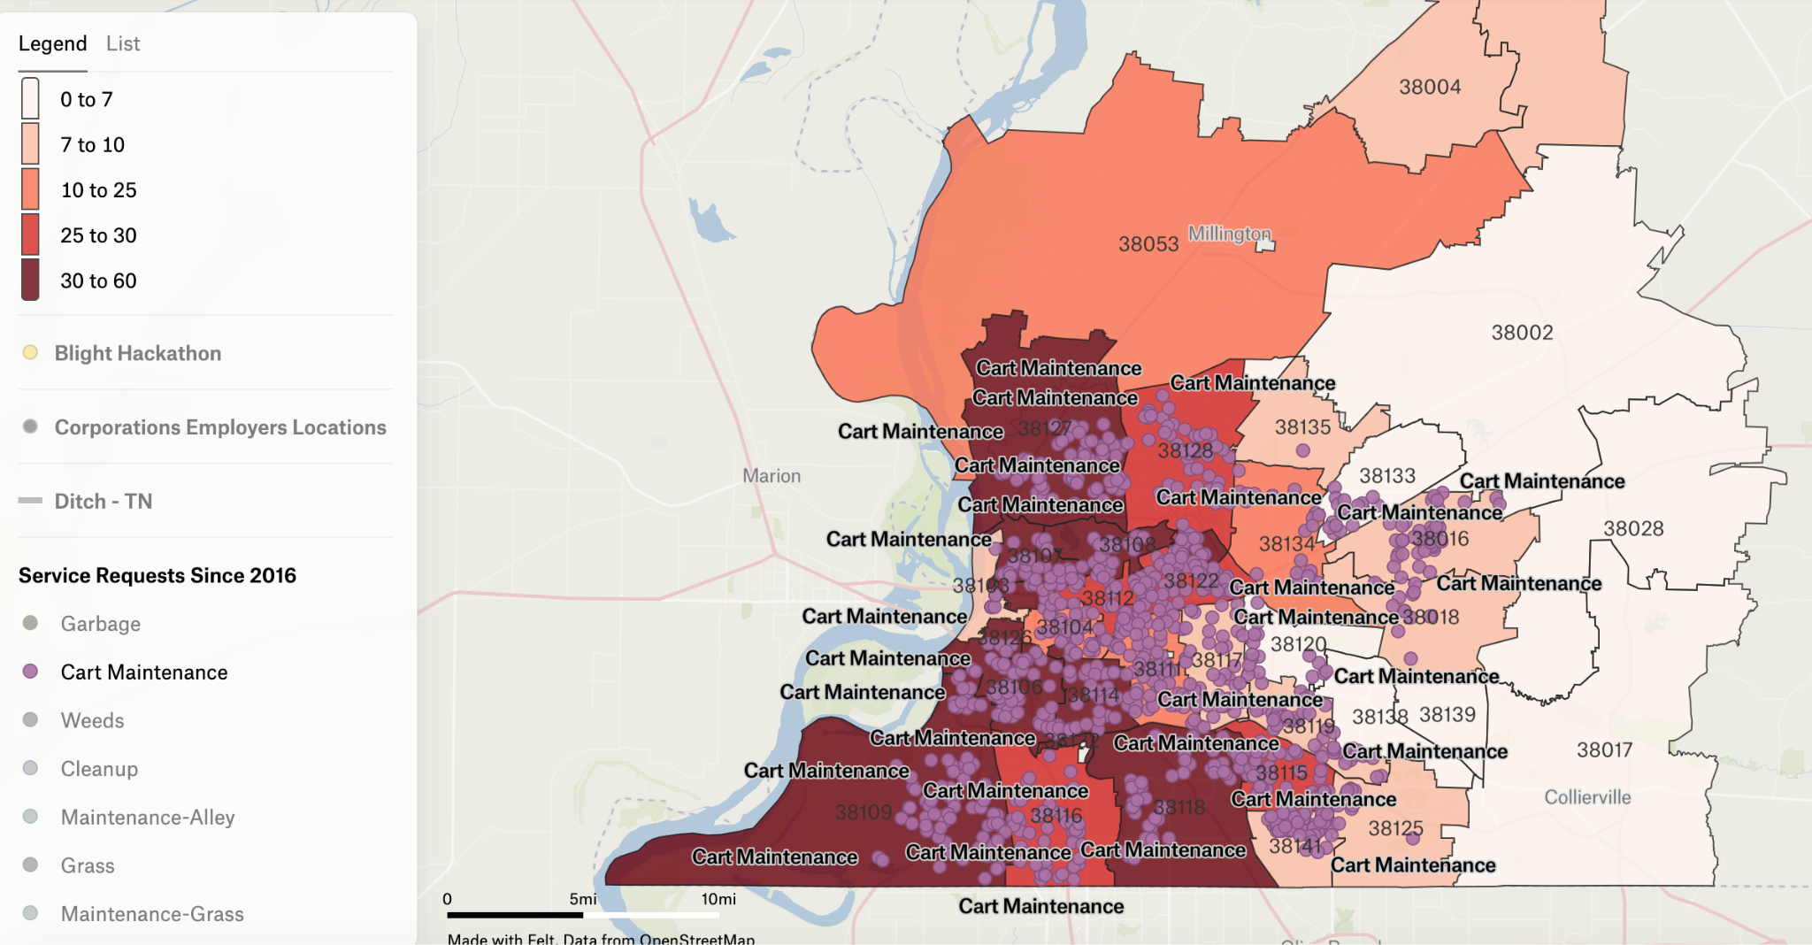

Slide 5
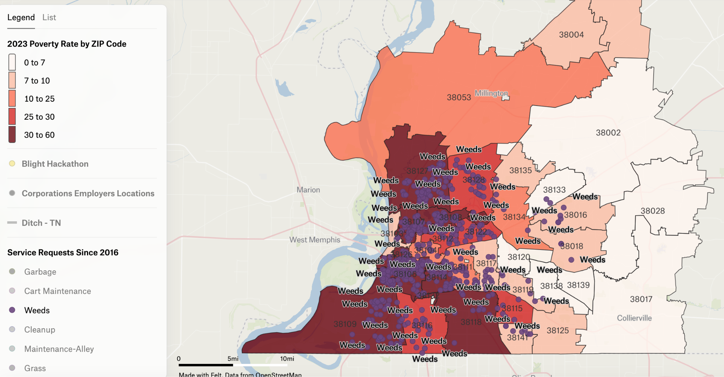

Slide 6
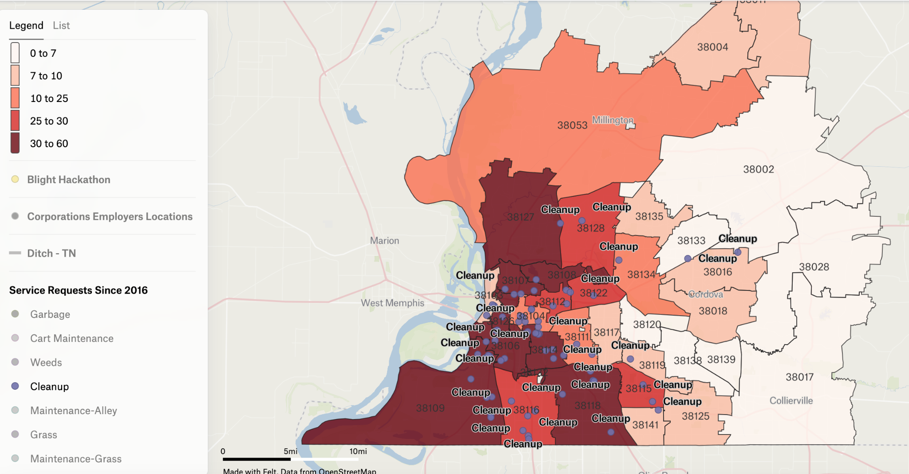

Slide 7
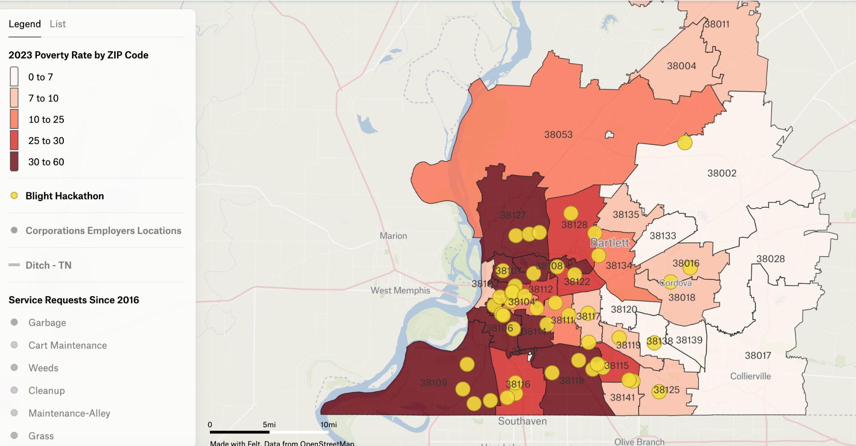

Slide 8
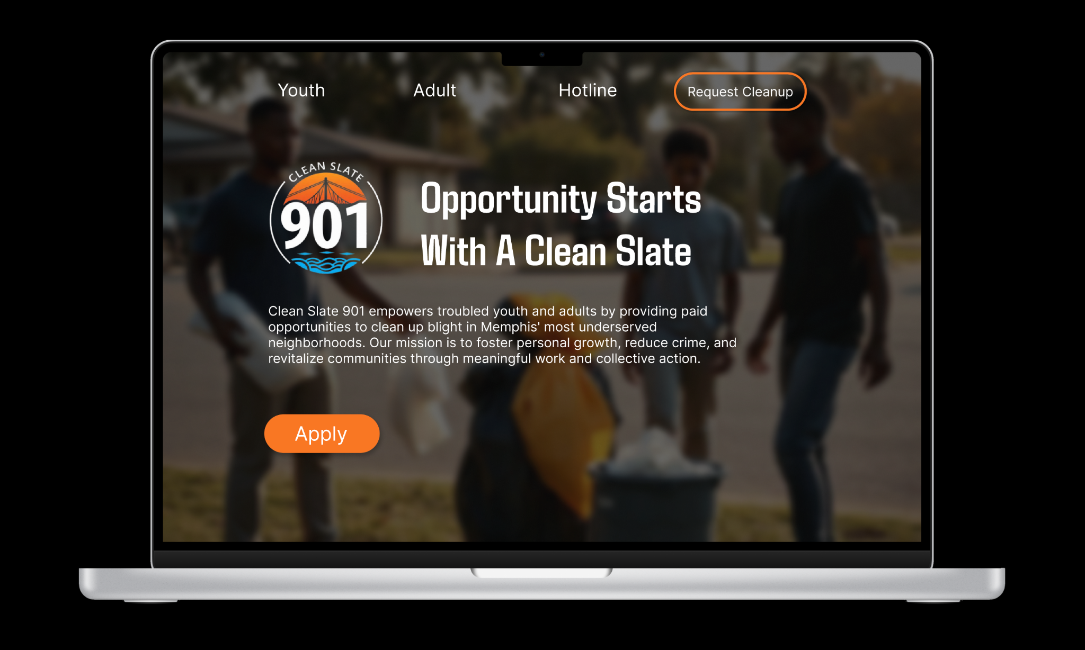

Slide 9
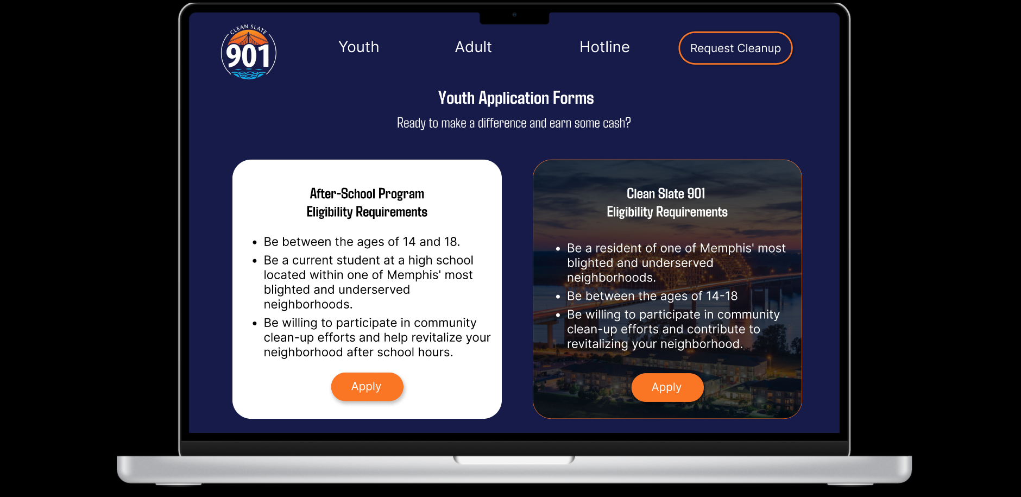

Slide 10
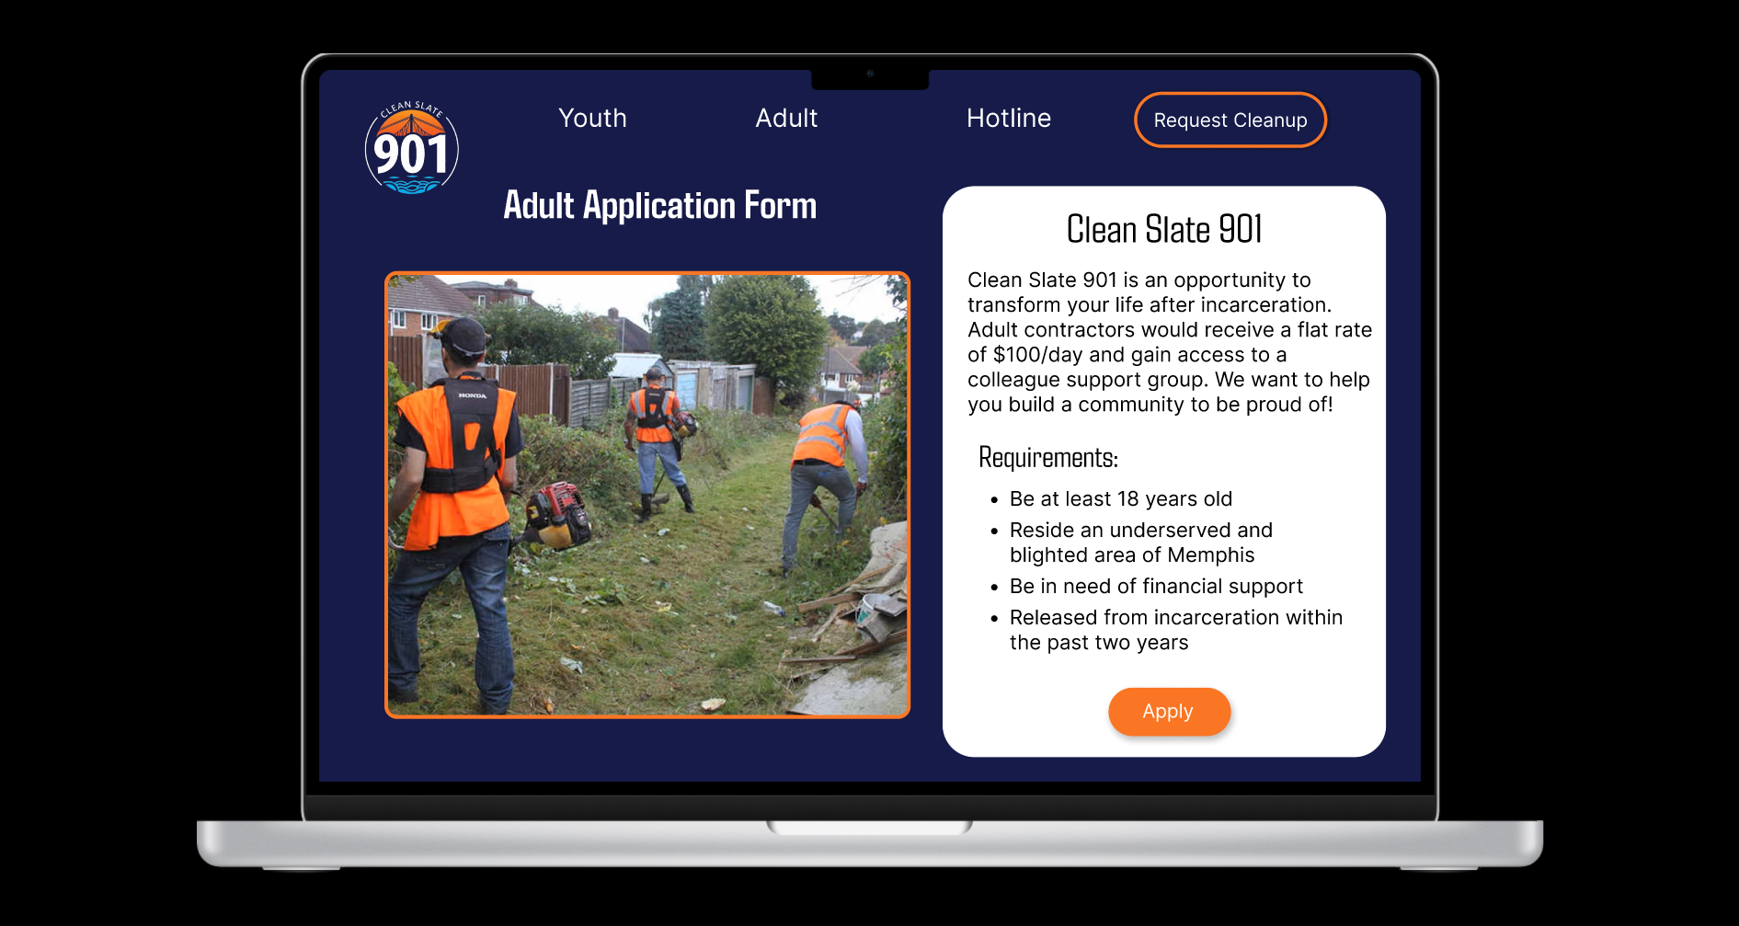

Slide 11
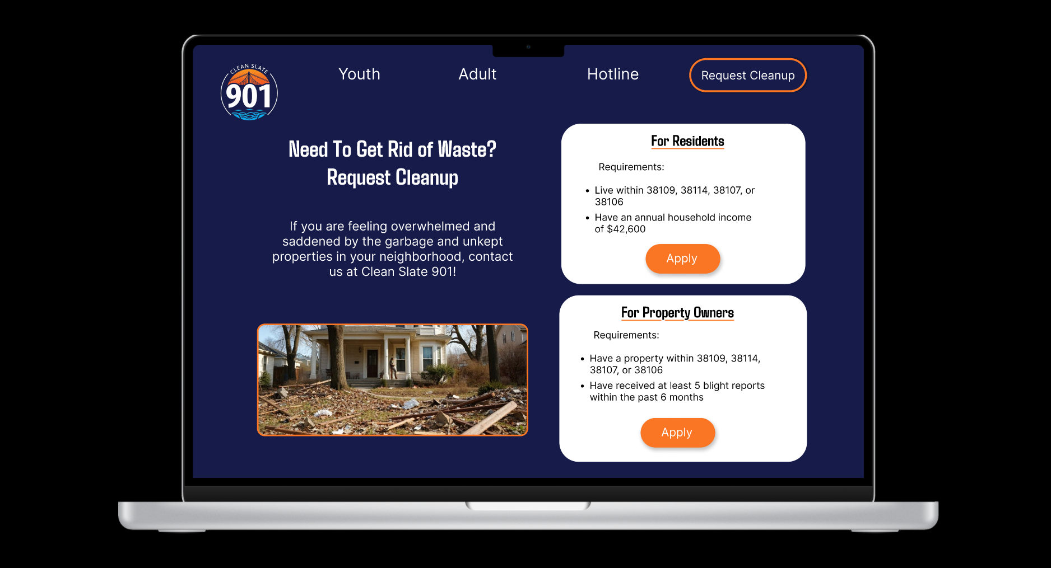

Slide 12
Thank you
Notes:
Wrap up
- contract between city and afterschool programs
-phase 2 going to be contract based - to get older youth and adults involved, teach landscaping skills
-trash be place in an area where city will come pick it up
-AI hotline for non-web users

