Slide 1
Byte the Blight
Prince Bobo
Michael Gattas
Leo Rule
Mike Schoenberger

Slide 2
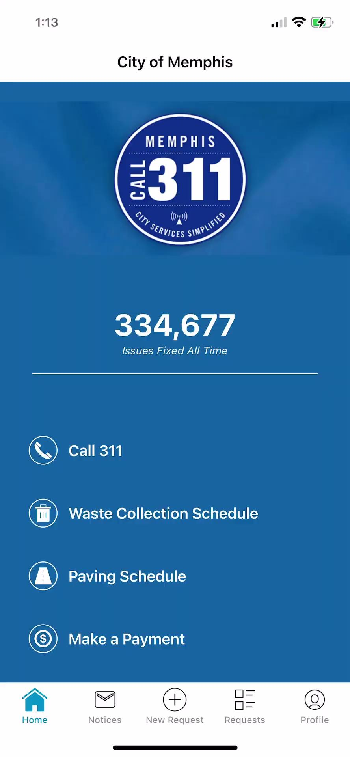
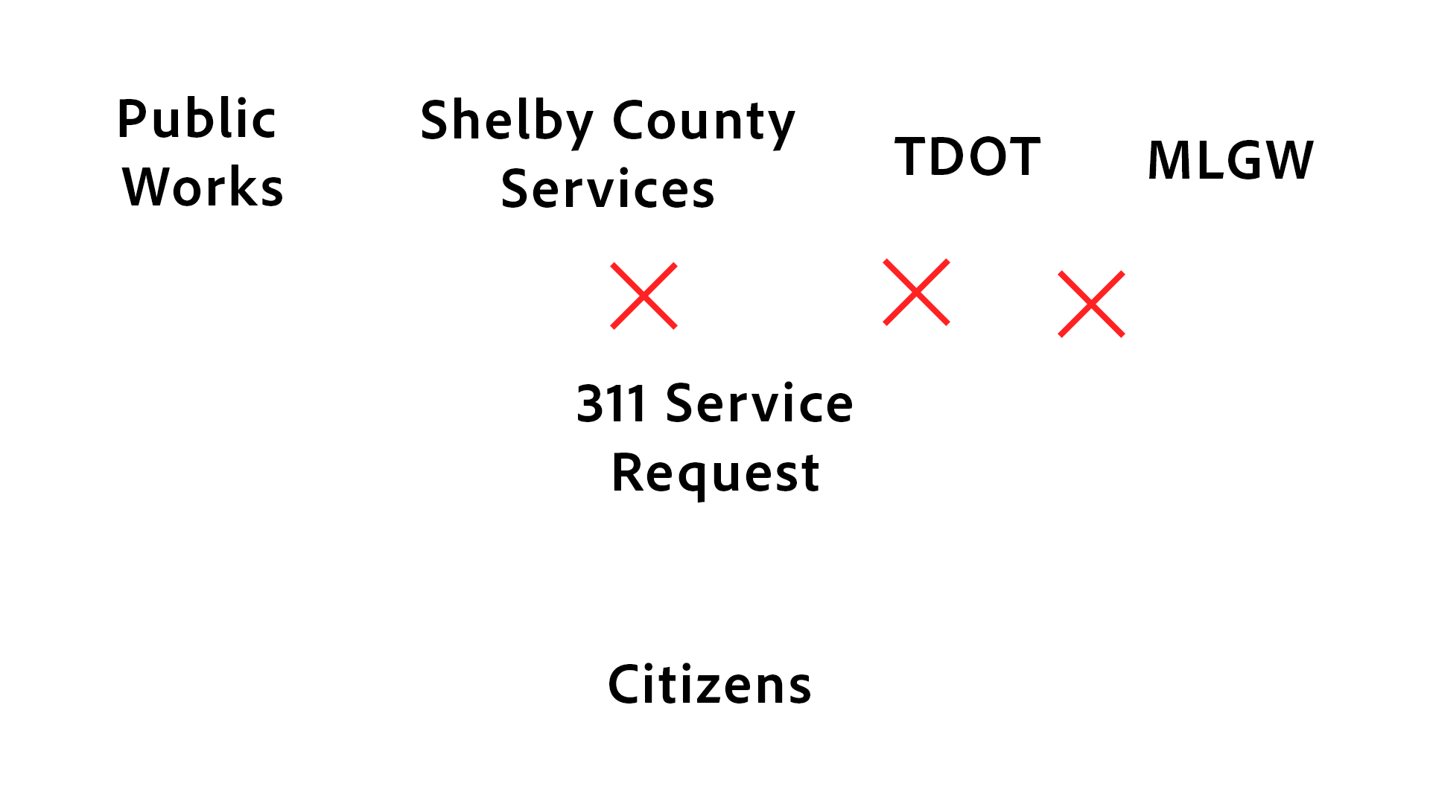
The Life-Cycle of Blight

Slide 3
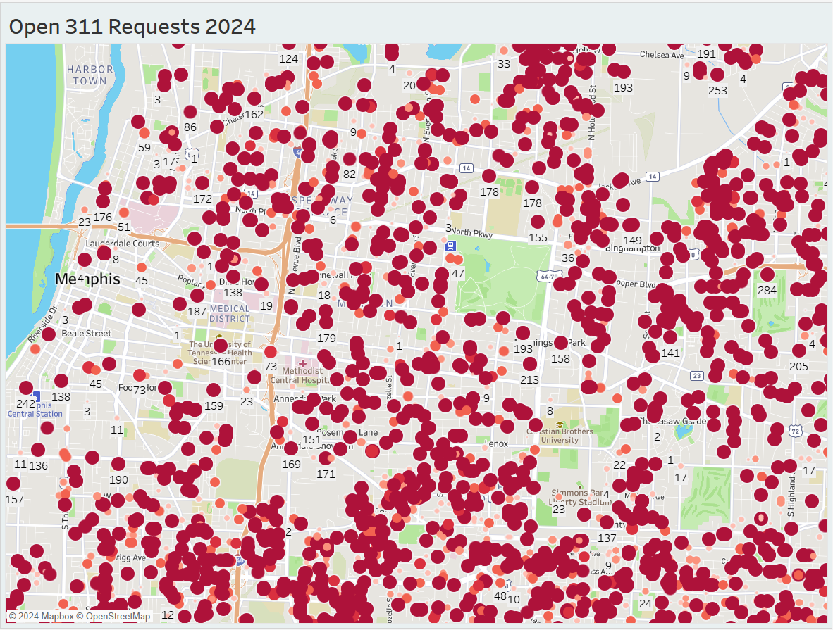
The State of Blight in Memphis
Last month, 55 dispatchers fielded nearly 7,000 new service requests every day

Slide 4
Public works alone will never solve Memphis Blight

Slide 5
What We Need
We need to capture the energy of passionate citizens, the Mayor’s Blight Team, other civic servants, entrepreneurs, and non-profits to flight blight by pursuing each of their own interests

Slide 6
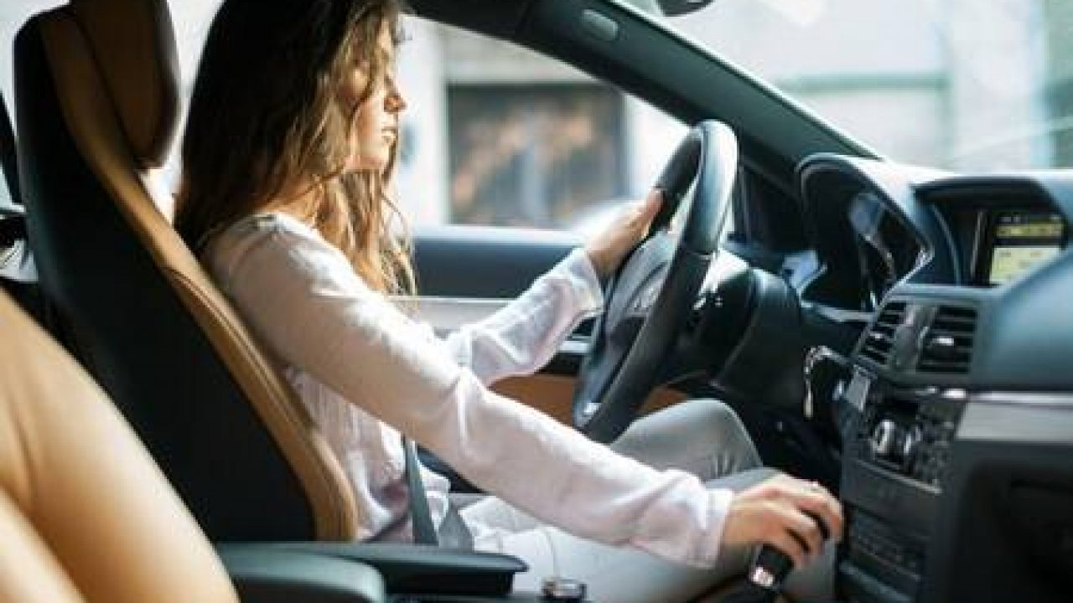
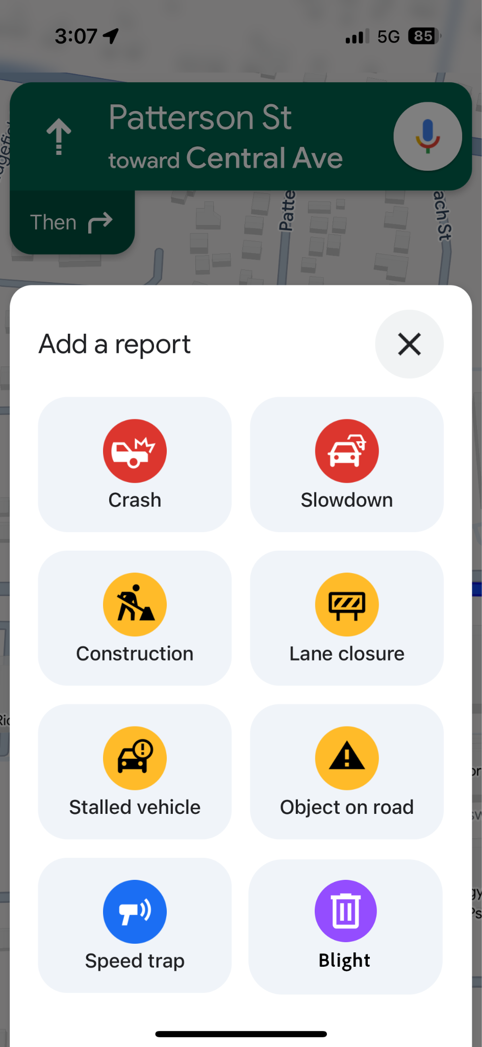

Slide 7
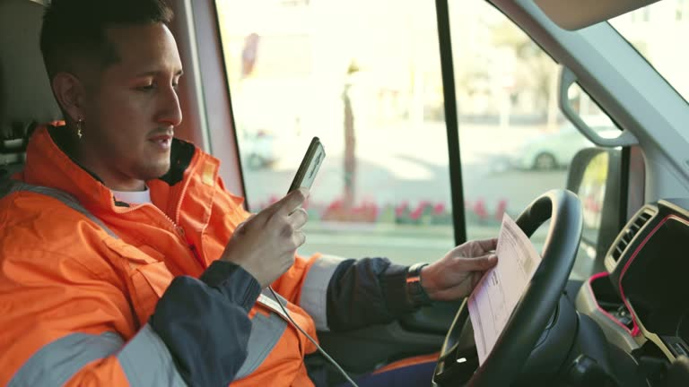
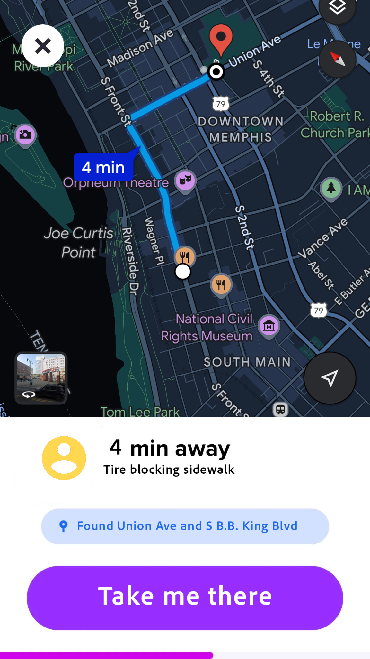

Slide 8
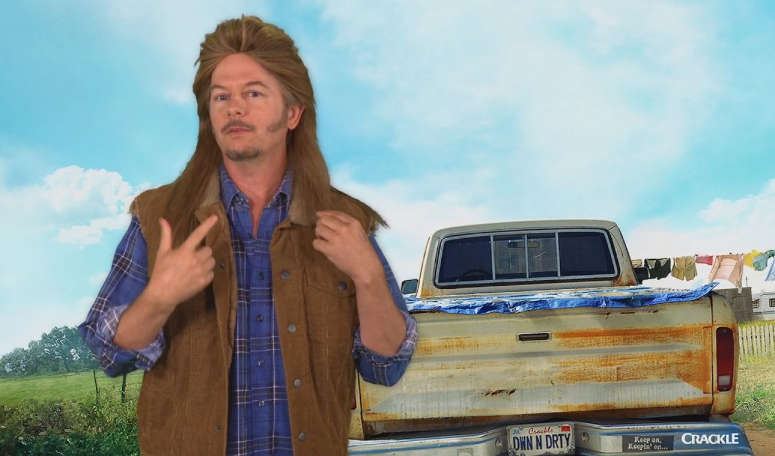
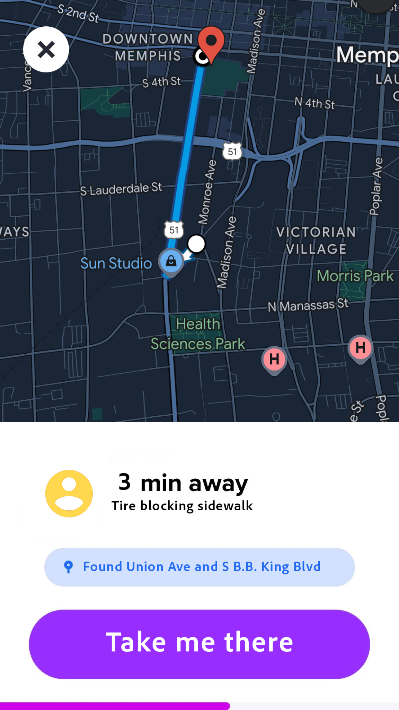

Slide 9
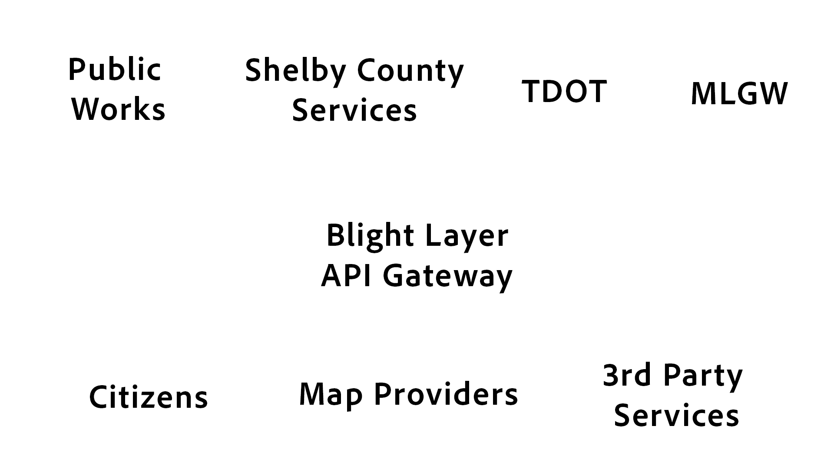
The Blight Layer Data Stream
We are building a new API Gateway to allow for seamless posting of blight-related data in our community and integrated solutions in civic, business, and personal spaces
Notes:
To elaborate, this API gateway would enable citizens, business, and civic service providers to get and receive Blight-related geographic data in real-time. In addition to reducing the input time from almost a minute to as little as five seconds, it would provide a public platform for technology and innovation across our city, and route requests to their appropriate department. With the addition of machine learning and speech-to-text, citizens could talk directly to an AI agent, populate the gateway with blight data, and create a service request from the appropriate jurisdiction accurately and seamlessly.

Slide 10
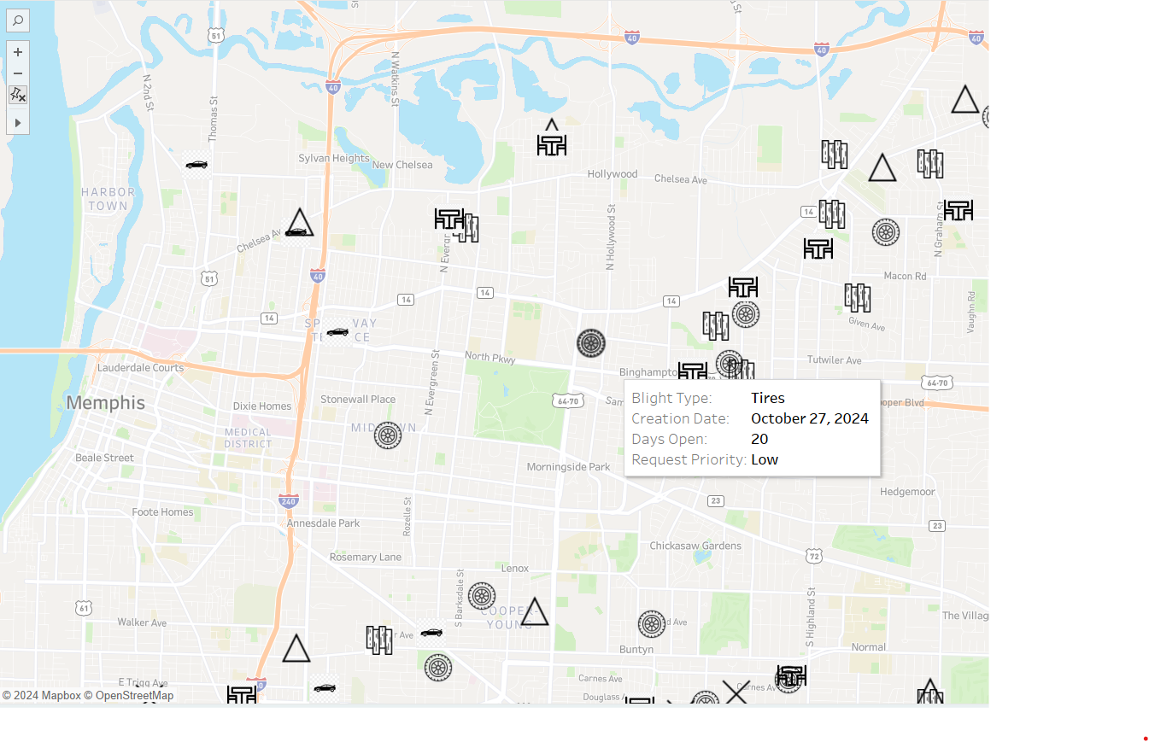
Applying the Data
Nonprofits, volunteers, and city workers could use a map built on top of the Blight Layer data stream to coordinate planned clean ups.

Slide 11
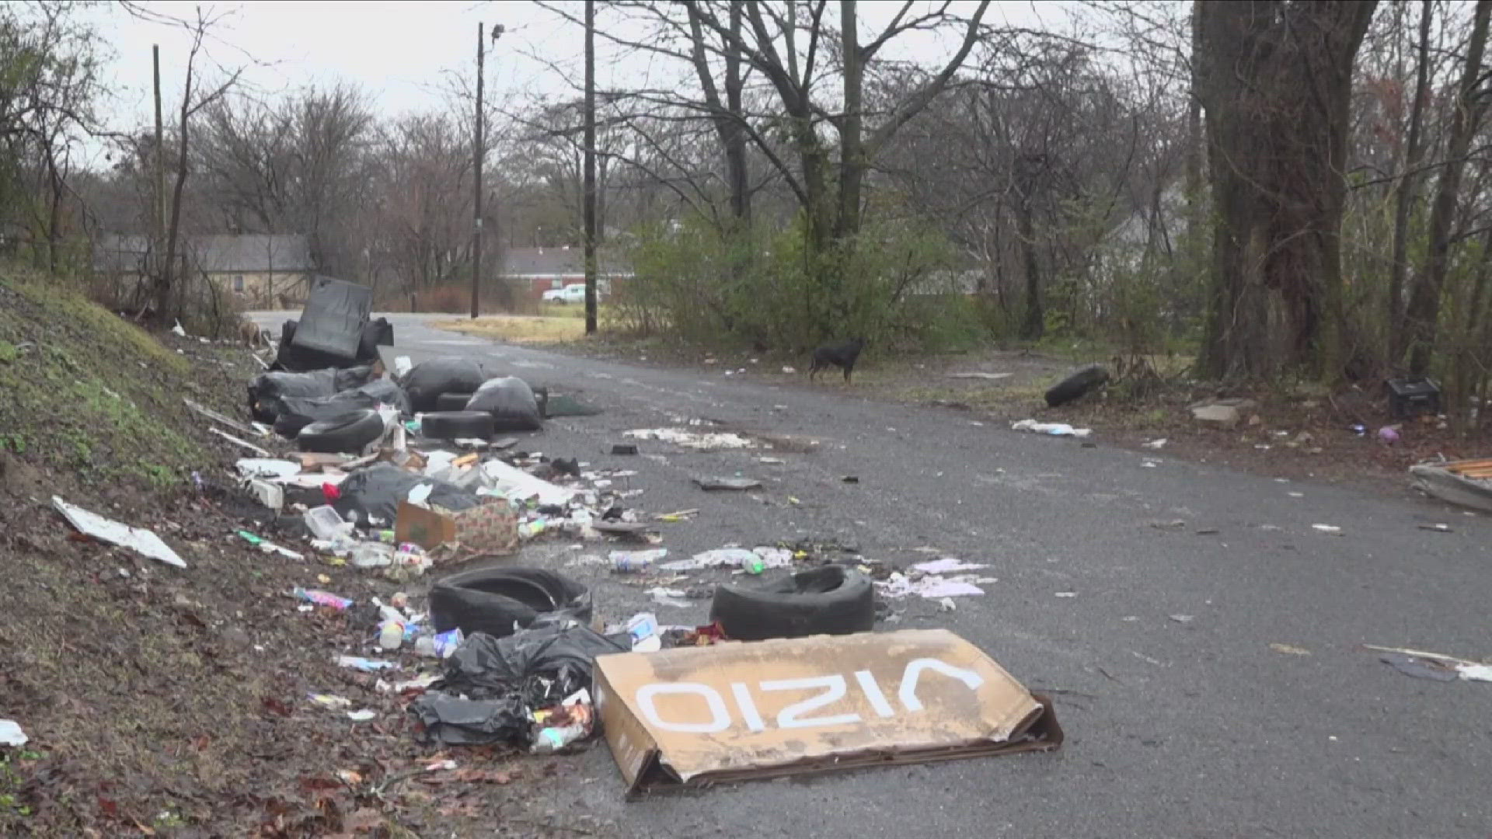
Great nonprofits and passionate citizens want to help eliminate this.

Slide 12
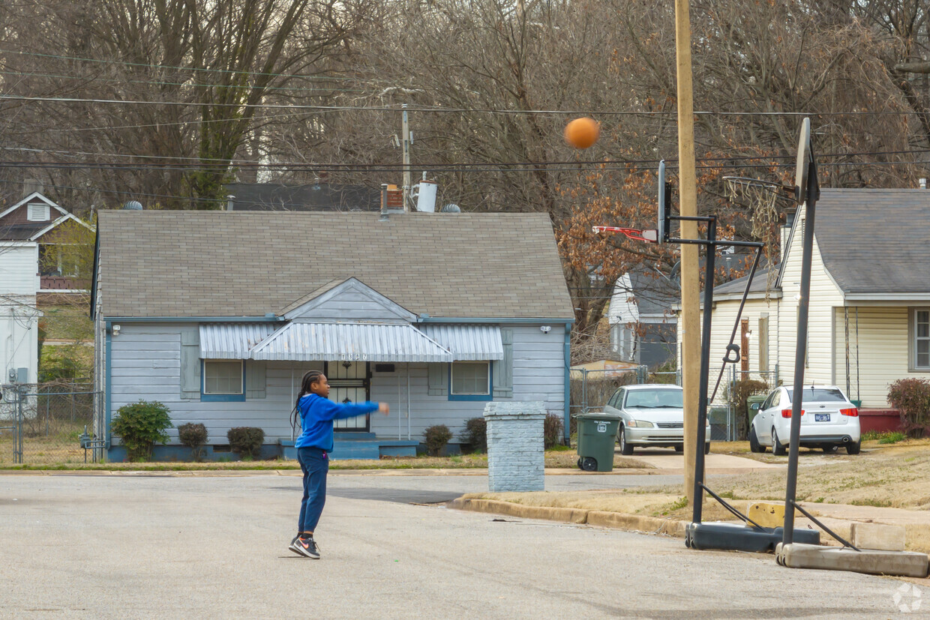
Help Our Community Thrive

Slide 13
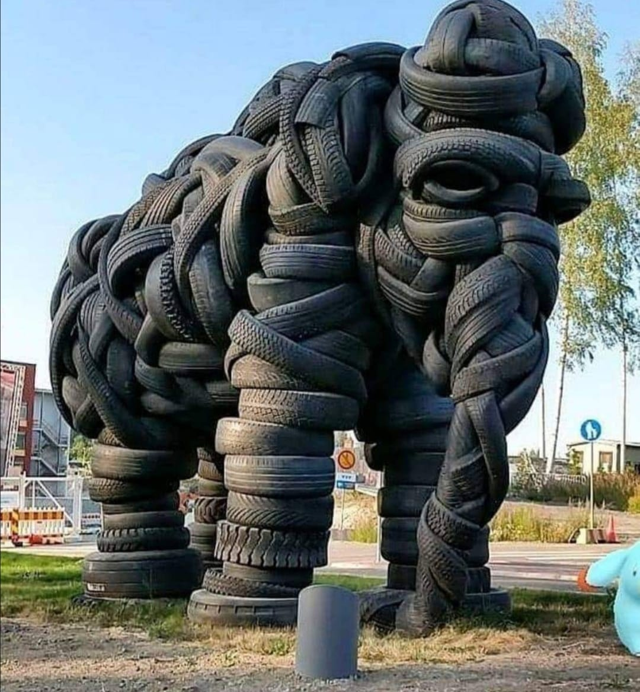
Who Benefits?
Citizens
311
MLGW
County
TDOT
Upcyclers
Entrepreneurs
Tech Platforms

